Slide 1
ElcoMaster™ for iPod, iPhone and iPad
Daniel Leonard Customer Support Engineer Elcometer UK

Slide 2
Data Management – ElcoMaster™ Mobile
Compatible Gauges from January 2014
Elcometer 456 Standard and Top DFT Gauges
Elcometer 224 Top Surface Profile Gauges
NEW Elcometer 510 Top Automatic Adhesion Gauges

Slide 3
Data Management – ElcoMaster™ Mobile
On iPhone
On iPod

Slide 4
Data Management – ElcoMaster™ Mobile
On iPad

Slide 5
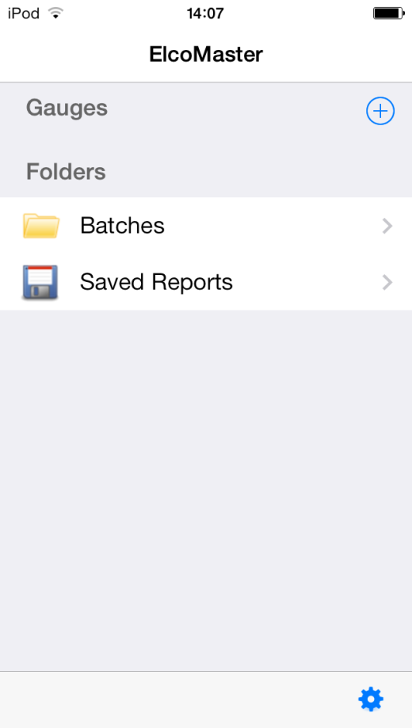
Data Management – ElcoMaster™ Mobile
Add a gauge

Slide 6
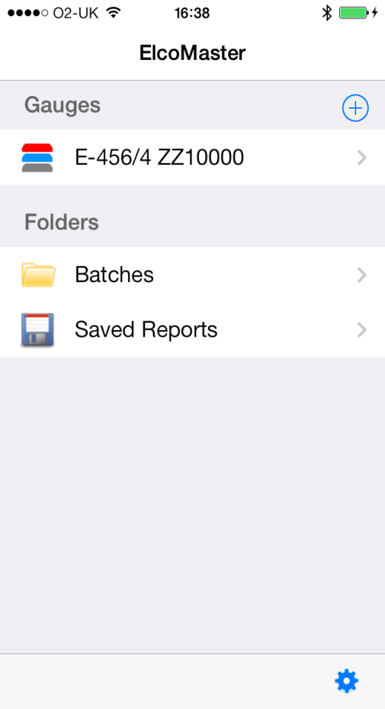
Data Management – ElcoMaster™ Mobile
Connected gauges appear here

Slide 7
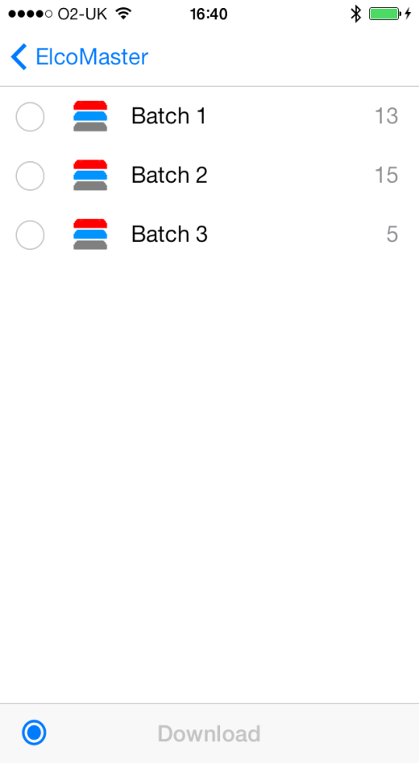
Data Management – ElcoMaster™ Mobile
Download batches

Slide 8
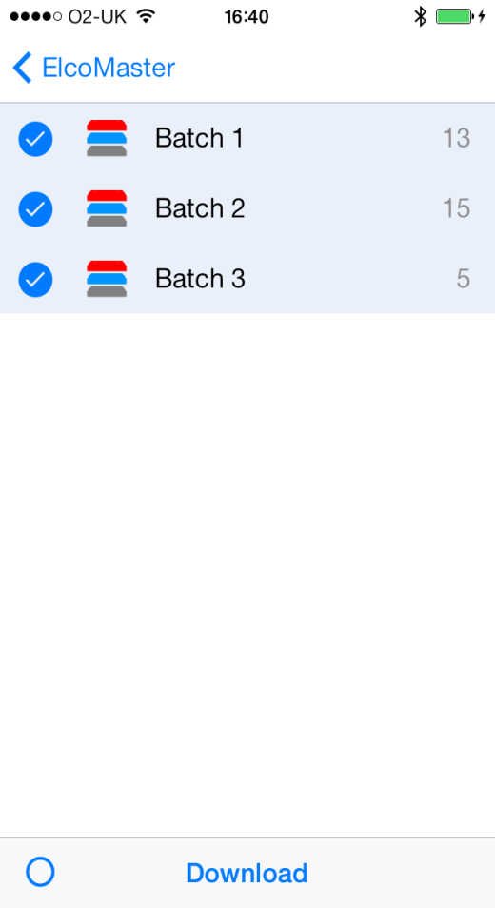
Data Management – ElcoMaster™ Mobile
Download batches

Slide 9
Data Management – ElcoMaster™ Mobile
Batch Browser

Slide 10
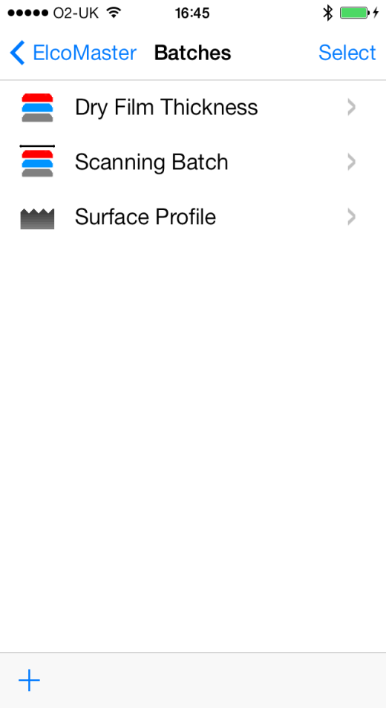
Data Management – ElcoMaster™ Mobile
Batch list

Slide 11
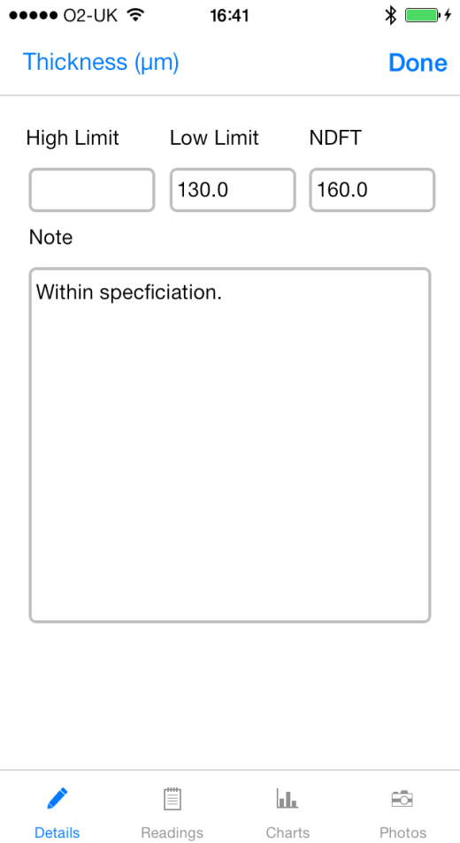
Data Management – ElcoMaster™ Mobile
Batch view
Details

Slide 12
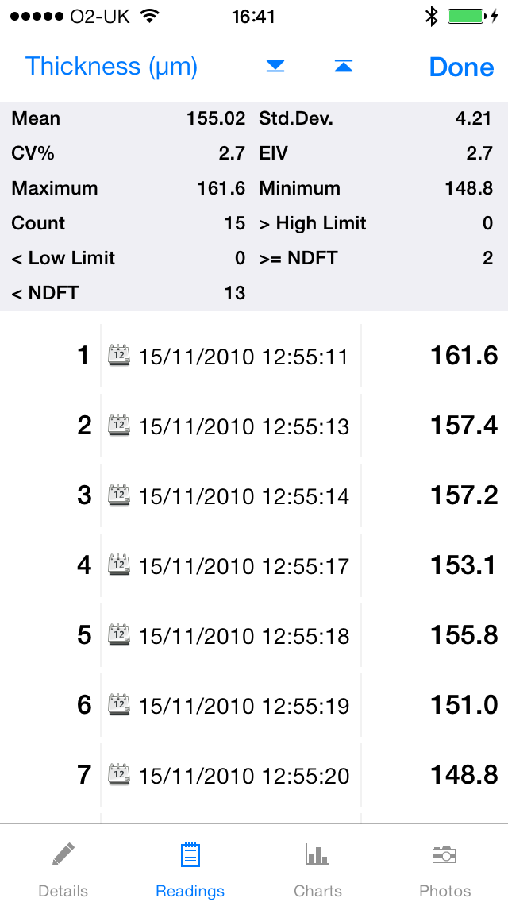
Data Management – ElcoMaster™ Mobile
Batch view
Readings

Slide 13
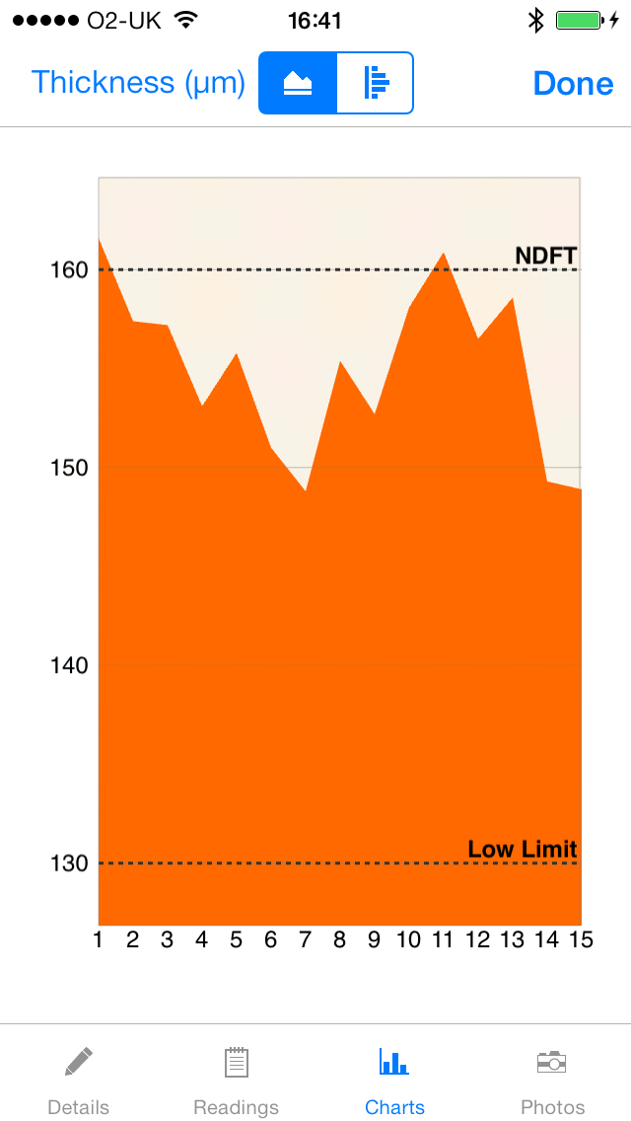
Data Management – ElcoMaster™ Mobile
Batch view
Charts

Slide 14
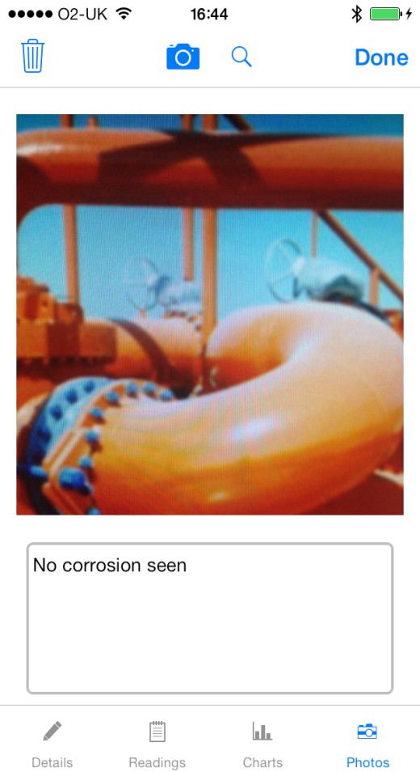
Data Management – ElcoMaster™ Mobile
Batch view
Photos

Slide 15
Data Management – ElcoMaster™ Mobile
Select Batches

Slide 16
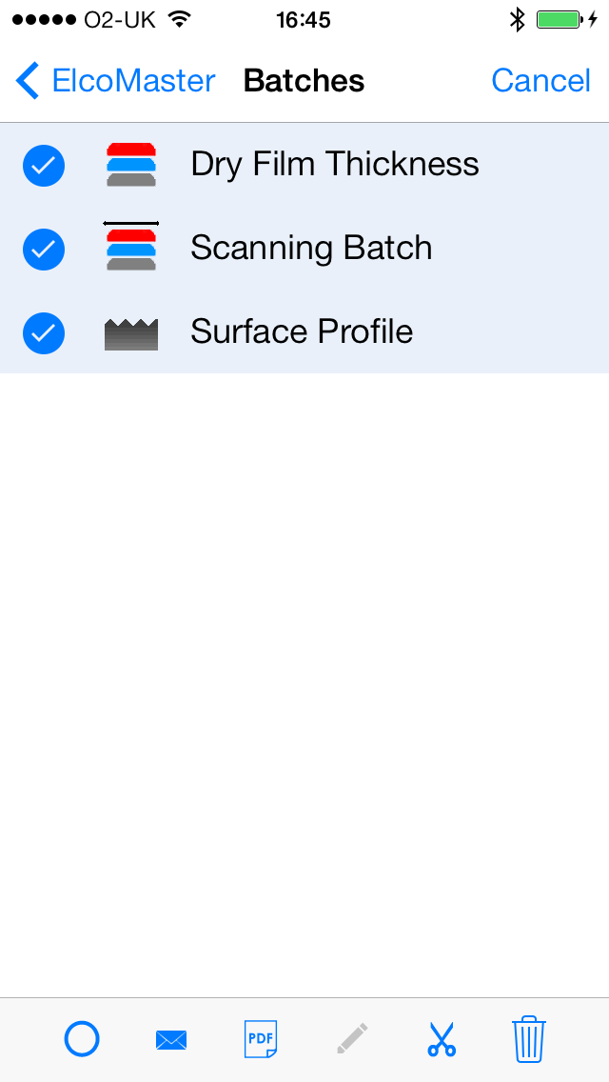
Data Management – ElcoMaster™ Mobile
Context menu

Slide 17
Data Management – ElcoMaster™ Mobile
Context menu
Select/Deselect All

Slide 18
Data Management – ElcoMaster™ Mobile
Context menu
Email Data

Slide 19
Data Management – ElcoMaster™ Mobile
Context menu
Generate PDF Report

Slide 20
Data Management – ElcoMaster™ Mobile
Context menu
Rename batch

Slide 21
Data Management – ElcoMaster™ Mobile
Context menu
Cut/Copy/Move

Slide 22
Data Management – ElcoMaster™ Mobile
Context menu
Delete

Slide 23
Data Management – ElcoMaster™ Mobile
Feature Focus – PDF Report
Generate a PDF report with all relevant inspection data
Can be instantly viewed by anyone on email
Customise with a company logo

Slide 24
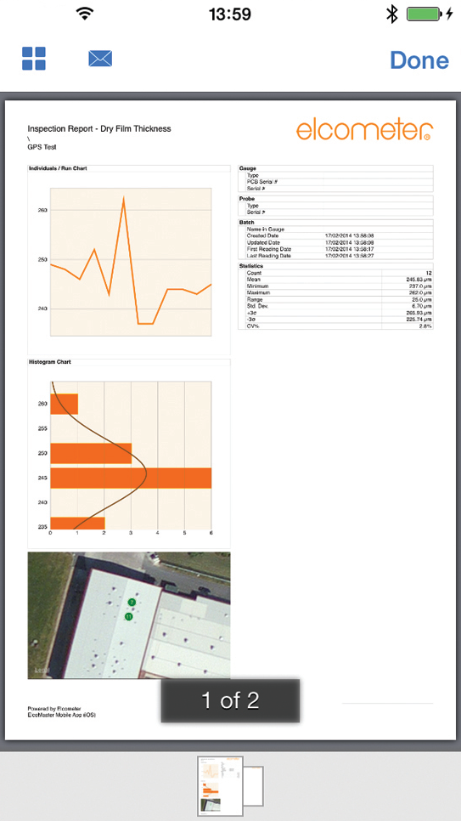
Data Management – ElcoMaster™ Mobile
Feature Focus – PDF Report
Your Logo Here
Data Summary
GPS Reading map
Notes
Pages

Slide 25
Data Management – ElcoMaster™ Mobile
Feature Focus – Elcometer 510 Adhesion Gauge Control
Download all data from the Elcometer 510T Adhesion gauge
Save and view all of the pull rate data live
Control the gauge from your iOS device

Slide 26
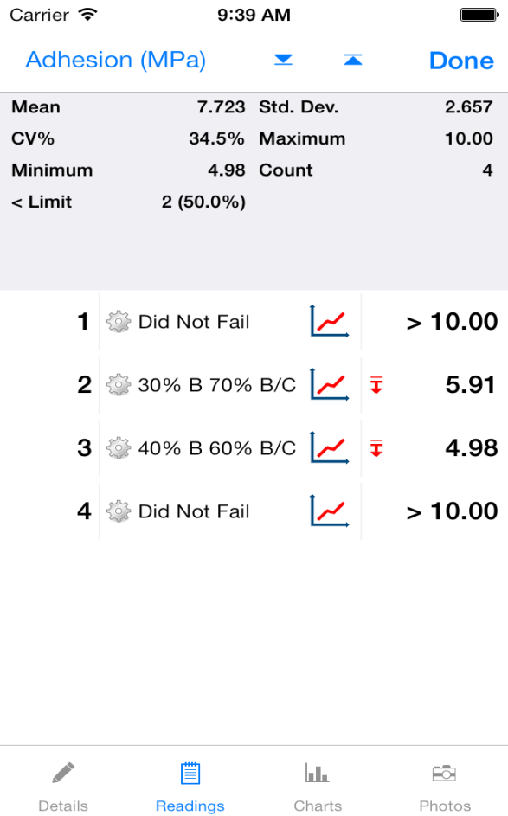
Data Management – ElcoMaster™ Mobile
Feature Focus – Elcometer 510 Adhesion Gauge Control

Slide 27
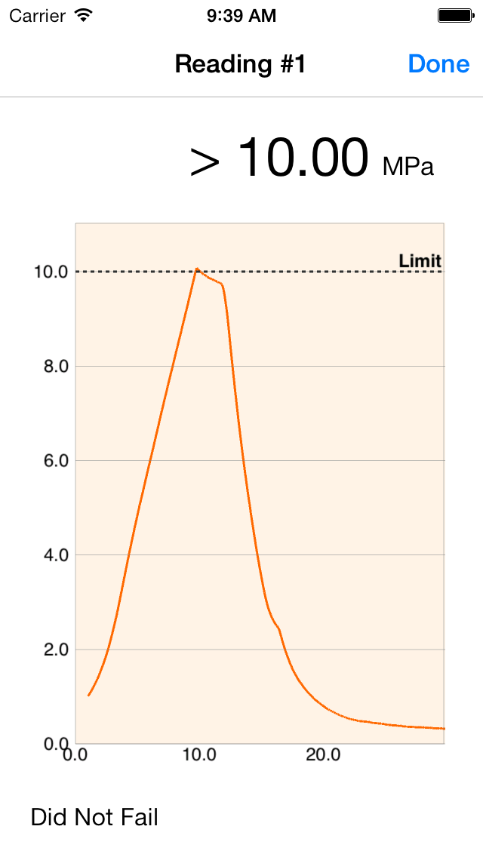
Data Management – ElcoMaster™ Mobile
Feature Focus – Elcometer 510 Adhesion Gauge Control

Slide 28
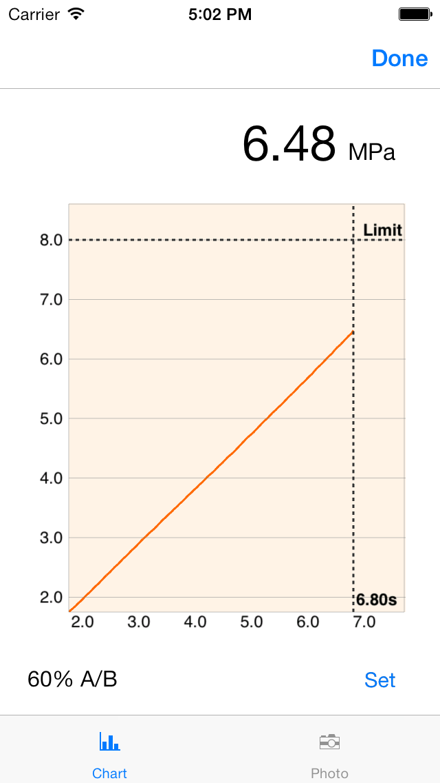
Data Management – ElcoMaster™ Mobile
Feature Focus – Elcometer 510 Adhesion Gauge Control

Slide 29
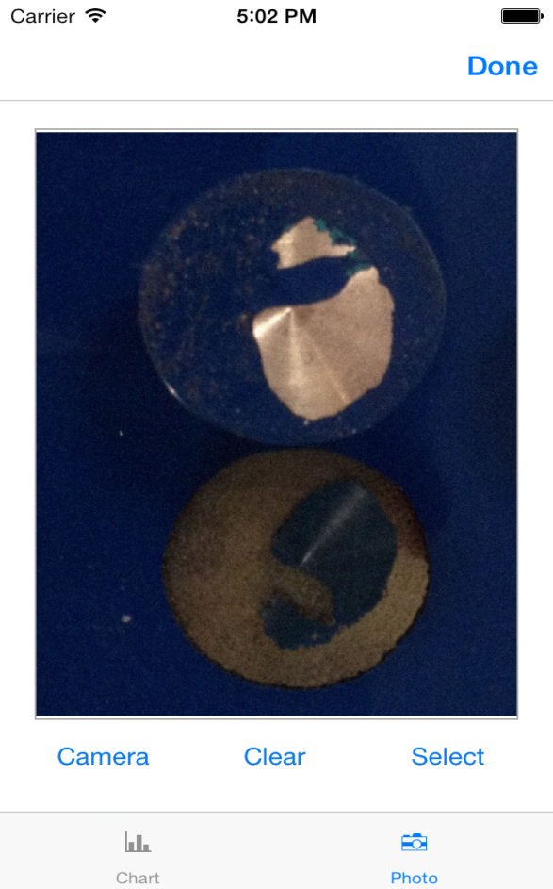
Data Management – ElcoMaster™ Mobile
Feature Focus – Elcometer 510 Adhesion Gauge Control

Slide 30
Data Management – ElcoMaster™ Mobile
Summary
Download, email and produce reports from gauge batches in the field
Connect a gauge live and collect readings over bluetooth
Add images to batches and reports directly from your device’s camera

Slide 31
Questions?

