Slide 1
Ongoing developments in the data transfer, storage and reporting of Coating Inspection Data
Paper by: Craig Woolhouse
Elcometer
Presented by: Graham Duk
BAMR

Slide 2
Coating Inspection – Trends
Originally it was coating thickness but now other factors in the coating process are recognised as key to coating performance
Project specifications are requiring inspection at all key stages of the application process
Surface Preparation
Climate Conditions
Film Thickness
Adhesion & Porosity
Appearance

Slide 3
Coating Inspection – Trends
The coatings market is demanding:
Increased inspection throughout the whole process
Proof that inspections were completed
Proof of inspection requires formal reporting
The amount of measurements and data is increasing
Trend is for electronic data capture
Electronic data capture reduces risk of human error

Slide 4
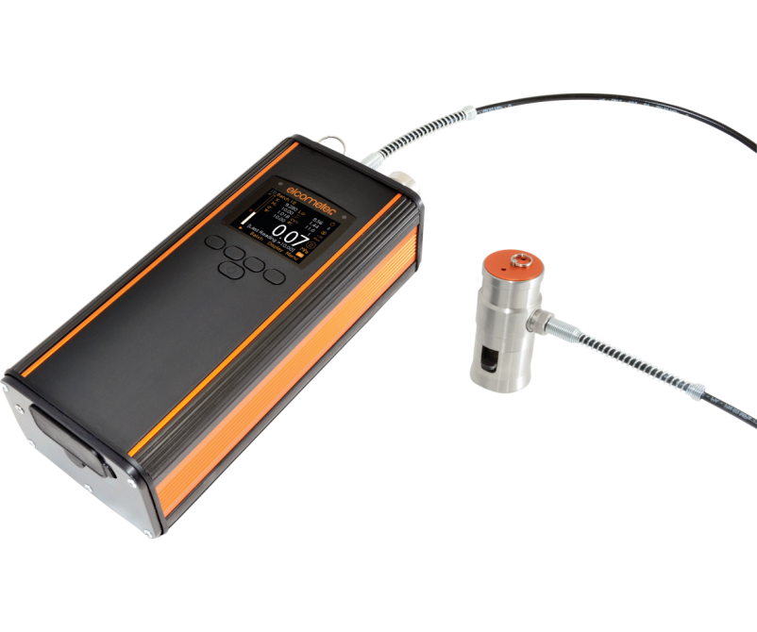
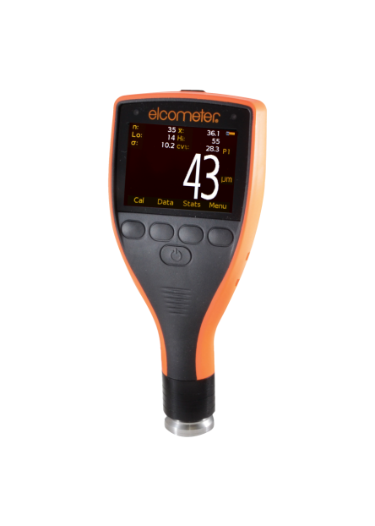
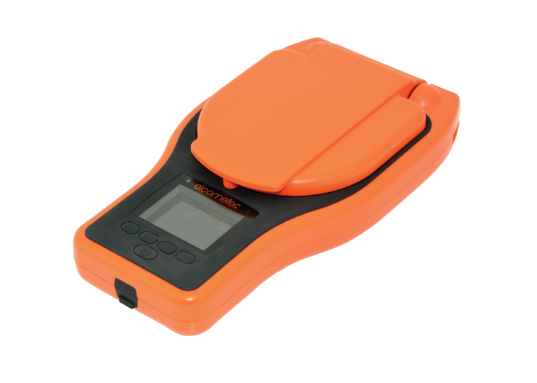
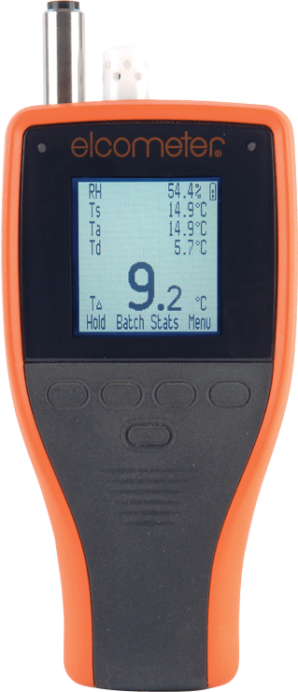
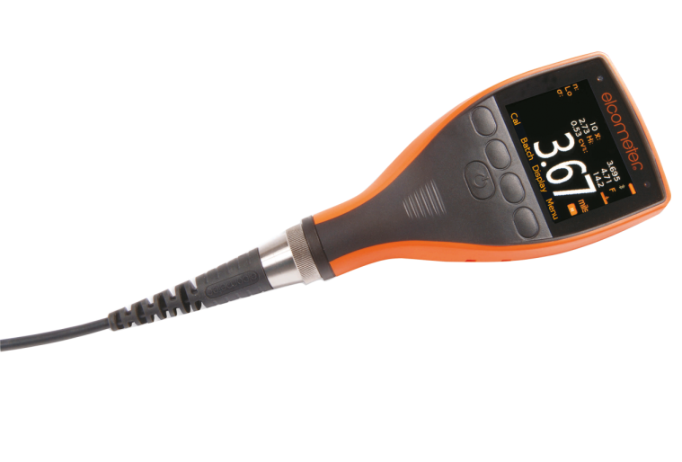
Coating Inspection – The Solution
Elcometer have developed a range of Gauges and Reporting Packages in response to these market demands

Slide 5
Data Collection – Elcometer Solution
Surface Preparation
Elcometer 224 Surface Profile Gauge
150,000 readings in 2,500 batches
Bluetooth and USB connectivity
Compatible with ElcoMaster

Slide 6
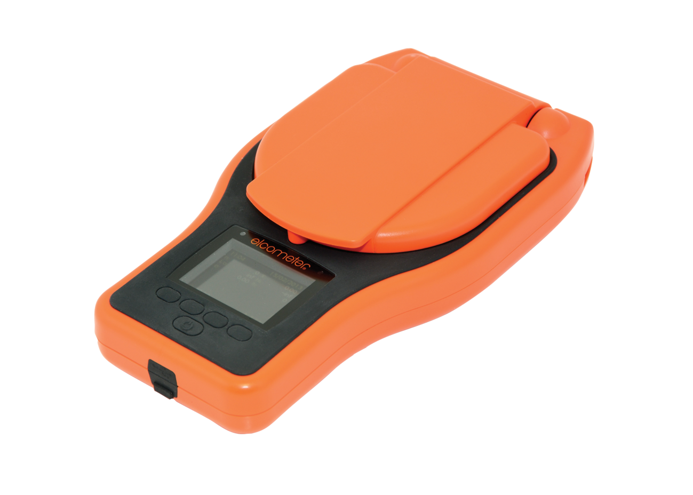
Data Collection – Elcometer Solution
Surface Preparation
Elcometer 130 Salt Contamination Meter
150,000 readings in 2,500 batches
Salt Mapping capability
Bluetooth and USB connectivity
Compatible with ElcoMaster

Slide 7
Data Collection – Elcometer Solution
Climatic Conditions
Elcometer 319 Dewpoint Meter
25,000 readings in 999 batches
Measuring RH%, Ta, Ts, Td and TΔ
Bluetooth and USB connectivity
Compatible with ElcoMaster

Slide 8
Data Collection – Elcometer Solution
Coating Thickness
Elcometer 456 Dry Film Thickness Gauge
150,000 readings in 2,500 batches
Bluetooth and USB connectivity
Compatible with ElcoMaster

Slide 9
Data Collection – Elcometer Solution
Adhesion
Elcometer 510 Automatic Adhesion Tester
Measurement range up to 100 MPa
10,000 readings and load graph memory
Bluetooth and USB connectivity
Compatible with ElcoMaster

Slide 10
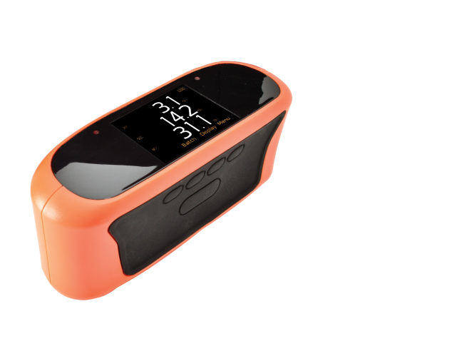
Data Collection – Elcometer Solution
Appearance
Elcometer 480 Glossmeter
Automatic Calibration and Diagnostics
Measurement range up to 2000 GU
40,000 readings in 2,500 batch memory
Bluetooth and USB connectivity
Compatible with ElcoMaster

Slide 11
Data Storage & Reporting – The Solution
To host, store and report the data collected during inspection Elcometer have developed software packages:
ElcoMaster 2 for PC and Laptop
ElcoMaster Mobile for Tablet and Phone
Both packages provide one standard platform for all gauges
Data can be stored on Cloud, Server, Host Unit and Email

Slide 12
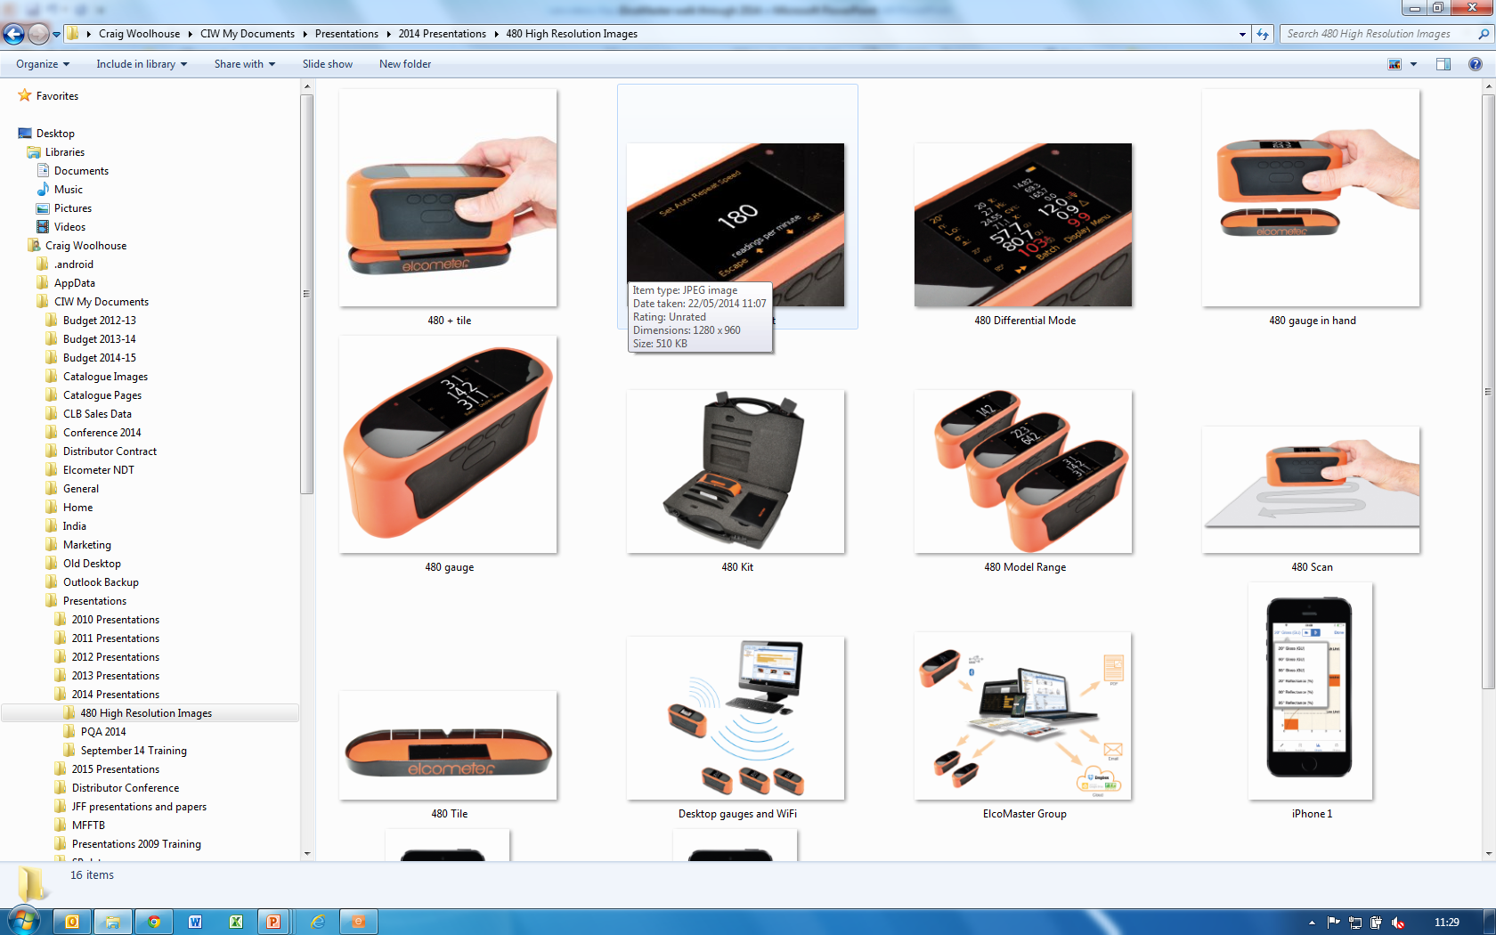
Data Storage & Reporting – ElcoMaster 2
Visual appearance and data storage based on windows applications

Slide 13
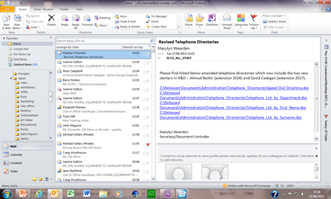
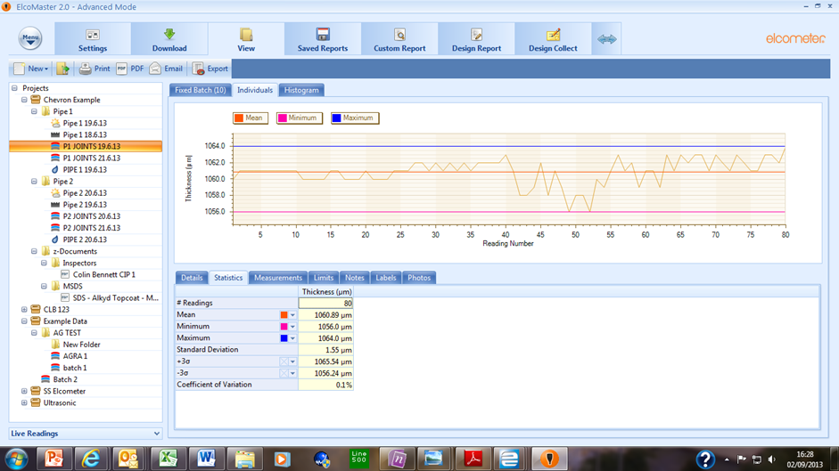
Data Storage & Reporting – ElcoMaster
Data is organised into Projects/Folders/Batches – all details of the batch readings can be seen

Slide 14
Data Storage & Reporting – ElcoMaster
Reports are generated as PDF or editable ElcoMaster Files
A variety of reports can be produced from a one page summary to a full multi-page Project Report
Customer specific report formats are widely used

Slide 15
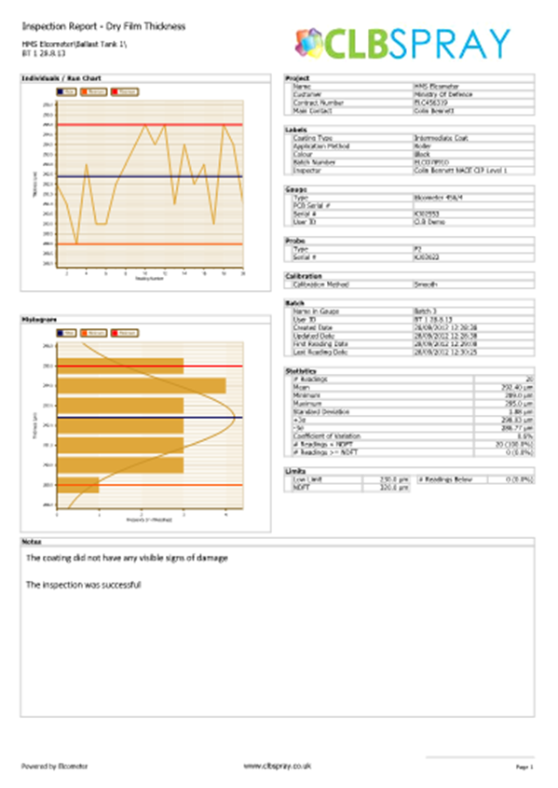
Data Storage & Reporting – ElcoMaster
Batch Summary Page

Slide 16
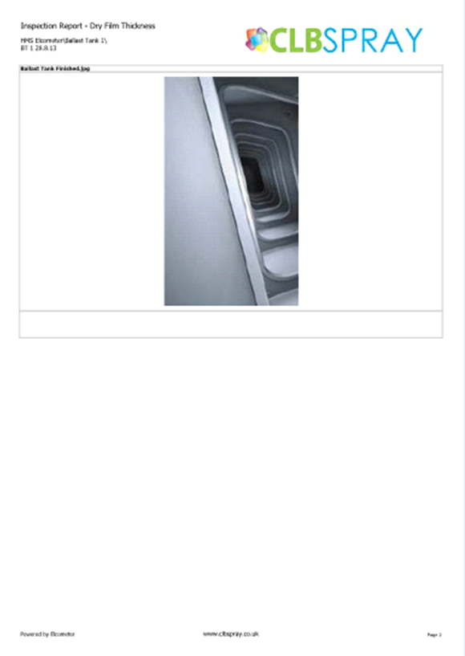
Data Storage & Reporting – ElcoMaster
Batch Photographs

Slide 17
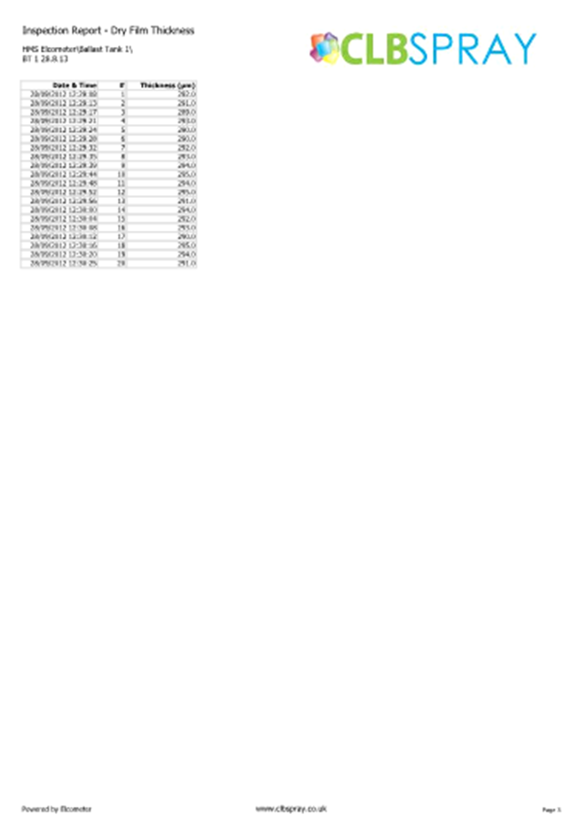
Data Storage & Reporting – ElcoMaster
Batch Readings

Slide 18
Introducing the 2017 ElcoMaster Mobile for Android and iOS

Slide 19
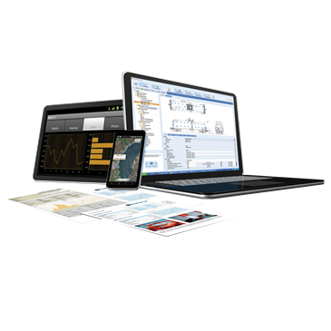
Data Storage & Reporting – ElcoMaster Mobile
ElcoMaster 2 links with ElcoMaster Mobile
Android and iOS platforms
Tablet
Mobile Phone
Bluetooth
Cloud

Slide 20
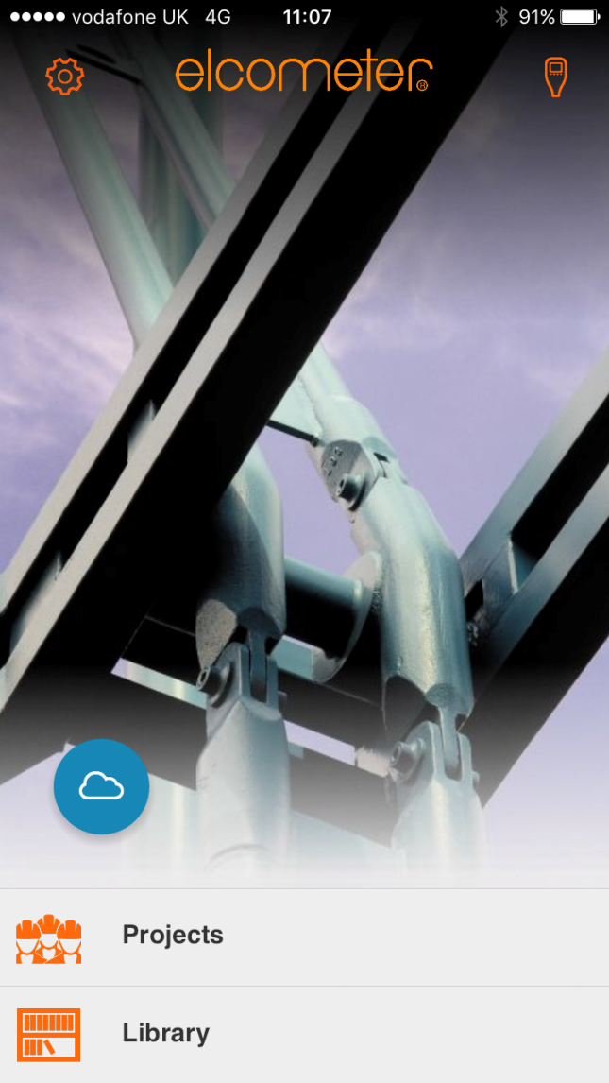
ElcoMaster Mobile from 2017

Slide 21
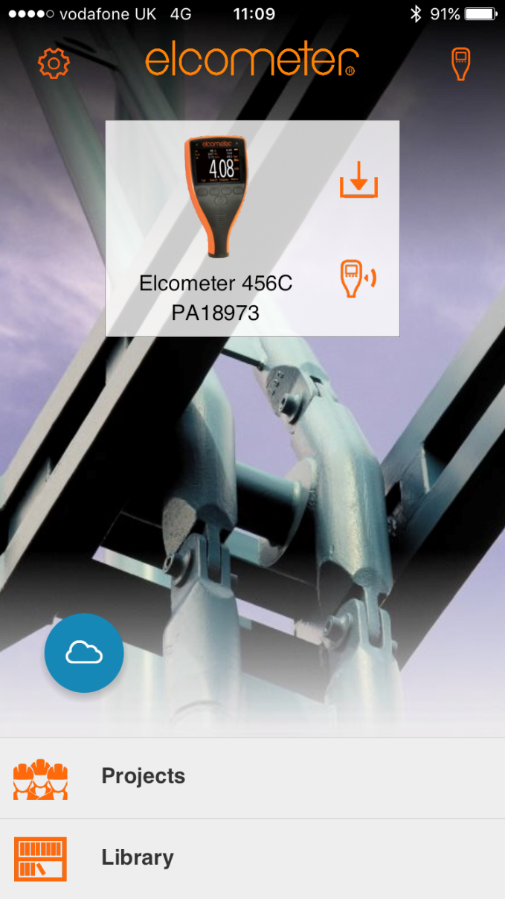
Data Management – ElcoMaster Mobile
Report Template Library

Slide 22
Data Management – ElcoMaster Mobile
Synchronise your Cloud Library example shows 17 files to update

Slide 23
Data Management – ElcoMaster Mobile
Add a project

Slide 24
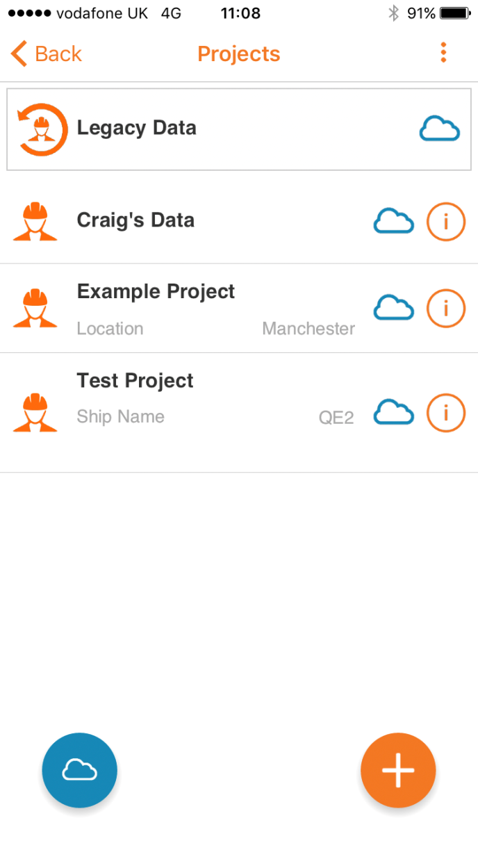
Data Management – ElcoMaster Mobile
Add a project

Slide 25
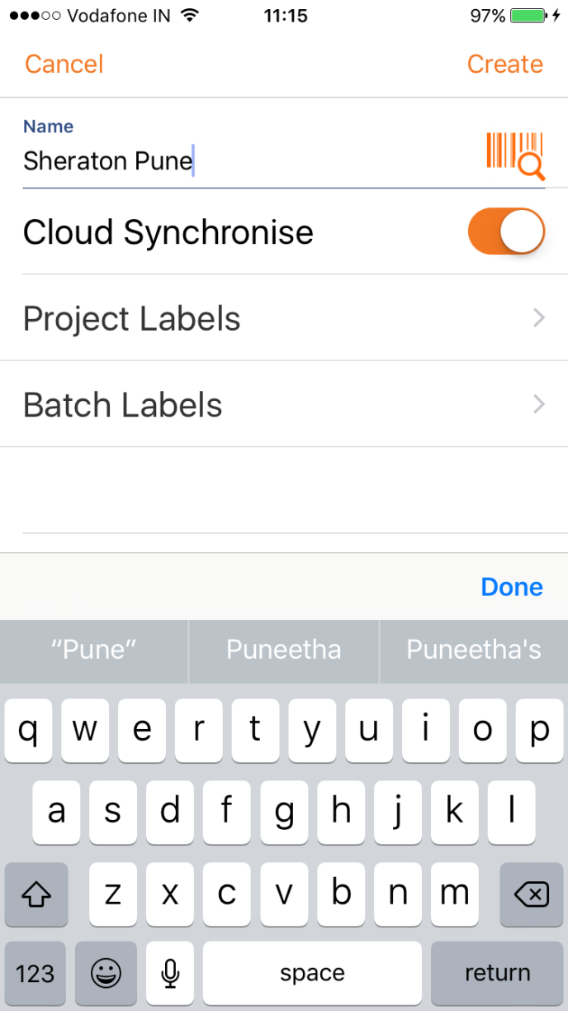
Data Management – ElcoMaster Mobile
Add a project

Slide 26
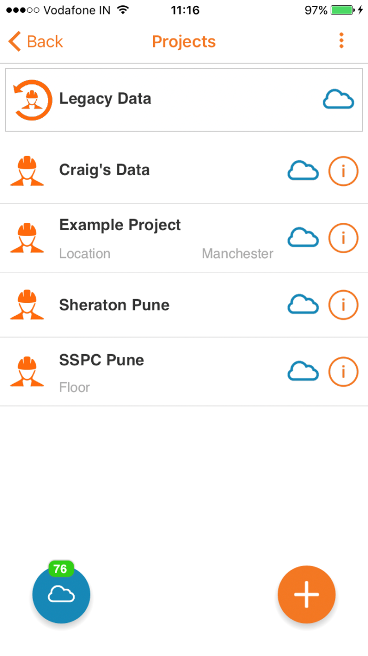
Data Management – ElcoMaster Mobile
Add a project

Slide 27
Data Management – ElcoMaster Mobile
Adding a gauge

Slide 28
Data Management – ElcoMaster Mobile
Add live readings from a gauge

Slide 29
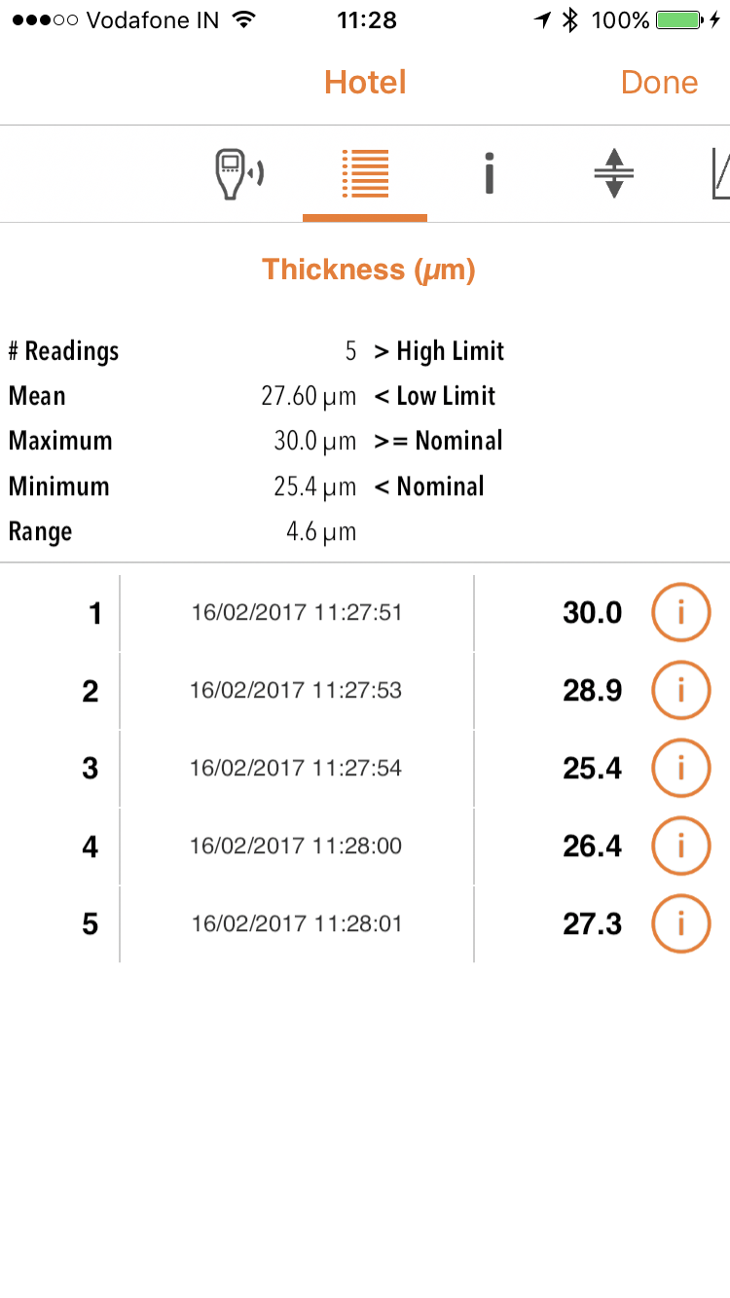
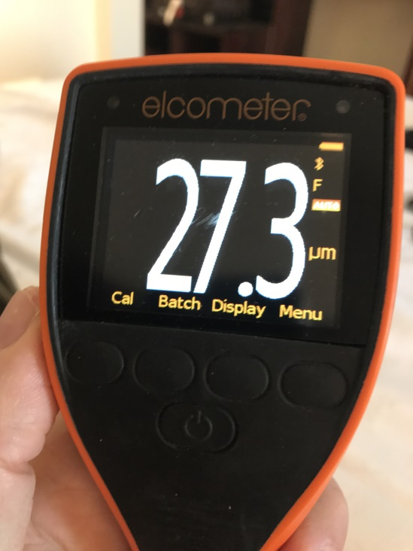
Data Management – ElcoMaster Mobile
Add live readings from a gauge

Slide 30
Data Management – ElcoMaster Mobile
Download from a gauge

Slide 31
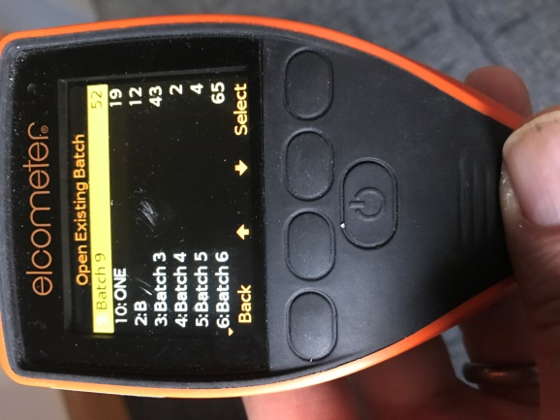
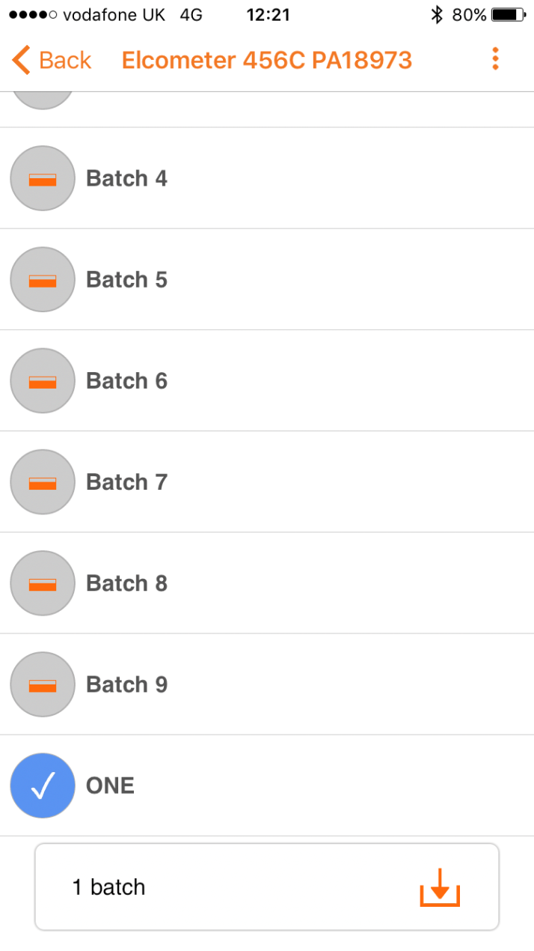
Data Management – ElcoMaster Mobile
Select batch or batches and download

Slide 32
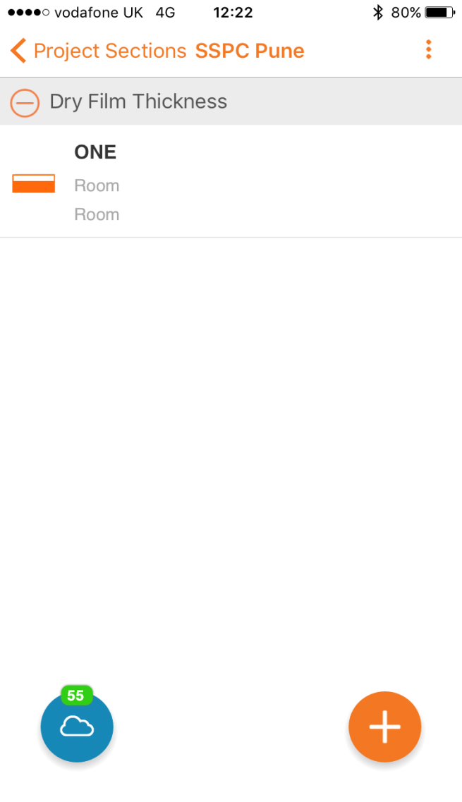
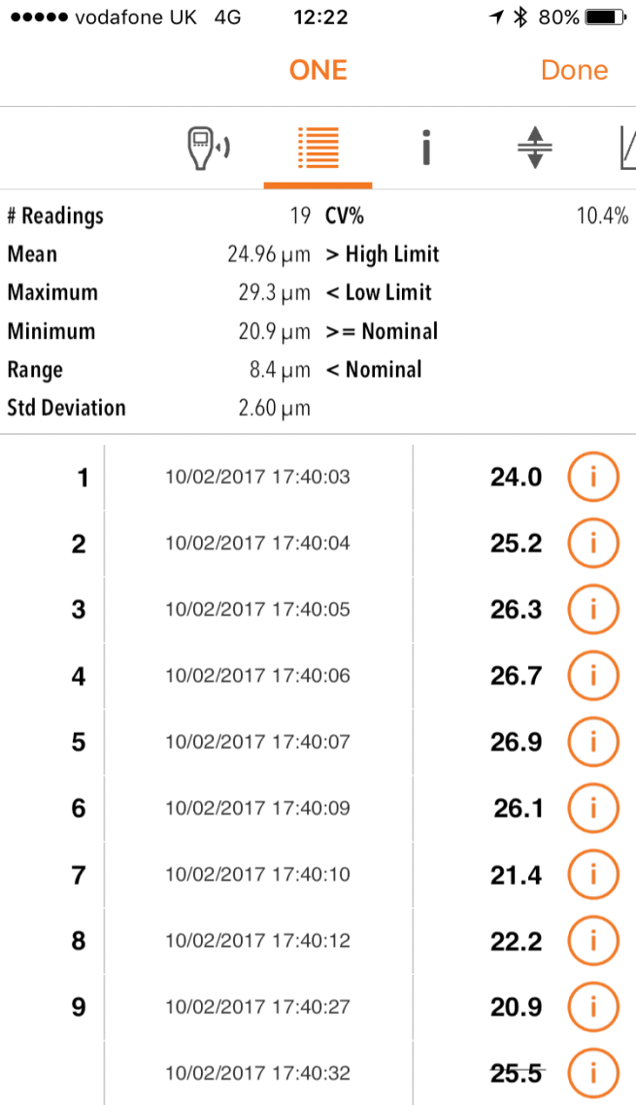
ElcoMaster Mobile - view data
View batch and tab through batch information

Slide 33
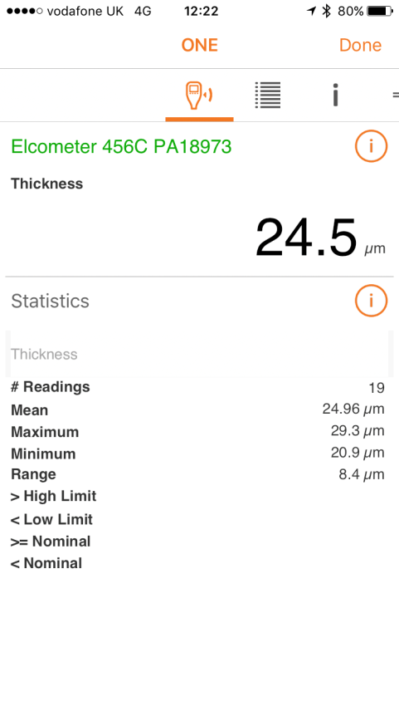
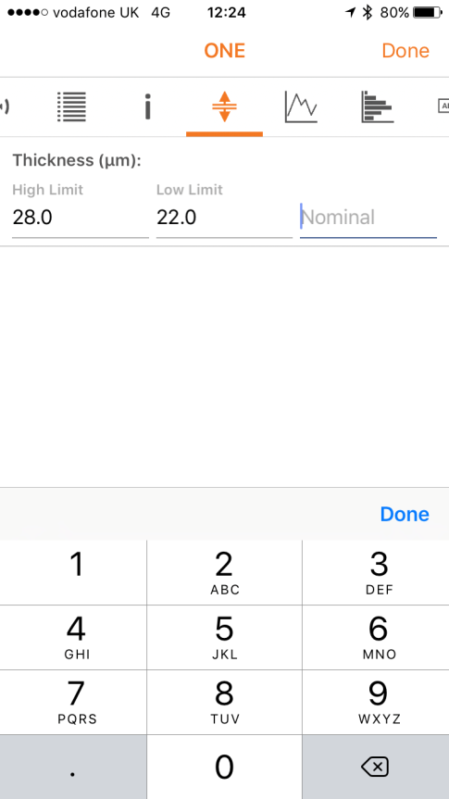
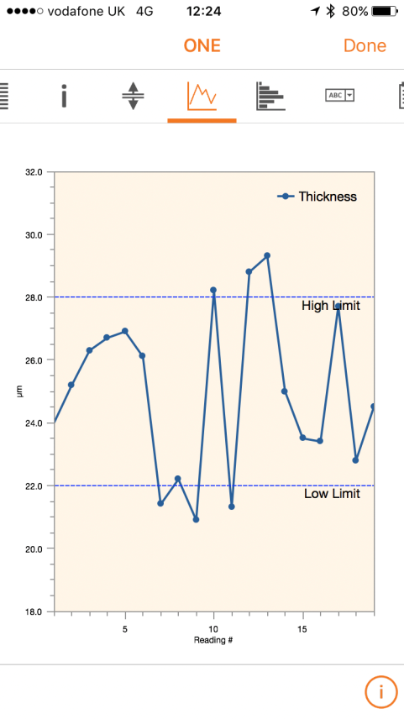
ElcoMaster Mobile - view data
Readings Data
Individual Data
Add Limits
Run Chart

Slide 34
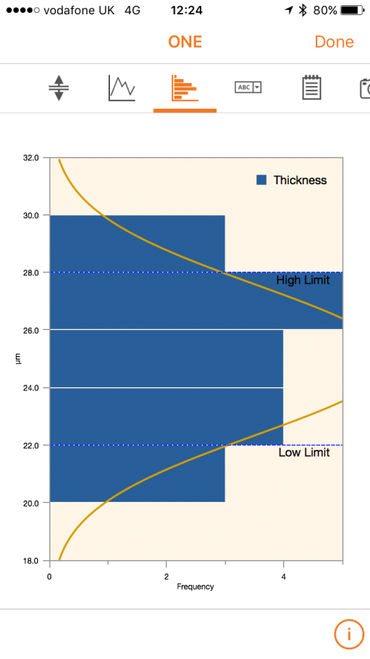
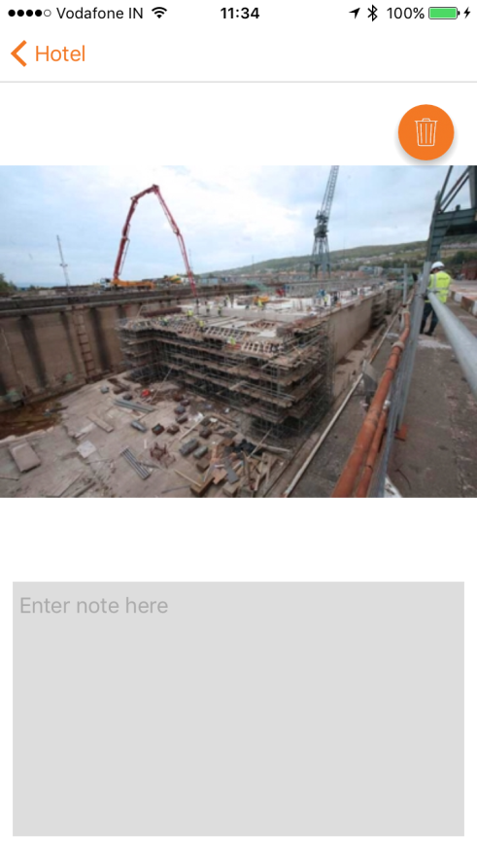
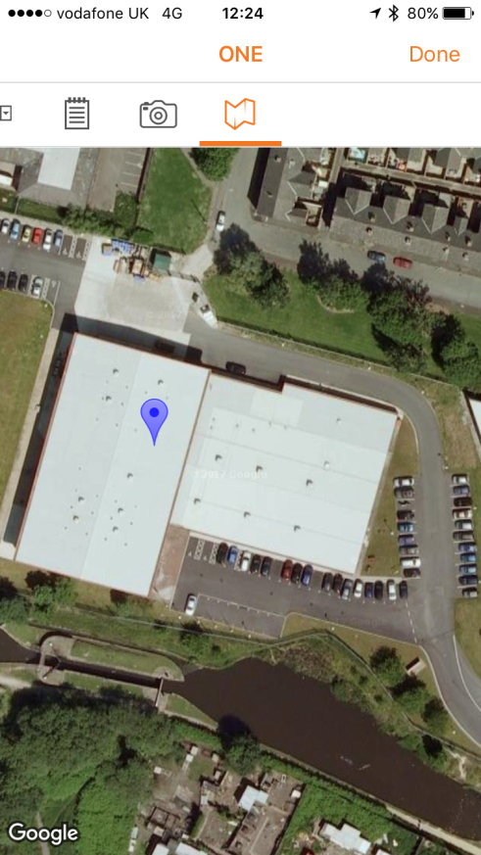
ElcoMaster Mobile - view data
Histogram
Add Photograph
Photograph
Add GPS data

Slide 35
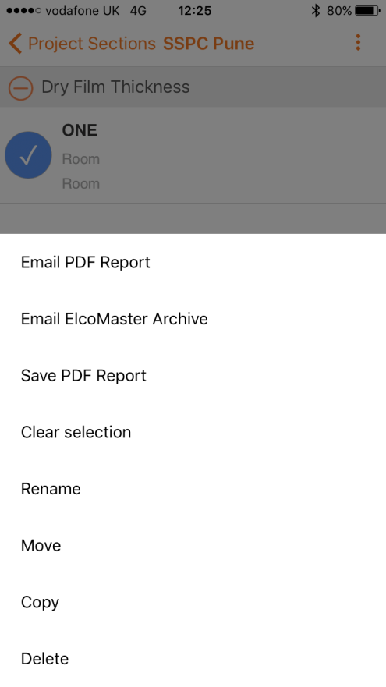
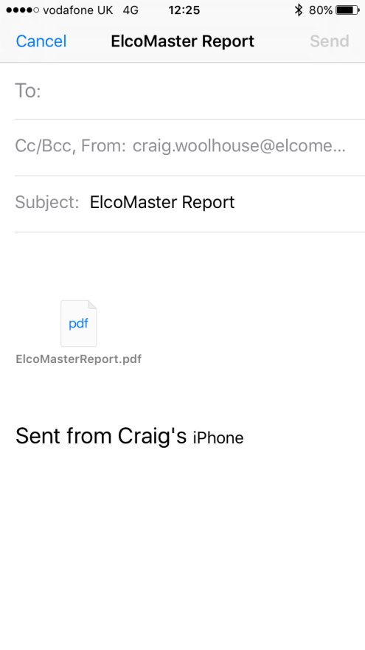
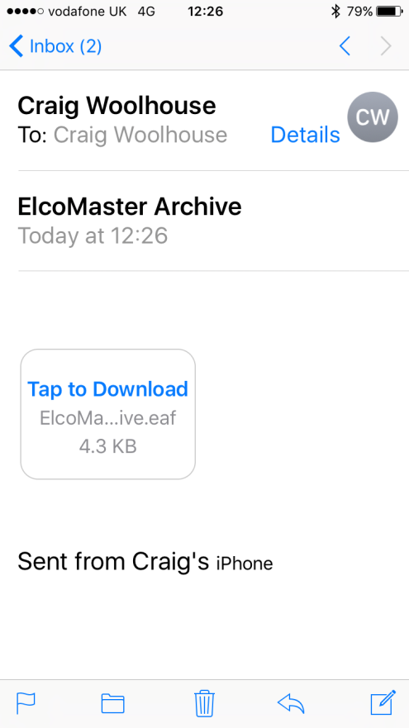
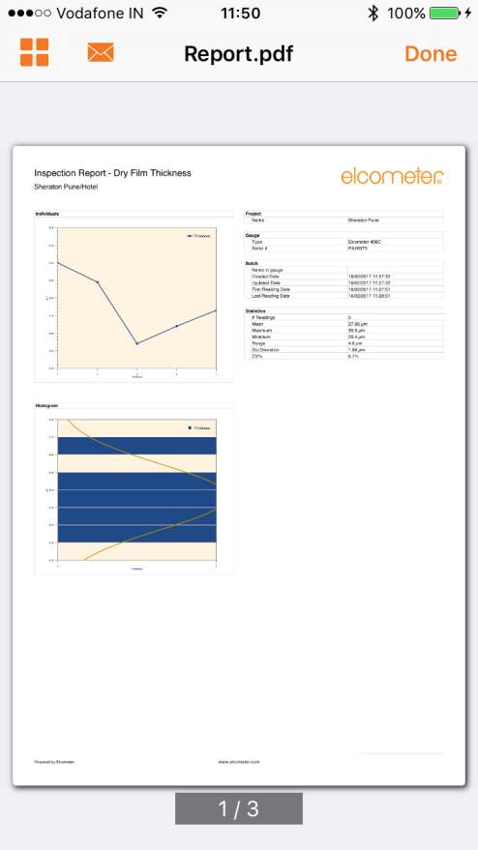
ElcoMaster Mobile – generate report
Select Report Type
Auto email
Receive email
Store/Amend Report

Slide 36
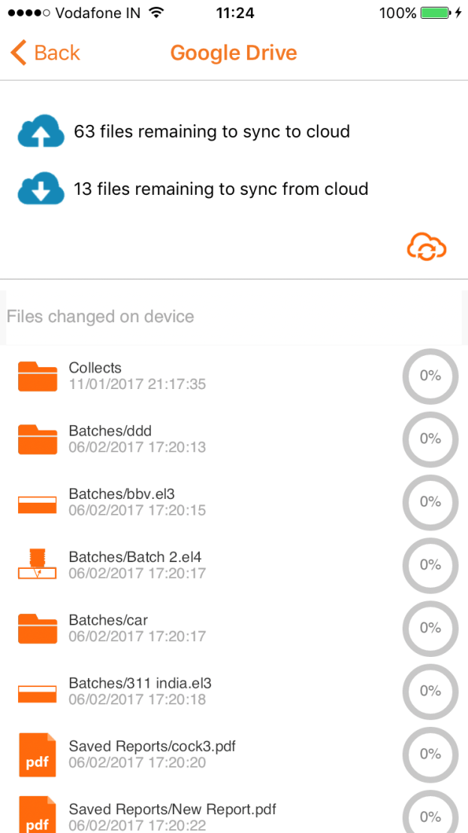
ElcoMaster Mobile – Cloud Storage
and then here
Simply click here

Slide 37
ElcoMaster Mobile – Summary
Intuitive to use Android and iOS software package
Stores data from multiple gauge types
Supports live reading function
Simple Report Formats
Cloud, Server, PC and Host storage available
Available since April 2017
Free download from Google Play and App Store

Slide 38
ElcoMaster Mobile – what is next?
Bespoke Report Format
Two way communications with Gauge
Bespoke Customer Specific Packages

Slide 39
ElcoMaster – where to find it?
ElcoMaster PC Version
Free download from www.elcometer.com
ElcoMaster Mobile
Free download from Google Play and App Store

Slide 40
Thank you for your time
Questions?

