Slide 1
Measuring Dry Film Thickness (DFT) on Concrete Substrates
Craig Woolhouse
Elcometer UK

Slide 2
DFT on Concrete Substrates
Traditional measurement techniques
Advances in NDT measurement technology
Use of the Elcometer 500 Coatings on Concrete Gauge
Things to look out for when measuring the coating thickness on concrete substrates
How to more effectively manage the results

Slide 3
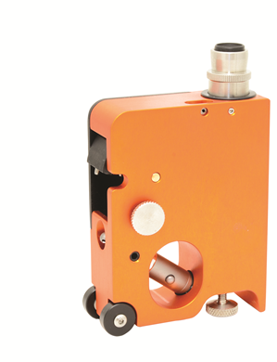
Traditional Measurement Techniques
Mechanical device – PIG Gauge
Destructive
Difficult to interpret results – scale range in the microscope

Slide 4
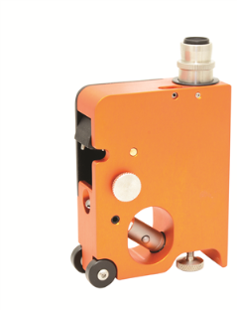
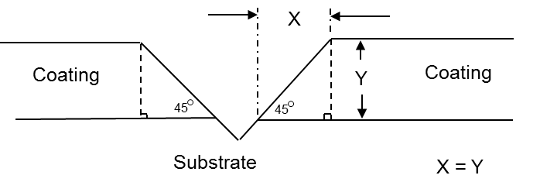
Paint Inspection Gauge (P.I.G.)

Slide 5
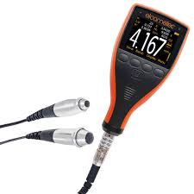
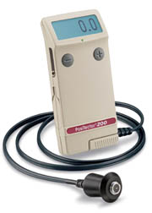
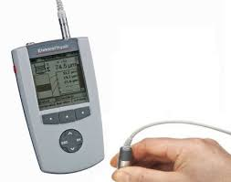
Current Measurement Techniques
Ultrasonic devices – Non Destructive

Slide 6
Ultrasonic Measurement

Slide 7
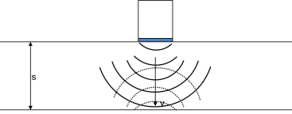
Ultrasonic Measurement
t is measured by the gauge
S is the calculated thickness
v (the velocity of the coating) is ‘inputted’ by the user
so if you set up the gauge with the wrong speed of sound, the thickness will be wrong

Slide 8
Ultrasonic Measurement
t is measured by the gauge
S is the calculated thickness
v (the velocity of the coating) is ‘inputted’ by the user
Different coatings (Epoxy, Acrylic, PVC, rubber, etc) each have a different speed of sound, so for an accurate reading, you cannot simply have a single speed of sound for all coatings

Slide 9
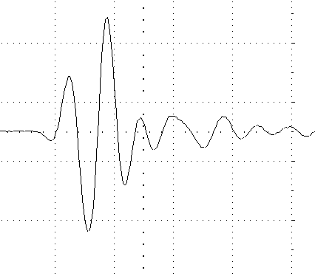
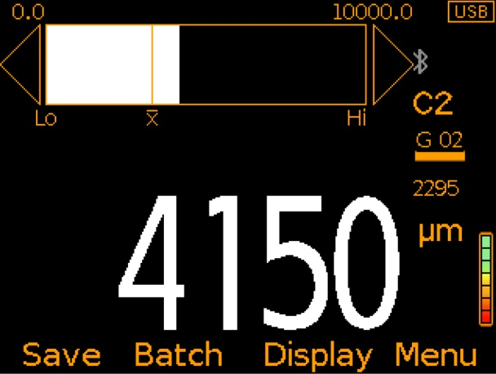
Ultrasonic Measurement
Metal Substrate DFT measurement isn’t daunting, so why should ultrasonic DFT be any different?
It doesn’t need to be. You shouldn’t have to set up gates or thresholds, or worry about what gain or what sort of A-Scan graph you have, the gauge should do this for you automatically
Calibrated correctly, the gauge should only give you the correct answer

Slide 10
Ultrasonic Gauge Calibration
There are 4 options for calibrating an ultrasonic gauge
Use a generic value for all coatings (not recommended)
Select the appropriate coating from a pre-defined material selection (generic speed from pick list)
Input the known speed of sound of the coating
Measure a sample of known thickness

Slide 11
Ultrasonic Gauge Calibration
There are 4 options for calibrating an ultrasonic gauge
Use a generic value for all coatings (not recommended)
Select the appropriate coating from a pre-defined material selection (generic speed from pick list)
Input the known speed of sound of the coating
Measure a sample of known thickness

Slide 12
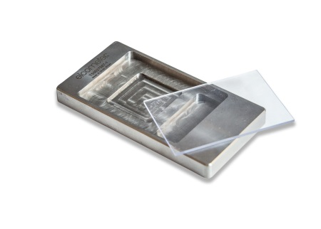
Ultrasonic Gauge Calibration
But how do you know what the speed of sound is for the coating?
Where do you get a sample of known thickness from?
A Coating Calibration Mould answers both of these questions. The CCM is a metal mould allowing for the creation of a known thickness of coating

Slide 13
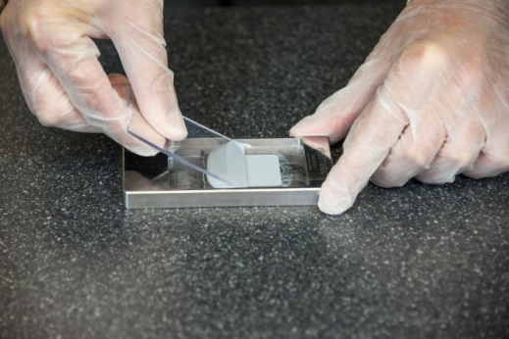
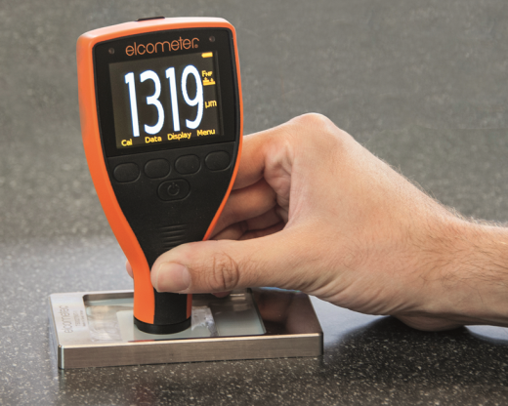
Ultrasonic Gauge Calibration
The CCM mould is filled with the coating under test
A scraper is used to level a predetermined wet film thickness of coating
Once fully cured a DFT gauge is used to accurately measure the coating thickness and …

Slide 14
Ultrasonic Gauge Calibration
The ultrasonic gauge can now be calibrated accurately on a sample of known thickness
And used to determine the coating’s speed of sound, which can be stored in the gauge for later use, or used to calibrate other gauges

Slide 15
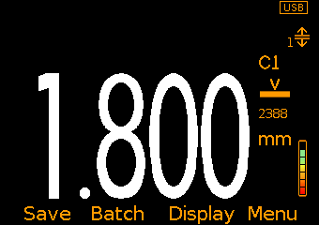
Elcometer 500 Gauge Usage
Calibrate by setting the material speed of sound
Select the correct probe type (C1 or C2)
Take and store readings recognising that
The gauge signal strength needs to be ‘in the green’
If no reading occurs then carefully move the probe over the substrate until a reading is obtained
Store the reading in the gauge memory
Download the data to ElcoMaster

Slide 16
Elcometer 500 Gauge Advantages
Fast
Rugged, Reliable and Ergonomic gauge design
Intelligent
New probe tip is field replaceable
Ease of Use
Simple Menu and On Screen Instructions
Powerful
Connects to ElcoMaster reporting software

Slide 17
Result Reporting
Ultrasonic measurement of coating thickness is covered by ASTM D6132-13 and SSPC-PA 9
These standards define the method, the procedure and the reporting requirements

Slide 18
Result reporting to SSPC-PA 9
SSPC-PA 9 is a recommended procedure for measuring DFT using Ultrasonic Gauges
a minimum of three (3) gage readings shall be made for each spot measurement of the coating.
an area measurement is obtained by taking five (5) separate spot measurements each 10m² up to 100m²
For areas between 30 and 100m² select 3 random 10m² areas
For areas greater than 100m² measure as above for the first 100m² and one 10m² area per 100m² thereafter

Slide 19
Result reporting to ASTM D6132-13
ASTM requires the following to be reported
Type of coating and substrate
Instrument used
manufacturer, model number, serial number and calibration date
Type of coating thickness or reference standard
Together with method of accuracy verification
Mean and standard deviation of readings
Operator I.D. and inspection date

Slide 20
Result Reporting
Modern digital inspection gauges enable the operator to
Save the readings in the gauge
Transfer the readings from the gauge to the PC/Phone
Analyse the data carrying out any calculations or statistical analysis required by the Standard
Produce and email a report instantly

Slide 21
Result Reporting
All the data required by the customer can be automatically transferred by the gauge to the software and directly onto your report… all at the click of a button

Slide 22
Conclusion
You don’t need to panic at the mention of Ultrasonic DFT gauges as they don’t have to be complicated!
Measuring coatings on concrete has been made significantly easier, faster and more accurate with the introduction of new ultrasonic gauges and through the use of coating calibration moulds
Ultrasonic DFT results on concrete no longer need to be viewed with scepticism

Slide 23
Now for a short demonstration…..

