Slide 1
Factors affecting Successful Coating Adhesion Testing
Craig Woolhouse B Eng, NACE CIP I
Elcometer

Slide 2
Contents
Introduction
Pull Off Adhesion Testers
Pull Off Adhesion Test Failure Modes
  Effect of Adhesive
  Effect of Gauge Dolly Design
  Variation in Surface Preparation prior to Dolly Application
  Effect of Adhesive Curing Temperature
  Effect of Cutting around the Dolly
  Effect of Applying the Load
Conclusions

Slide 3
What is Pull Off Adhesion Testing?
ASTM D 4541 and ISO 4624 pull-off methods of adhesion testing involve the exertion of a perpendicular force to the coated surface in an effort to remove an adhered ‘dolly’ from the coating or substrate. The force used is a measure of the adhesive properties of the coating
This paper investigates the effects of the typical variables experienced during pull off Adhesion Testing

Slide 4
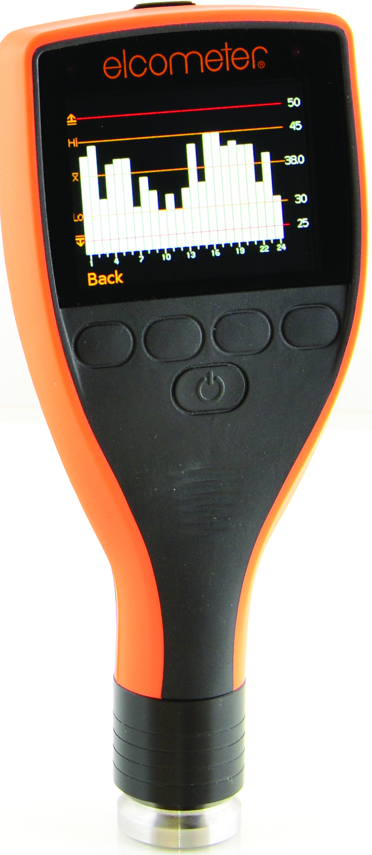
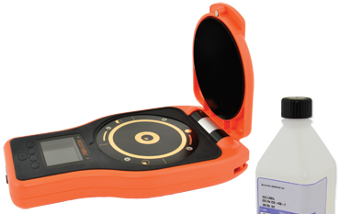
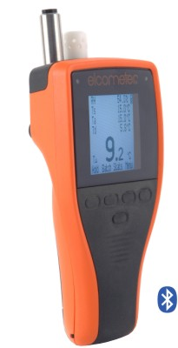
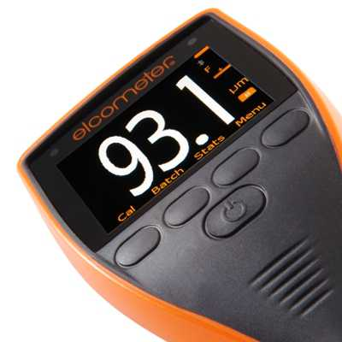
Introduction
Why test for Coating Adhesion?
  To meet the requirements of the project specification
  To ensure that the following parameters are acceptable
      Surface Profile
      Surface Cleanliness
      Climatic Conditions
      Dry Film Thickness

Slide 5
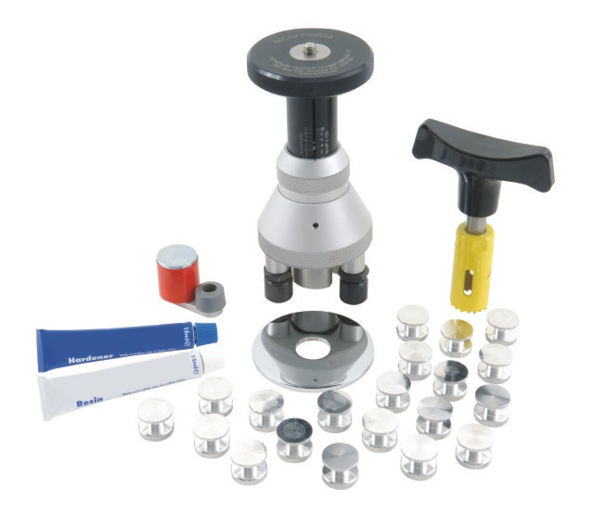
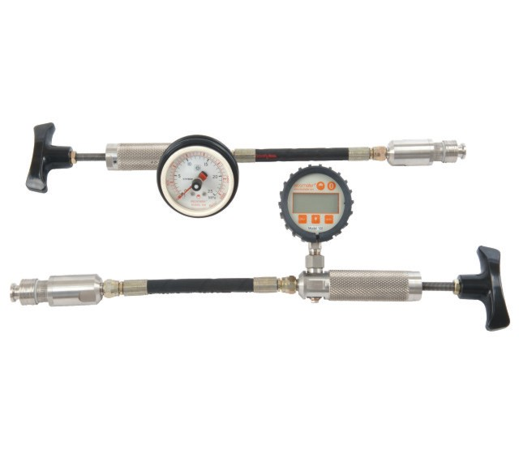
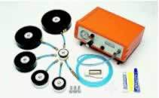


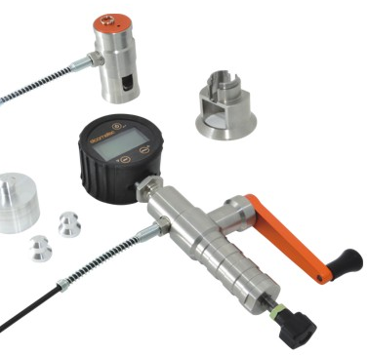
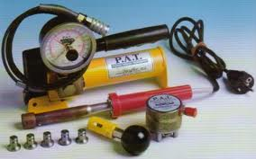
Introduction
Which tools are available?
  ASTM D4541 Pull Off Adhesion Testers
    Type II – Fixed Alignment Tester
    Type III – Self Alignment Tester
    Type IV – Self Alignment Tester
    Type V – Self Alignment Tester
    Type VI – Self Alignment Tester

Slide 6
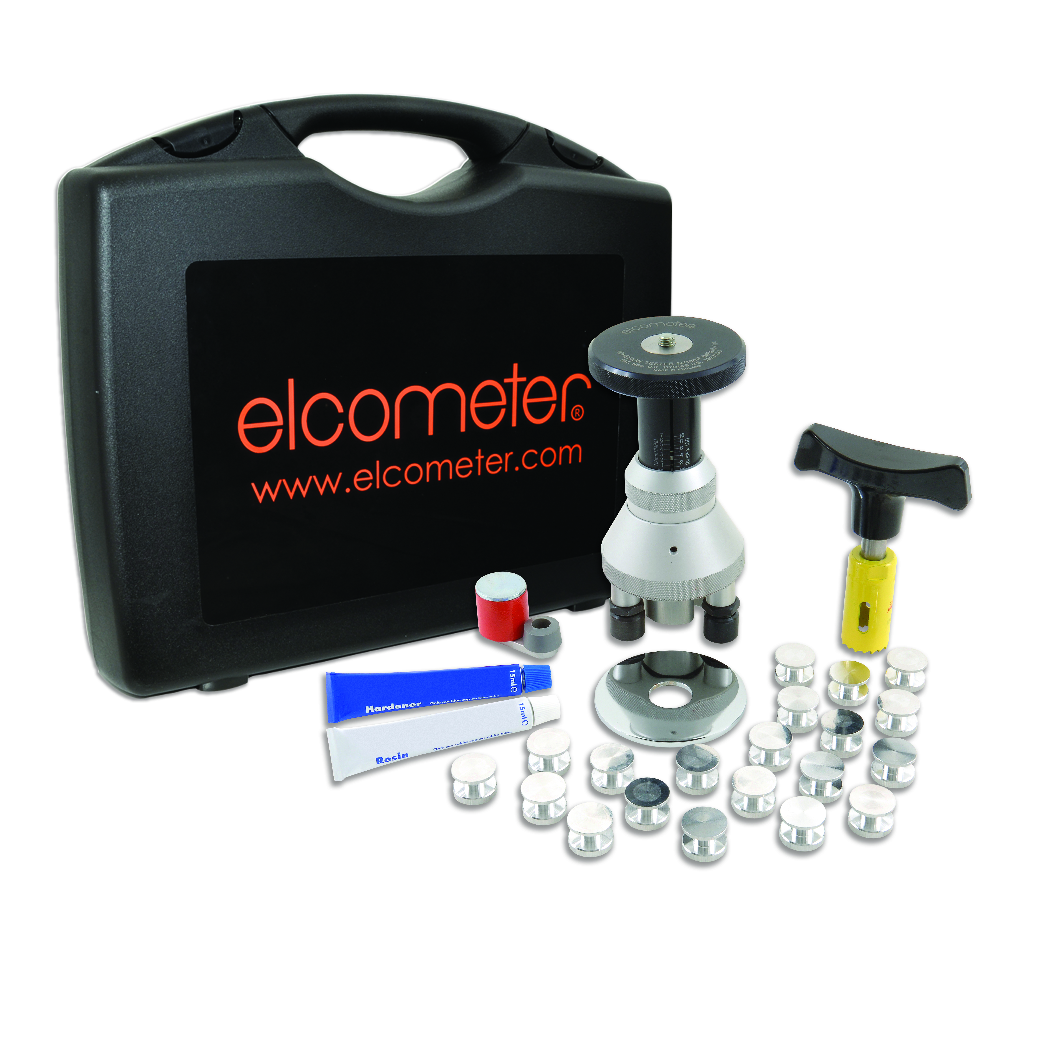
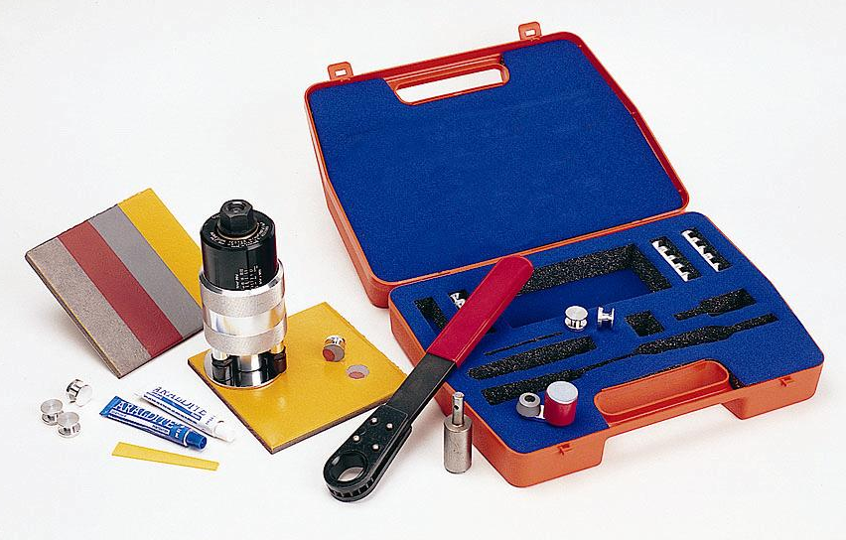
Types of Pull-Off Testers
ASTM Type II - Fixed Alignment Manual Adhesion Tester

Slide 7
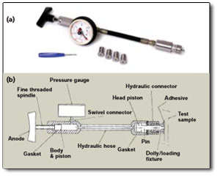
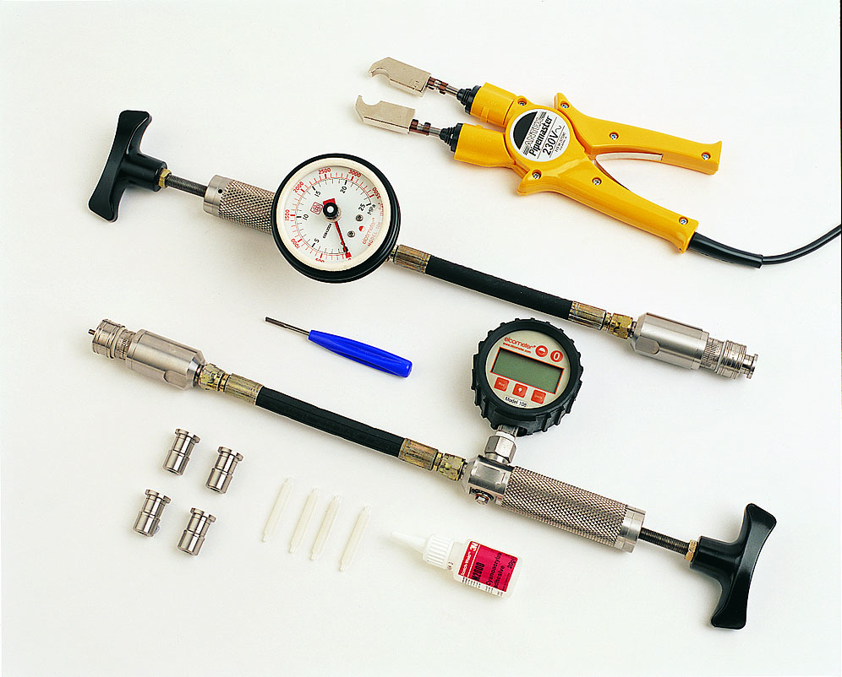
Types of Pull-Off Testers
ASTM Type III - Self-Alignment Hydraulic Adhesion Tester

Slide 8
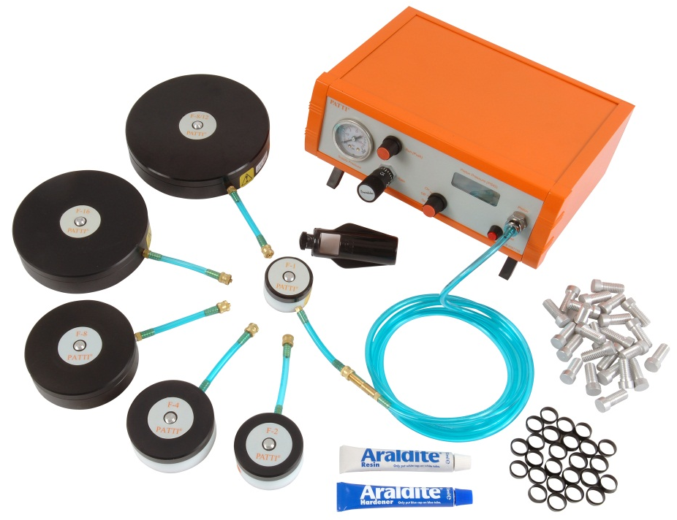
Types of Pull-Off Testers
ASTM Type IV - Self-Alignment Pneumatic Adhesion Tester

Slide 9
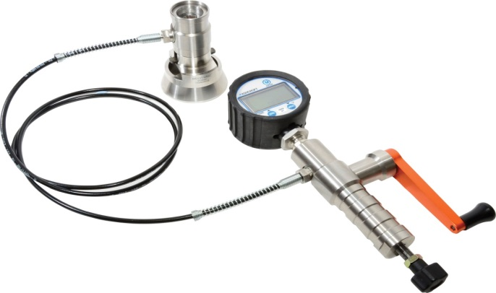
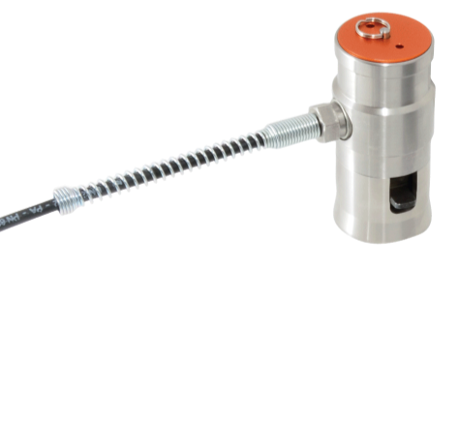
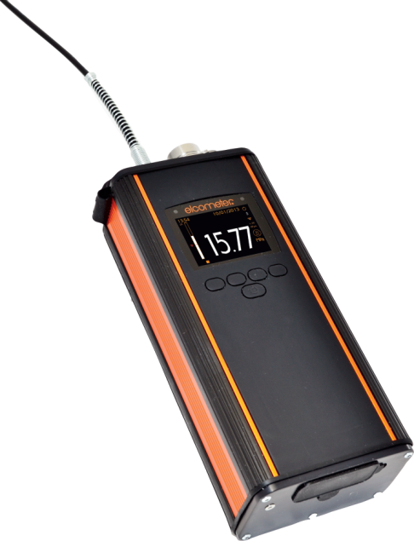
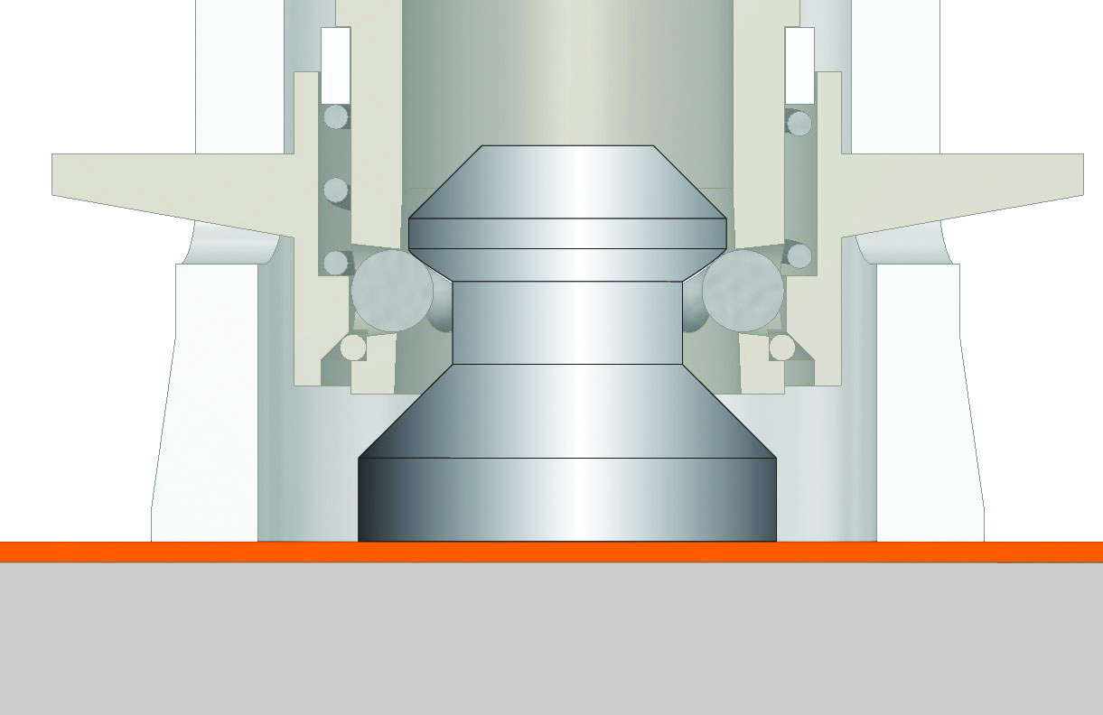
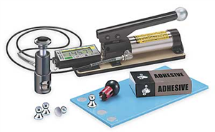
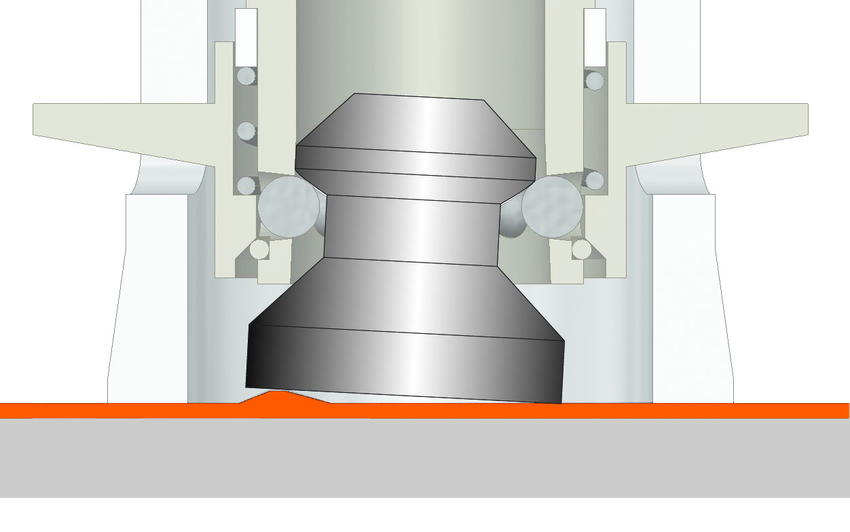
Types of Pull-Off Testers
  ASTM Type V - Self-Alignment Adhesion Tester

Slide 10
Types of Pull-Off Testers
  ASTM Type VI - Self-Alignment Adhesion Tester

Slide 11
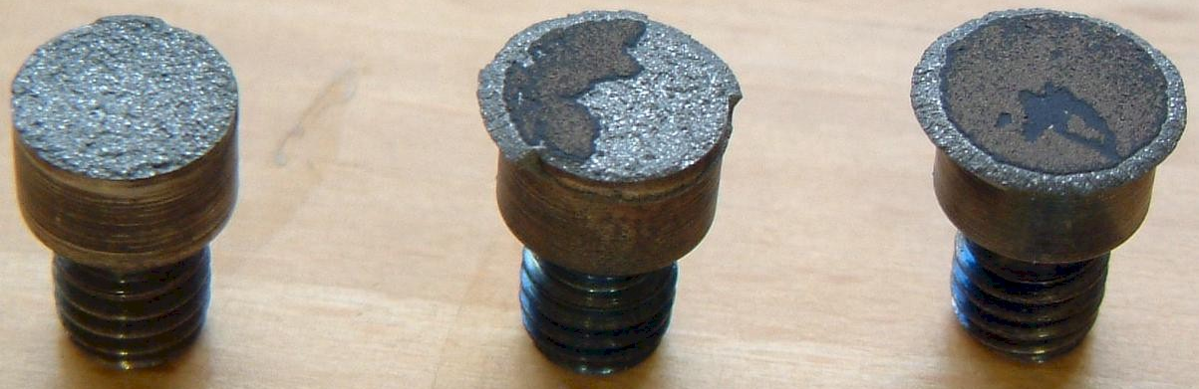
Coating Failure Modes
Glue Failure
Cohesive Failure
Adhesive Failure

Slide 12

Test Tools
ASTM Type V compliant testers were used for this analysis
Elcometer 510 (automatic)
Elcometer 506 (manual)

Slide 13
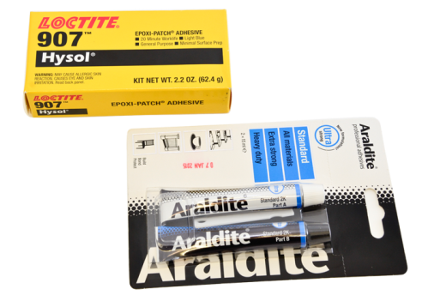
Which Adhesive?
Loctite and Araldite 2 pack epoxy products are most commonly used
Both adhesives were mixed 1:1
The average value for both adhesives is the same at 10.3 MPa
The critical factor is that both adhesives have sufficient strength for a typical test
Dolly | Glue | Test Value (MPa) | Failure Type
1 | Araldite | 8.1 | Adhesive Glue
2 | Araldite | 10.3 | Adhesive/Cohesive 50:50 Glue/Coating
3 | Araldite | 10.9 | Adhesive/Cohesive 50:50 Glue/Coating
4 | Araldite | 11.8 | Adhesive Coating
5 | Araldite | 9.8 | Adhesive/Cohesive 80:20 Glue/Coating
6 | Loctite | 8.2 | Adhesive/Cohesive 80:20 Glue/Coating
7 | Loctite | 7.6 | Adhesive/Cohesive 10:90 Glue/Coating
8 | Loctite | 12.0 | Adhesive/Cohesive 95:5 Glue/Coating
9 | Loctite | 11.8 | Adhesive/Cohesive 60:40 Glue/Coating
10 | Loctite | 11.0 | Adhesive/Cohesive 50:50 Glue/Coating

Slide 14
Mixing the Adhesive
The ratio of hardener and resin may affect the result
  3 mixes of Araldite Adhesive were tested
  Using more hardener affects the results significantly
  Using more resin has less effect
  The optimum is 1:1 ratio
Set | Glue Mix Resin:Hardener | Pull 1 (MPa) | Pull 2 (MPa) | Pull 3 (MPa) | Pull 4 (MPa) | Pull 5 (MPa) | Average Pull Value | % variation
1 | 1:1 | 6.0 | 6.4 | 7.6 | 7.6 | 4.5 | 6.67 | -
2 | 1:2 | 5.8 | 4.0 | 3.9 | 3.6 | 3.9 | 3.93 | -41%
3 | 2:1 | 5.8 | 5.5 | 6.2 | 7.9 | 7.0 | 6.33 | -5%

Slide 15
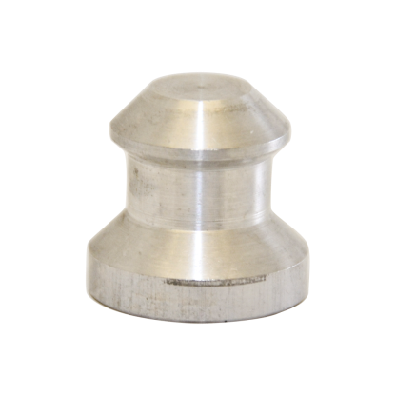
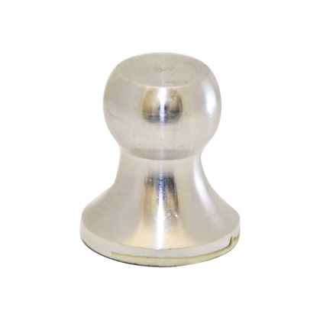
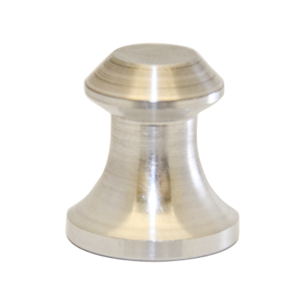
What is the effect of Dolly Design?
ISO and ASTM standards recommend the length of the dolly be at least half the diameter of the dolly. If this recommendation is taken literally, then some commercially available dollies do not comply.
However the thickness of the base should also be a consideration
  The testing in this report utilised a selection of the designs shown below
Elcometer Type V Dolly
Competitor Type V Dolly
Hybrid Type V Dolly

Slide 16
Dolly Design
Set | Elcometer 506 (MPa) | Hybrid (MPa)
1 | 10.4 | 9.4
2 | 10.7 | 8.2
3 | 11.3 | 9.1
4 | 9.8 | 8.8
5 | 10.3 | 8.5
Average value | 10.46 | 8.8
A 16% higher pull strength is required to remove the thicker based dolly from the surface than the thinner based dolly
Video examination showed that for both designs the dollies started to lift from the edges, but there was no discernible visible difference in the mechanical action of the pull test on each dolly

Slide 17
Dolly and Coating Preparation
ASTM D4541 outlines “to reduce the risk of glue failures, the surface of the coating can be lightly abraded to promote adhesion of the adhesive to the surface”
  4 sets of dollies were glued to an uncoated surface
  Either the dolly, the surface, both or neither were abraded
Dolly Set | Pull 1 (MPa) | Pull 2 (MPa) | Pull 3 (MPa) | Pull 4 (MPa) | Pull 5 (MPa) | Average Pull Value | % variation
1 | 10.9 | 11.5 | 11.4 | 11.5 | 11.4 | 11.4 | -
2 | 10.0 | 5.7 | 8.2 | 10.9 | 11.2 | 9.7 | -15%
3 | 11.1 | 10.8 | 11.2 | 10.7 | 10.9 | 10.9 | -4.9%
4 | 10.8 | 10.8 | 10.3 | 9.8 | 11.1 | 10.6 | -7%
Set 1 – Dolly and coated surface abraded Set 2 – Coated surface abraded
Set 3 – Dolly abraded Set 4 – Neither surface abraded

Slide 18
Dolly Preparation
What level of surface preparation of the dolly should be undertaken for best results?
  2 sets of dollies were prepared, one sanded and the other blasted
  These results indicate that blasted dollies give a higher test value than a sanded dolly, in this case by 22%
Dolly | Sanded (MPa) | Blasted (MPa)
1 | 8.7 | 10.0
2 | 10.3 | 14.2
3 | 11.3 | 14.4
4 | 14.8 | 11.9
5 | 10.8 | 13.4
Average Value | 10.8 | 13.2

Slide 19
Curing Temperature
‘Temperature and Time of Cure’ and ‘Temperature at Time of Test’ have an effect on the results obtained
  Various cure times and temperatures were used, and the tests were carried out at different temperatures
  The best results were obtained when the pull occurred at “Room Temperature”
  Cure Temperature has little effect on the final result
Dolly Set | Cure time (hours) | Cure temp (°C) | Test temp (°C) | Average test value (MPa)
1 | 24 | 22 | 22 | 11.2
2 | 8 | 30 | 22 | 9.0
3 | 24 | 50 | 50 | 7.5
4 | 24 | 50 | 22 | 10.8
5 | 8 | 30 | 30 | 8.2
6 | 24 | 30 | 22 | 10.4

Slide 20
To Cut or not to Cut?
What do the two key Adhesion Testing Standards say?
  ASTM D4541 advises “Scoring around the fixture violates the fundamental in situ test criterion that an unaltered coating be tested. If scoring around the test surface is employed, extreme care is required to prevent micro-cracking in the coating, since such cracks may cause reduced adhesion values. Scored samples constitute a different test, and this procedure should be clearly reported with the results”
  ISO 4624 states “carefully use the cutting device to cut around the circumference of the dolly through to the substrate, unless otherwise specified or agreed”

Slide 21
To Cut or not to Cut?
Standards, experience and market evidence suggest that there are a number of views as to the effect of cutting the coating
    Are micro-cracks in the coating initiated by cutting?
    Does cutting the dolly post cure affect the bonding of the adhesive?
In this analysis three different test modes were assessed
    Testing of uncut coating
    Testing of coating cut after dolly adherence
    Testing of coating cut before dolly adherence

Slide 22
To Cut or not to Cut?
The results suggest that cutting after dolly adherence produces the lowest values and also suggest that cutting before dolly adherence also reduces the value obtained compared with not cutting
Dolly Set | Cut or un-cut | Test result (MPa) | Type of failure | Average
1 | Uncut | 10.3 | Adhesive
2 | Uncut | 8.5 | Partial
3 | Uncut | 10.5 | Partial | 10.4
4 | Uncut | 10.5 | Adhesive
5 | Uncut | 10.6 | Adhesive
6 | Cut Post Adherance | 9.7 | Partial
7 | Cut Post Adherance | 9.6 | Partial
8 | Cut Post Adherance | 9.0 | Partial | 9.5
9 | Cut Post Adherance | 10.6 | Adhesive
10 | Cut Post Adherance | 9.2 | Partial
11 | Cut Pre Adherance | 9.8 | Adhesive
12 | Cut Pre Adherance | 10.1 | Adhesive
13 | Cut Pre Adherance | 9.5 | Adhesive | 9.9
14 | Cut Pre Adherance | 9.9 | Adhesive
15 | Cut Pre Adherance | 10.5 | Adhesive

Slide 23
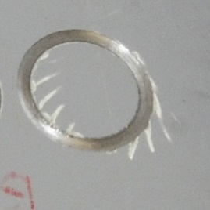
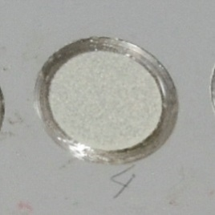
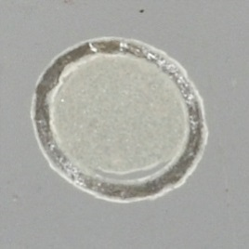
To Cut or not to Cut?
Cut or un-cut | Average
Uncut | 10.4
Cut Post Adherance | 9.5
Cut Pre Adherance | 9.9
The average results indicate that cutting the dolly has an impact on the test results, but this effect is reduced if the cutting occurs before the dolly is adhered
Note that the cutting process is uncontrolled and that these tests were carried out in lab conditions thus the data may not be replicated in the field
Freehand
Pre-cut
Post-cut

Slide 24
Applying the Load
The different methods of applying the load to an adhesion gauge are thought to affect the results obtained
  Dollies were glued to a coated surface and tested by applying loads in different ways to replicate the manual type II and type III gauges
  Initial results would suggest that the method of loading has little effect providing the load on the dolly is not allowed to “relax” for too long
Set | Test A (MPa) | Test B (MPa) | Test C (MPa)
 | ½ rev and 2 seconds | ½ rev and 10 seconds | 1 rev a second
1 | 10.1 | 10.3 | 10.5
2 | 11.2 | 9 | 11.5
3 | 11 | 10.5 | 8.7
4 | 10.5 | 8.6 | 10.4
5 | 9.6 | 10.5 | 10.2
Average | 10.9 | 9.9 | 10.3

Slide 25
Conclusions
Epoxy 2 Pack Adhesive should be mixed as close as 1:1 as possible
The glue manufacturer or type is irrelevant, providing the bonding strength is greater than that of the coating being tested
The base of the dolly should be as thick as possible within the design limits of the dolly
An abraded coating surface, and a blasted dolly surface give the best preparation for a successful adhesion test
Whilst an increase in temperature may speed up the cure time required, testing should be at “room temperature” wherever possible to ensure the best results
If dolly cutting must be done, pre-cutting is preferable
Load application should be smooth with minimum delay

