Slide 1
  PROTECTIVE COATINGS
  By
  Chris Heron
  Customer Support Engineer

Slide 2
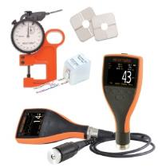
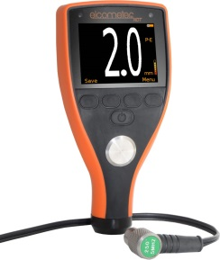
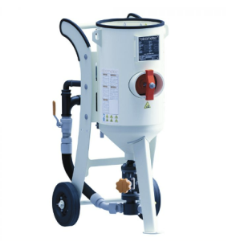
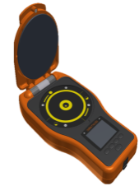
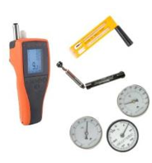
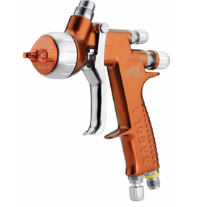
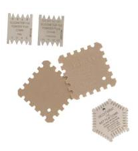
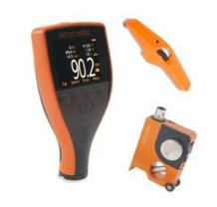
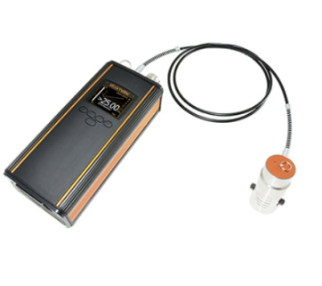
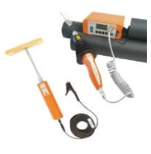

Material Thickness
Abrasive Blasting
Surface Profile
Surface Cleanliness
Climate
Spraying
Wet Film Thickness
Dry Film Thickness
Adhesion
Pinhole & Porosity
Inspection Kits

Slide 3
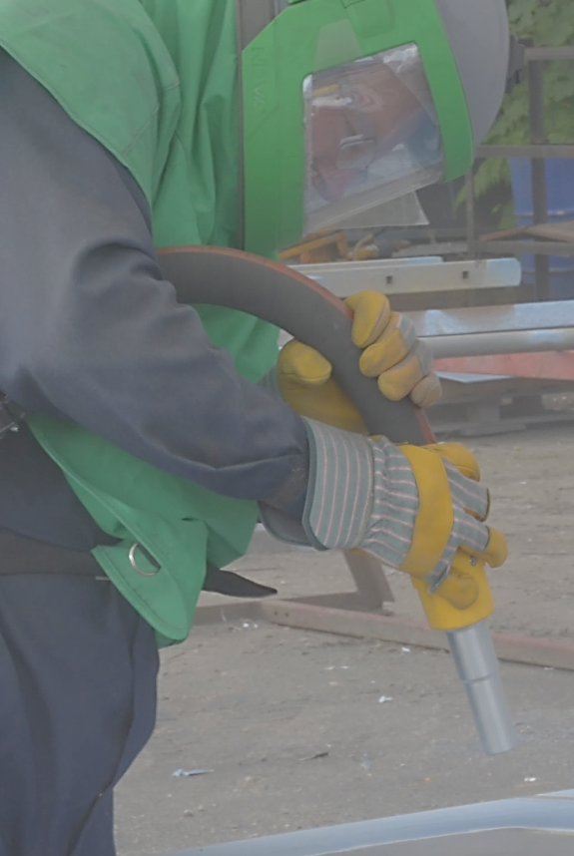
  Surface Preparation

Slide 4
  Blast cleaning is used to:
    Remove contamination from substrates prior to applying protective coatings
    To provide an anchor pattern to increase adhesion of paint coating
  The surface conditions after blasting can be:
      Measured for Profile
      Measured for Roughness
      Visually assessed for Appearance

Slide 5
    Profile vs Roughness
    Profile is not the same as roughness and vice versa
    Profile is measured by average peak to valley height in a small area
    Roughness measures amplitude fluctuations over a wavelength
    Consider the following surfaces :-

Slide 6
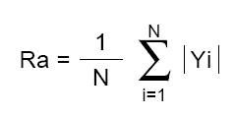

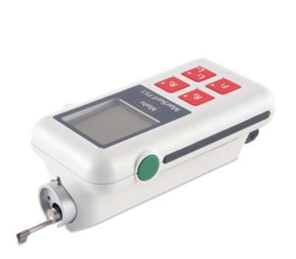
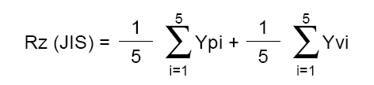
  Profile vs Roughness
  Profile can be measured easily with simple instrumentation
  Roughness requires sensitive instrumentation and complex formulae
    e.g.

Slide 7
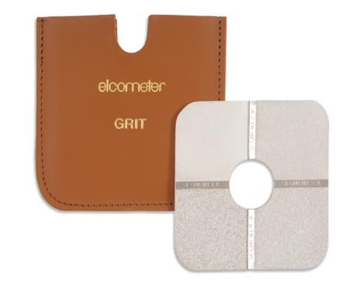
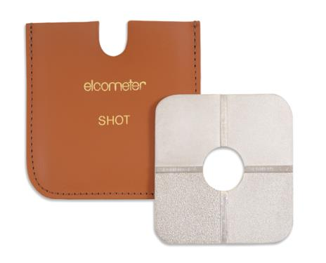
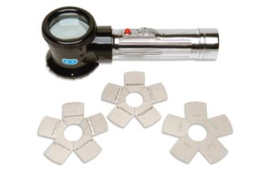
    ASTM D4417 Method A - Surface Comparator
    Elcometer 125
      Method of Use
        Visual or Tactile Comparison with
        blast cleaned surface
        Finer than Fine, Fine, Medium, Coarse &
        Coarser than Coarse ratings
      Quick to use, durable, low cost per test
      Verify by visual inspection

Slide 8
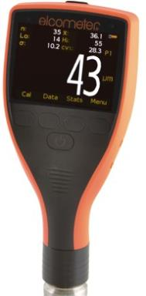
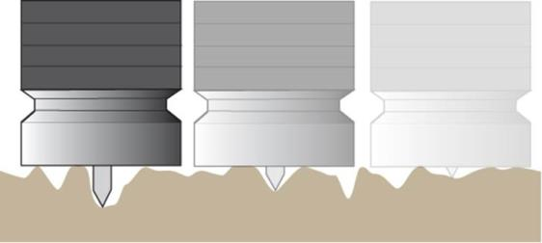
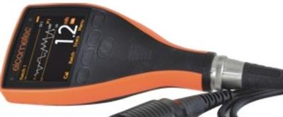
    ASTM D4417 Method B – Dial Depth Gauge
      Method of Use
        Set zero on flat surface (Glass slide)
        Take average of 10 readings in same area
      Quick to use, durable, low cost per test
      Calibration check against glass slide
      Verify by visual inspection of tip, field check using shims

Slide 9
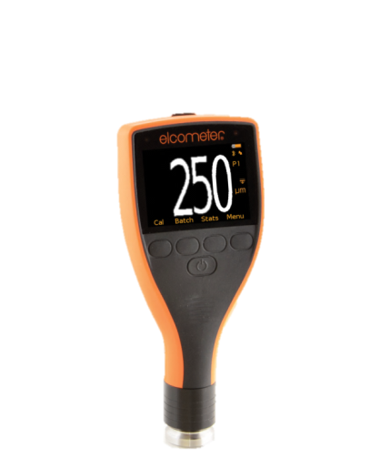
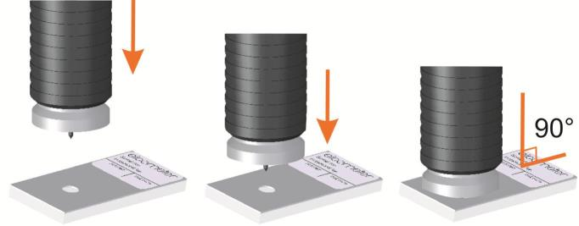
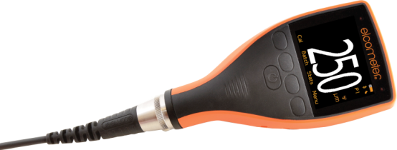
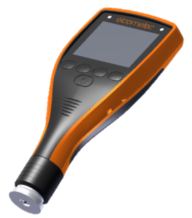
Calibrating the gauge is a simple process of zeroing on a smooth glass “zero” tile
The new Elcometer 224 has on screen instructions to guide the user through the calibration process

Slide 10
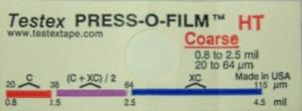
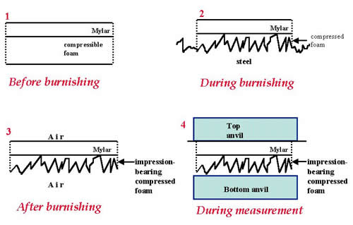
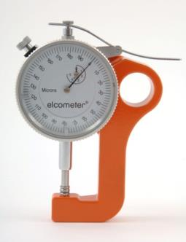
    ASTM D4417 Method C – Replica Tape
      Method of Use
        Create surface impression with 4 grades of Mylar tape
        Take average of either 3 or 6 readings in same area
      Slow to use, high cost per test
      Calibration of snap gauge only
      Verify snap gauge using shims

Slide 11

Elcometer 122/124
Testex Tape :
There are four ranges of tape
Coarse minus (C-) (not used in blast profiles)
Coarse (C) for 20-38μm profiles
X-Coarse (XC) 64-115μm
X-Coarse plus (XC+) for profiles between 115-127μm
  Special test required for profiles between 38 and 64 microns
Notes:
The tape is easy to use and provides a permanent record of the test for the project records.

Slide 12
https://youtu.be/vMws9YLPt8Y
Notes:
The tape is easy to use and provides a permanent record of the test for the project records.

Slide 13
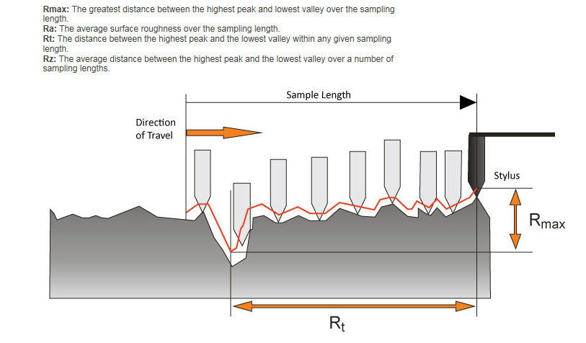
    Elcometer 7061

Slide 14
  Surface Cleanliness

Slide 15
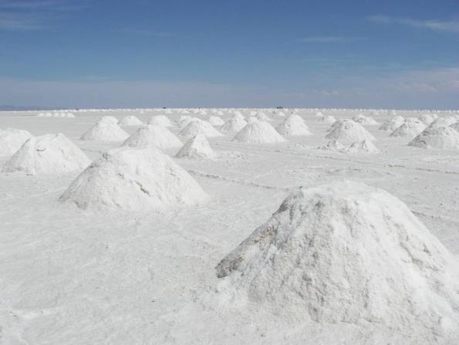
  Chloride Salt Detection

Slide 16
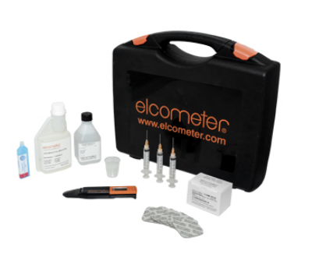
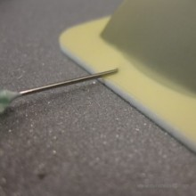
Surface Salt Measurement Methods
    Elcometer 138 - Bresle Patch
    ISO 8502-6/9
      Method of Use
        Adhesive Patch applied to surface
        Water injected and agitated to extract salts
        Water removed and tested for conductivity
      Verify by conductivity
        Temperature compensation to 25ºC
      Many ‘alternative’ patches available

Slide 17
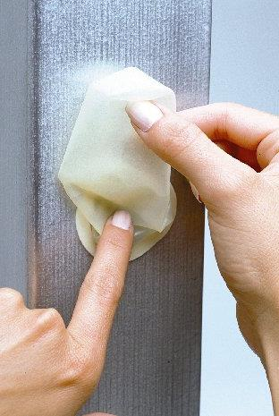
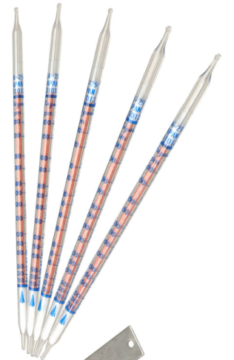
Surface Salt Measurement Methods
    Elcometer 134 Chlor*Test
      Method of Use
        Pour test solution into sleeve
        Place sleeve on surface & work solution
        Remove sleeve with solution
        Test solution with titration tube
      Multiple concurrent tests possible
Surface Profile

Slide 18
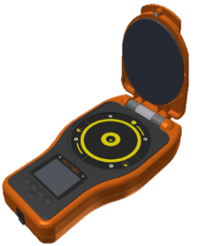
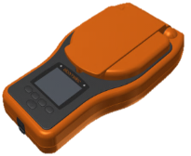
Elcometer 130
  Model S: Surface Cleanliness Measurement Mode
  Range: 0 - 25µg/cm2
  Accuracy: ±1% of the reading plus ±0.1μg/cm2
  USB data output to ElcoMaster 2.0 (live readings only)

Slide 19
Elcometer 130
  Model T: Surface Cleanliness & Conductivity Measurement Modes
  Extended measuring range, multiple measuring units, user selectable statistics, memory, upper limit, batching and review graphs to the user
  USB & Bluetooth data output to ElcoMaster 2.0

Slide 20
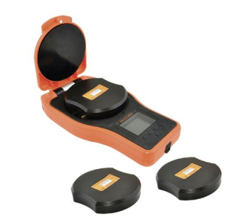
The gauges are calibrated using Calibration Verification Tile Sets in
accordance with Certification Procedures
    Optional Calibration Verification Tile Sets
    Supplied as a set of 3, these tiles can be used to verify the accuracy of the gauge calibration at 0.4, 5 and 20µg/cm2.

Slide 21
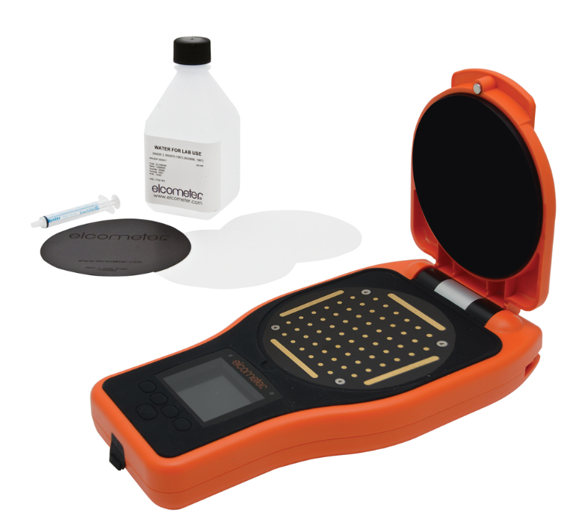
Surface Cleanliness
Elcometer 130 Soluble Salt Profiler
  Latest technology allows mapping of salt density over paper area
  Reveals peak salt concentration as well as average
  Peak salt concentration areas cause localised corrosion cells – rust spotting

Slide 22
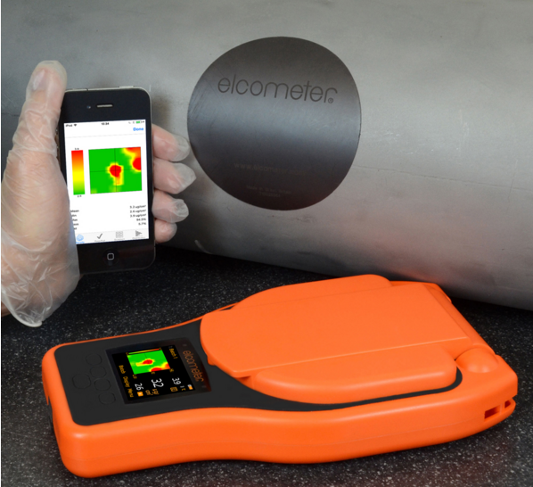
Surface Cleanliness
Elcometer 130 SSP
  Compatible with Android / Iphone
  Density expressed as hotspots
  3D images
  Pass / Fail salt map

Slide 23
Surface Cleanliness
https://youtu.be/Cu6GBwCx02E

Slide 24
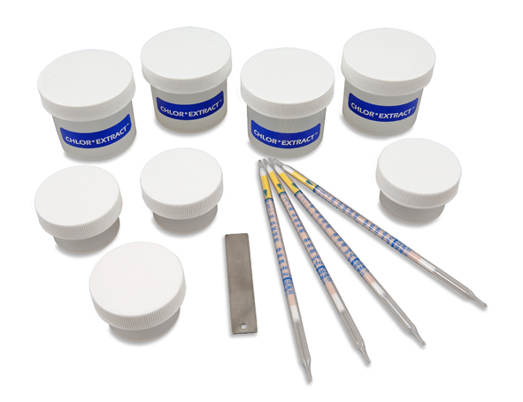
134A - Salt Detection in Abrasives
Surface Cleanliness
CHLOR*TEST - A™
It is important to detect salt in abrasives to prevent salt being blasted back onto surface during cleaning
Four tests per kit
Simple to use
Notes:
Kits are also available for testing abrasives and water. Abrasives are tested as they are often reused and salt contamination can build up in the recycling process. Water should be tested if it is to be used to wash down a blasted surface to remove dust.

Slide 25
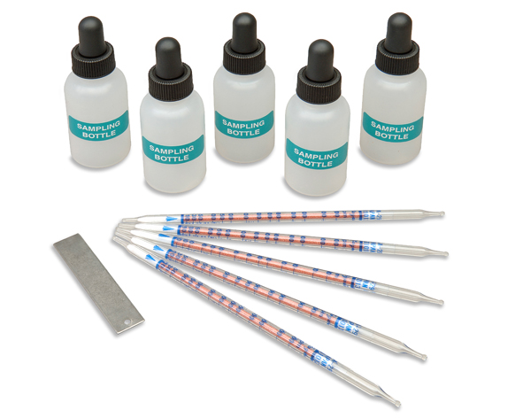
134W Salt Detection in Water
Surface Cleanliness
CHLOR*TEST - W™
5 Tests per kit
Place sample in clean test bottle using dropper
Test with titration tube
Notes:
For testing water the kit is very simple. A sample of the water is taken using the clean dropper and placed in the clean test bottle.

Slide 26
  Other Surface Cleanliness Tests

Slide 27
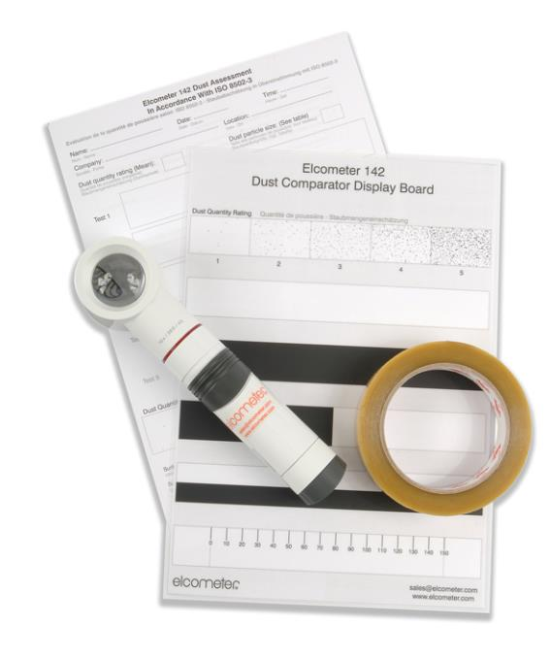
Surface Cleanliness
Elcometer 142 Dust Kit
  Assessment of quantity and size of dust particles on a surface
  Used as a pass / fail device
  Permanent record of test
  Dust comparator display board
Notes:
This image shows the effect of the different cutter angles on the same thickness of coating.

Slide 28
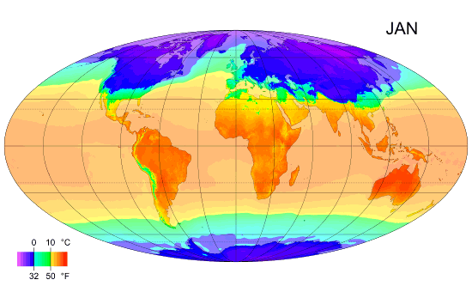
  Climatic Monitoring
Main Menu

Slide 29
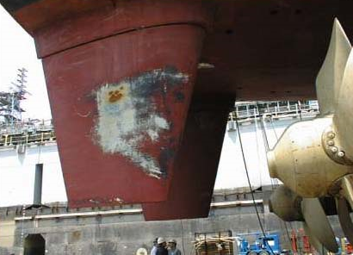
Coatings can only be applied in the right conditions
Poor conditions can result in poor curing and adhesion, leading to failure
The key parameters are
  Relative Humidity
  Air Temperature
  Surface Temperature
  Dewpoint Temperature

Slide 30

Relative Humidity
A ratio of the amount of moisture in the air at a given temperature to the maximum amount of water that the air at that temperature can hold expressed as a percentage
Saturation - 100% RH

Slide 31
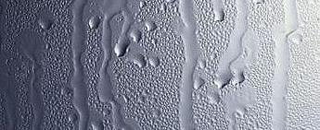
Dew Point Temperature
The temperature at which the moisture in the air condenses as water
    The surface temperature must be a minimum of 3 degrees above the dew point temperature. (Delta T)

Slide 32
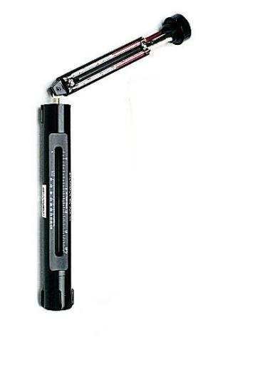
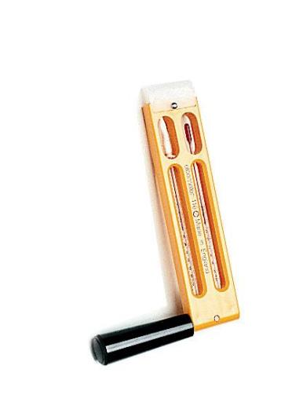
Elcometer 116 Whirling/Sling Hygrometers
Wet bulb temp decreases as it dries
Dry bulb temp stabilises
  Sling – 116A
  Bacharach – 116C
116A
116C
Notes:
The Elcometer 116A and 116C are now fitted with spirit thermometers to avoid the use of mercury which is now a banned substance.
Both have reservoirs of clean water to moisten one of the bulbs using a wick. As the thermometers are whirled the moisture evaporates at a rate dependant on the humidity. Evaporation causes cooling so the dry bulb will show a higher temperature than the wet bulb. This temperature depression is a measure of humidity.

Slide 33
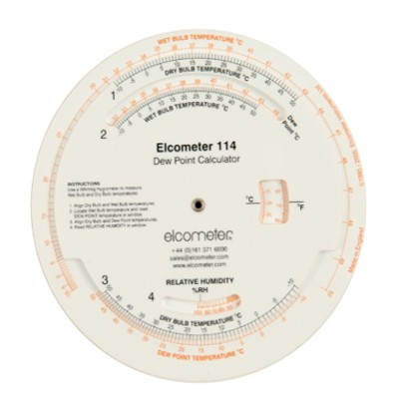
Elcometer 114
Dewpoint Calculator
Notes:
The wet/dry bulb calculation can be carried out using the Elcometer 115. The top half calculates the dewpoint from the wet and dry bulb values and the bottom half uses the dewpoint and the dry bulb temperature to calculate the relative humidity.
The example given in typical of conditions in Manchester.

Slide 34
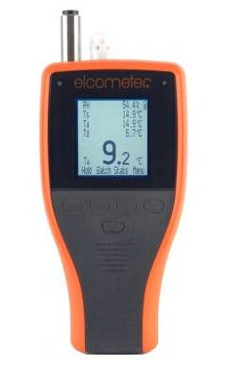
Elcometer 319 Dewpoint Meter
  Available as standard or top models
  Measures all relevant climatic properties
  Fully compatible with ElcoMaster™
Notes:
This image shows the effect of the different cutter angles on the same thickness of coating.

Slide 35
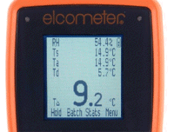
Key features
  Easy menu-driven user interface in multiple languages
  Clear illuminated display showing up to five parameters from
    RH: % Relative Humidity
    Ts: Surface Temperature
    Ta: Ambient Air Temperature
    Td: Dewpoint Temperature
    ΔT: Difference between the dewpoint and surface temperatures
    Tdb: Dry bulb temperature
    Twb¹: Wet bulb temperature
¹ Calculated Value

Slide 36
https://youtu.be/X9lx0IHrHjQ

Slide 37
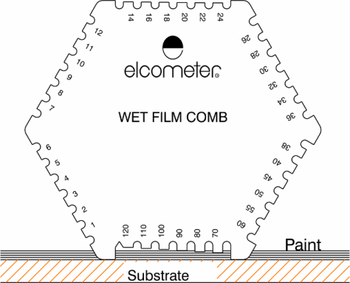

  Wet Film Thickness
Main Menu
Notes:
Wet film thickness is the first opportunity for the operator to check his work and the earliest point to correct any short fall in coating thickness. Every paint applicator should have a wet film comb.

Slide 38


Elcometer 3230 Wet Film Wheel
Different scales available
Notes:
The Elcometer 3230 Wet Film Wheels were formally known as Elcometer 120. They have an eccentric inner wheel with two concentric outer wheels. The distance from the outer wheel to the inner wheel at any point is shown on the scale marked on the outer wheel.

Slide 39

Elcometer 112 Hexagonal Wet Film Combs
  3 different scales available
  Punched Aluminium
  Accuracy ±5% of marked value or
  3μm (0.12mil) whichever is the greater
Notes:
Hexagonal wet film combs offer a broad range of values for general purpose use. They can be fabricated from stainless steel for long life or from aluminium for low cost.

Slide 40


Elcometer 115
  Precision formed Stainless Steel
  Certificate available
  4 scale ranges
Elcometer 3238
Long Edge Wet Film Comb
  3 scale ranges
Notes:
The Elcometer 115 has long been the main product in this group. Formed using the wire erosion technique, the teeth markings are accurate to a couple of microns. These combs are hard wearing and can be be issued with a calibration certificate.
The four combs supplied as a set come in a leather wallet.

Slide 41
Dry Film Thickness
Main Menu

Slide 42
Dry Film Thickness
Destructive
Main Menu

Slide 43

Elcometer 141 P.I.G.
Paint Inspection Gauge
  Different cutters for different thicknesses of coating
Illuminated Microscope
  x50 Magnification
Notes:
Destructive coating thickness measurement is important as not all coating/substrate combinations can be measured using non-destructive techniques.
The Elcometer 141 is the Elcometer design for the Paint Inspection Gauge using an ergonomic cutting method to make the system easier to use in the field.

Slide 44

121/4 Paint Inspection Gauge - PIG
  Successor to 121/3
  Available as a standard or top
  Destructive test
  Quick, versatile method of coating thickness examination
  Top version holds 3 cutting tools
  Built in 50x microscope
Notes:
This image shows the effect of the different cutter angles on the same thickness of coating.

Slide 45


No 4
P.I.G. Operation
  Sectional View of Cuts
  View Through Microscope
  Count number of divisions and multiply by cutter factor
No 1
No 6
Coating
4 divisions
Notes:
This image shows the effect of the different cutter angles on the same thickness of coating.

Slide 46


Slide 47
Mechanical Coating Thickness Gauges
Main Menu

Slide 48

Elcometer 211
  Known as the Banana Gauge
  ± 5% accuracy
  “Fixed” calibration
  Metric & Imperial Scale options
  Used in hazardous environments
  Can be used underwater
Notes:
The Elcometer 211 was developed to improve the accuracy of pull-off gauges to +/- 5% accuracy from the +/- 10% performance of the 111 and to increase the range of the most popular product, the scale 1.
The 211 is known as the banana gauge due to its shape.

Slide 49
Electronic Coating Thickness Gauges
Main Menu

Slide 50

First Principles ….
Electronic gauges can only measure on
metallic substrates
If the substrate is magnetic ( ferrous ) then the
gauge uses Electromagnetic Induction
If the substrate is non-ferrous ( non magnetic )
then the gauge uses Eddy Current technique
Notes:
Moisture in building and building materials including wood, brick, plaster, concrete is of interest if the materials are to be coated but it is also a requirement for surveying and appraisal.

Slide 51
Electromagnetic Induction
Coils inside the gauge generate a low frequency magnetic field.
The variation of the field is proportional to the distance between the probe tip and the substrate
A measurement coil measures the magnetic field
Notes:
Moisture in building and building materials including wood, brick, plaster, concrete is of interest if the materials are to be coated but it is also a requirement for surveying and appraisal.

Slide 52
Eddy Current
Coils inside the gauge generate a high frequency magnetic field.
These induce Eddy currents into the substrate
The strength of the Eddy currents are proportional to the distance between the probe and base material
The Eddy current magnetic field strength is then measured
Notes:
Moisture in building and building materials including wood, brick, plaster, concrete is of interest if the materials are to be coated but it is also a requirement for surveying and appraisal.

Slide 53

Discuss whether the following can be measured …
Paint on lead
Paint on plastic
Paint on iron
Paint on wood
Gold on copper
Notes:
Moisture in building and building materials including wood, brick, plaster, concrete is of interest if the materials are to be coated but it is also a requirement for surveying and appraisal.

Slide 54

456C Coating Thickness Gauge
  Robust ergonomic design
  USB and Bluetooth data output to ElcoMaster ™ 2.0
  Accurate to 1-3% of range
  70+ readings per minute
Notes:
A number of optional accessories are available for the 456. The jumbo handgrip is for operators who wear thick industrial gloves. The V-adapter is for round surfaces such as pipes. The portable printer connects to the gauge with a cable where as the Infrared printer is a line-of-sight remote connection over about 0.5M using the Infrared port of the gauge to transmit.

Slide 55

Key Features
Fast reading rate of more than
70 readings per minute
Dust and water resistant
rugged design to IP65
Specialised probes to meet a
wide range of applications
Secure probe connection for
improved durability
USB and Bluetooth® data output
to ElcoMaster 2.0 software
Integral and separate gauges to measure
coatings up to 30mm thick

Slide 56

To select the correct instrument for the job you need to know…
What the substrate is made of
What the coating is
What thickness the coating is
Integral or separate probe desired
Data storage required ?
Notes:
Moisture in building and building materials including wood, brick, plaster, concrete is of interest if the materials are to be coated but it is also a requirement for surveying and appraisal.

Slide 57
Elcometer 456C
Ferrous, Non-Ferrous and Dual FNF
  Other Options
    Basic
    Standard
    Top
  Basic now features Bluetooth for single reading transfer
  Standard & Top have USB and Bluetooth output
  Standard 1500 readings in 1 batch
  Top 250,000 readings in 1500 batches
Notes:
The Elcometer 456 is the most popular of the Elcometer coating thickness gauges.
It is available as Basic, Standard or Top software options with either integral or separate probes and F, N or dual FNF operation.
This is the Elcometer philosophy of Customer choice in operation.

Slide 58

Notes:
The Elcometer 456 is the most popular of the Elcometer coating thickness gauges.
It is available as Basic, Standard or Top software options with either integral or separate probes and F, N or dual FNF operation.
This is the Elcometer philosophy of Customer choice in operation.

Slide 59
https://youtu.be/0eQLTmZnV4U
Notes:
The Elcometer 456 is the most popular of the Elcometer coating thickness gauges.
It is available as Basic, Standard or Top software options with either integral or separate probes and F, N or dual FNF operation.
This is the Elcometer philosophy of Customer choice in operation.

Slide 60

Scanning Probe
  A new 456C probe for scanning a coated surface
  Scan an area then lift the probe to display :
    Average coating thickness
    Maximum coating thickness
    Minimum coating thickness
Notes:
A number of optional accessories are available for the 456. The jumbo handgrip is for operators who wear thick industrial gloves. The V-adapter is for round surfaces such as pipes. The portable printer connects to the gauge with a cable where as the Infrared printer is a line-of-sight remote connection over about 0.5M using the Infrared port of the gauge to transmit.

Slide 61

Scanning Probe
  Readings can be displayed on a run graph
  Auto repeat mode takes & stores data every 0.5 secs
  Snap on replaceable cap
  40% faster when used with SSPC PA2
    Fixed batch size ( 5 )
    Counted average ( 3 )
Notes:
A number of optional accessories are available for the 456. The jumbo handgrip is for operators who wear thick industrial gloves. The V-adapter is for round surfaces such as pipes. The portable printer connects to the gauge with a cable where as the Infrared printer is a line-of-sight remote connection over about 0.5M using the Infrared port of the gauge to transmit.

Slide 62

Coating Adhesion
Main Menu

Slide 63

Method selection
  Cross Cut
    Fast low cost
    Flat surfaces only
    Up to 250 µm (10 mil)
  Pull Off
    Use dollies
    Slower due to time for adhesive cure
    Flat & Curved surfaces
Notes:
These are the benefits and limitations of the two adhesion testing methods.

Slide 64

Elcometer 1540 Cross Cut Tester
  1 mm cutter 11 teeth
  Gives 100 squares
  Easy to assign adhesion percentage
Notes:
The blade is easier to use for cross hatch cutting, as one pass gives 11 cuts simultaneously in one direction and a second cut at right angles produces a 10 by 10 matrix of 1 mm squares. The percentage damage can be easily calculated.

Slide 65


Elcometer 107 Cross Hatch Cutter Kits
Notes:
The Elcometer 107 is ideal for field testing on structures.
The ISO and ASTM kits differ in the blade spacing and the type of tape required for each test.

Slide 66

Elcometer 1542 Cross Hatch Adhesion Tester
  Ideal for test panels
  Wheeled carriage for greater stability
Notes:
The Elcometer 1542 is ideal for adhesion testing on test panels.

Slide 67
Pull-off Methods - Common Issues
  Use adhesive to attach dolly to coating
  Measure force to remove coating
  Ensure dolly face is rough for good contact
  Choice of adhesive
Substrate
Notes:
All the pull-off methods attach a dolly to the coating and measure the force required to remove the dolly and the coating from the surface.
Glue failures are not valid and the test has to be repeated.
Cohesive failures within a coating will occur at values below the optimum adhesion particularly if the coating has been exposed to water or moisture. If in these circumstances coating has been retained on the surface, the protective properties of the coating have been maintained.
Some adhesives attack certain types of coatings. Some adhesives cure very quickly and other require heating. The conditions of the test and the type of coating will dictate the best adhesive but always remember the adhesive must also be suitable for the metal of the dolly.

Slide 68




Adhesion Test Failure Modes
Glue Failure
  Failure of the applied adhesive
  Not an Admissible Test unless failure occurs above test specification
Adhesive Failure
  Coating to substrate or undercoat mechanical bond failure
  Admissible Test
Cohesive Failure
  Coating chemical bond failure
  Admissible Test

Slide 69

  Adhesive
  Failure
  Partial adhesive
  Failure
  Cohesive
  Substrate
  Failure
  Glue
  Failure

Slide 70


Elcometer 106 - ASTM type II - Pull-off Adhesion Tester
  5 Scales
  2 types – hand wind or ratchet
  Ideal for general applications
Notes:
The Elcometer 106 is an Elcometer design and was patented, however the patent is now out of date. There are five scales for coatings on metals, Scales 1 and 2 cover typical paints on metal surfaces, scales 3 and 4 cover adhesion values associated with sprayed metal coatings, flame sprayed aluminium and zinc and arc sprayed coatings. Scale 5 is used for testing adhesives.
The major limitation for the 106 is ensuring that the force is applied steadily and evenly within a 90 second time-to-failure test requirement.

Slide 71

  Elcometer 108 ASTM type III -Hydraulic Adhesion Tester
  0 - 18MPa range
  Dolly has a hole through the centre
  Through hole force pushes dolly away from surface
  Curved dollies available
  Supplied with heated tongs to clean dolly
  Designed for use on pipework and cylindrical surfaces
Notes:
The Hydraulic Adhesion tester was designed and developed by Conoco and Elcometer bought the design from Conoco some years ago. As a result Elcometer has improved the original design and now added a digital pressure gauge as an alternative to the analogue gauge.
The Elcometer 108 is popular for off shore anti-corrosion coatings , particularly sprayed metals coatings.

Slide 72

Elcometer 506 Digital Adhesion Tester
  Manual hydraulic operation
  Measures up to 50MPa
  Compatible with 14.2, 20 & 50mm dollies
  Dolly size selection button auto-ranges
  Course adjustment screw

Slide 73


Elcometer 506 Adhesion Gauge
Designed to orientate load to minimise shear effects
Digital and Analogue versions available
Actuator skirt options available for thinner substrates
Usable on metal, wood, concrete and other substrates
Available with field verification unit

Slide 74

Elcometer 506 Adhesion Tester
  Different ‘skirts’ available
  Large skirt for 50mm dolly
  Narrow skirt for thin substrates
  Standard skirt for 14.2 & 20mm

Slide 75




Elcometer 510 - ASTM type V -Automatic Adhesion Gauge

Slide 76
Elcometer 510:
  Model S
    An entry level gauge
    Battery Powered
    Defined pull rates
    60 reading memory
    USB output to ElcoMaster 2.0;

Slide 77

Elcometer 510:
  Model T
    Battery and Mains Power
    USB & Bluetooth (Android and iPhone, iPad, iPod)
    Up to 60,000 readings in 2,500 alphanumeric batches
    Cohesive/ adhesive attribute information,
    Pull rate graph
    Pull to Limit setting

Slide 78









Variable pull rates 0.1 – 1.4MPa/s (15-203psi) to meet national and international standards
Smooth and continuous pressure application for consistently repeatable results
MPa, psi, N/mm² and N
Store up to 10,000 readings, 2,500 alpha numerical batches with attributes and pull rate graphs
Pull to maximum or to a pre-defined limit (non-destructive test)
10mm dolly: <100MPa (14400psi)
14.2mm dolly: <50MPa (7200psi)
20mm dolly: <25MPa (3600psi)
50mm dolly: <4MPa (580psi)
Optional thin substrate skirt
.

Slide 79


Cohesive / Adhesive Failure Attributes

Slide 80
https://youtu.be/xOJp-uOYQCs

Slide 81
Porosity Detection in Coatings
Main Menu

Slide 82

Definition of Porosity
A flaw or defect in the cured coating that reduces the effectiveness of the coating as a protection against corrosion.
Notes:
Porosity in coatings can be caused by a number of coating and application problems but there are many application such as linings for storage tanks and pipelines where no porosity can be allowed in the coatings.

Slide 83
Porosity Test Methods
  Low Voltage (Wet Sponge Method)
  High Voltage (DC / Pulsed DC) Holiday Detection
    (Also known as spark testing)
    - ONLY USE ON NON CONDUCTIVE COATINGS !!!
Notes:
There are two test methods for porosity, low voltage up to 90V and high voltage up to 30 kV (30,000V).
Elcometer offer a DC high voltage tester but some of our competitors also offer pulsed DC, where the voltage cycles from zero to the high value many times per second. Pulsed DC units are easier to make and therefore tend to sell at a lower value but the test is not the same as for a high voltage DC test.

Slide 84

Elcometer 270 Pinhole Detectors
  Low Voltage Method
  Wet Sponge Pinhole Detection ( wet sponge & squeeze out )
Notes:
The Elcometer 270 Wet Sponge Pinhole Detector has replaced the 204 and 269 in the Elcometer range. The product should be referred to as the damp sponge method but the original wet sponge method goes back to a simple “battery and bell” circuit developed in the 1930’s and using a sponge as the probe to deliver the moisture to the holes in the coating.

Slide 85
Summary - 270
  Suitable for non-conductive coatings on a conductive substrate
  9V for coatings up to 300 µm
  90V for coatings up to 500 µm

Slide 86
High Voltage Holiday Detection
High Voltage Holiday Detection is a method of locating flaws in electrically insulating protective coatings on conductive substrates.

Slide 87


Slide 88
Pulsed DC & Continuous DC Explained
Pulsed DC
The Elcometer 280 operates using this principle
Continuous DC
The Elcometer 236 and 266 operate using this principle
Voltage Applied
Time
Voltage Applied
Time

Slide 89

Elcometer 266
Continuous DC
5kV, 15kv & 30kv options
  Interchangeable handles
Auto/Digital voltage and sensitivity settings
Safety features
  For operator
  For coating

Slide 90

Elcometer 266 – Coating Safety
Current limiting
Voltage Calculator with digital
standards library
Integrated jeep tester

Slide 91

Elcometer 280
Pulsed DC
0.5 – 35kV range
Standard Gauge or Top Kit
Trailing earth lead
Auto/Manual digital voltage setting

Slide 92

The 2 Key Advantages of the Pulsed DC System
The pulsed DC system does not need the direct metal-to-metal ground contact and therefore can be used with a trailing lead.
The Elcometer 280 can be used to test for holidays over slightly conductive coatings, or dirty or damp surfaces up to 25mm thick

Slide 93










Accessories for Elcometer High Voltage Detectors
A wide range of electrodes and accessories is available :
  Band Brush Probes
  Wire Brush Probes
  Internal Pipe Brush Probes
  External ‘C-type’ Brush Probes
  External Pipe Rolling Springs
  Conductive Rubber Probes
  Grounding Mats

Slide 94
https://youtu.be/SwTjZOJDJ-s

Slide 95


Elcometer 165 - Elcopatch
High quality consistent repairs
Suitable for metal and non metal
Reduced wastage
Save time
Easy to use

Slide 96

Elcometer 165 - Elcopatch
Uses industry standard cartridges
Abrasion ring & abrading tool
Adhesion patch with fill indicator holes

Slide 97

Elcometer 165 - Elcopatch
Optional heater pack
Helps to ensure adhesive flows
Rechargeable battery

Slide 98




Elcometer 165 - Elcopatch

Slide 99


Slide 100
https://youtu.be/vtndOTylUmw

Slide 101
Questions ?
Notes:
The fifth certificate being considered is the Certificate of Conformity to Standards. This is applicable if a product has been made to meet the requirements of a particular national or international standard. Many of the inspection products are used in accordance with standards and the product is not defined within the standard in other than general terms. However, some of the physical test products and the Covermeters are made according to the requirement of specific standards and such a certificate may be appropriate.

