Slide 1
Paperless Quality Assurance
Presenter:
Daniel Leonard
Customer Support Engineer
Elcometer Limited
© Elcometer Limited 2012
Notes:
1

Slide 2
Paperless QA
Introductions

Slide 3
Paperless QA
Objectives
  Measure surface profile using a digital surface profile gauge in accordance with ASTM D 4417 Method B (Elcometer 224)
  Measure for surface cleanliness using a salt contamination meter in accordance with SSPC Guide 15 ( Elcometer 130 )
  Measure ambient conditions in accordance with industry standards using a digital dew point meter (Elcometer 319)
  Measure dry film thickness using a type 2 gauge in accordance with SSPC-PA 2 and other major industry standards (Elcometer 456)
  Create a digital Coating Technical Report by importing your readings directly from each of the gauge types into Elcomaster 2.0

Slide 4
Paperless QA
Course Outline
  Part 1: Measuring surface profile data using the Elcometer 224
  Part 2: Measuring surface salt contamination using the Elcometer 130
  Part 3: Measuring and recording climatic information using the Elcometer 319
  Part 4: Measuring dry film thickness using the Elcometer 456
  Part 5: Creating Paperless Quality Assurance reports with Elcomaster 2.0

Slide 5
Paperless QA
Course Format
  Lecture
  Hands on practical sessions
    Elcometer 224
    Elcometer 130
    Elcometer 319
    Elcometer 456
    Downloading data from a gauge in Elcomaster 2.0
    Creating a simple report in Elcomaster 2.0
    Detailed report creation in Elcomaster 2.0
  Written test
    25 multiple choice questions
    Creation of a coating technical report

Slide 6
Paperless QA
What is Paperless QA?

Slide 7
Paperless QA
Paperless
QA
Paper free. Carry out the procedure generating as few pieces of paper as possible.
Paper is easily lost and presents storage challenges
Quality Assurance: The maintenance of a desired level of quality in a service or product.
Quality is assessed and maintained through checks and inspections

Slide 8
Paperless QA
Download data from complete
range of Elcometer gauges
Store and organise
gauge data along with other
photographs notes and reports in one
place
Elcomaster 2.0
Monitor gauges remotely
over bluetooth
Communicate your data
effectively to any level
Create professional reports
using easy to design
templates
Create PDF report
files for easy printing
or emailing

Slide 9
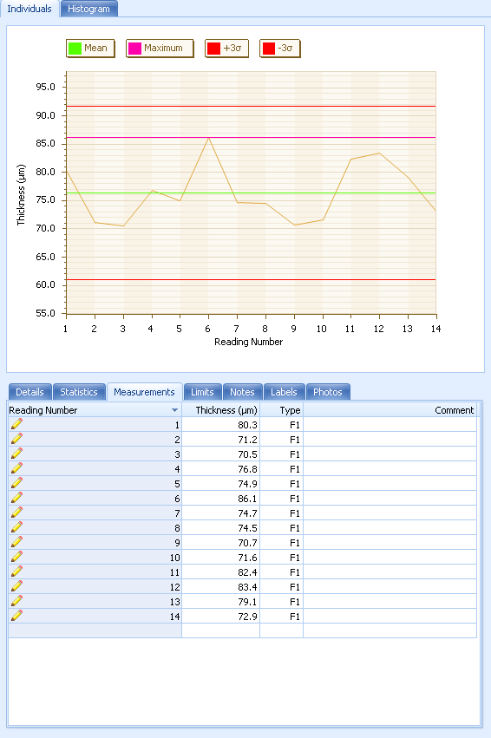
Paperless QA
Elcomaster 2.0 – Three key uses
A means of transferring data off the gauge, to store and to view
  Quick and easy record keeping

Slide 10
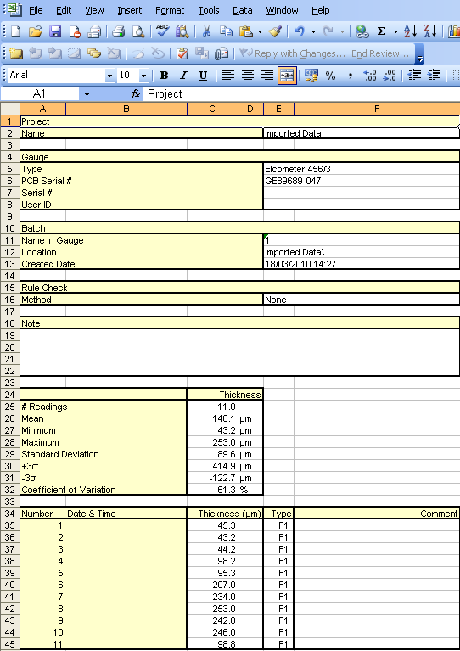
Paperless QA
Elcomaster 2.0 – Three key uses
A means of transferring data off the gauge, to store and to view
  Quick and easy record keeping
Exporting the gauge data to excel
  Saves all batch readings and header data
  Keep records or do further spreadsheet analysis

Slide 11
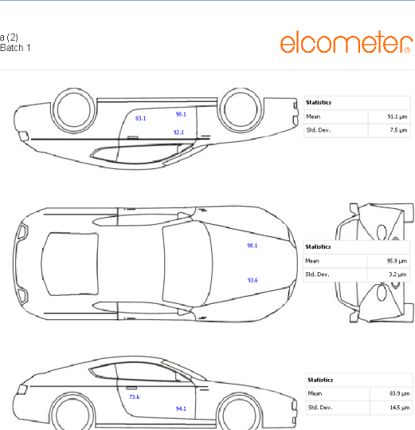
Paperless QA
Elcomaster 2.0 – Three key uses
A means of transferring data off the gauge, to store and to view
  Quick and easy record keeping
Exporting the gauge data to excel
  Saves all batch readings and header data
  Keep records or do further spreadsheet analysis
Creating professional, customised coating technical reports
  True paperless QA and record keeping
  No need for any other software

Slide 12

Paperless QA
Coating technical report
The report contains all of the data collected during the coating application process
Gauge readings, specifications, inspection documents and photographs/diagrams may be included in the report
Data needs to be stored, organised and presented coherently

Slide 13
Surface Preparation
Measuring blast profiles with the Elcometer 224

Slide 14
Paperless QA
Module Objectives
  Define surface profile
  Define the surface profile coating requirements of related industry standards
  Measure surface profile using a digital surface profile gauge, in accordance with ASTM D 4417, Method B
  Download data from the Elcometer 224 gauge into Elcomaster

Slide 15
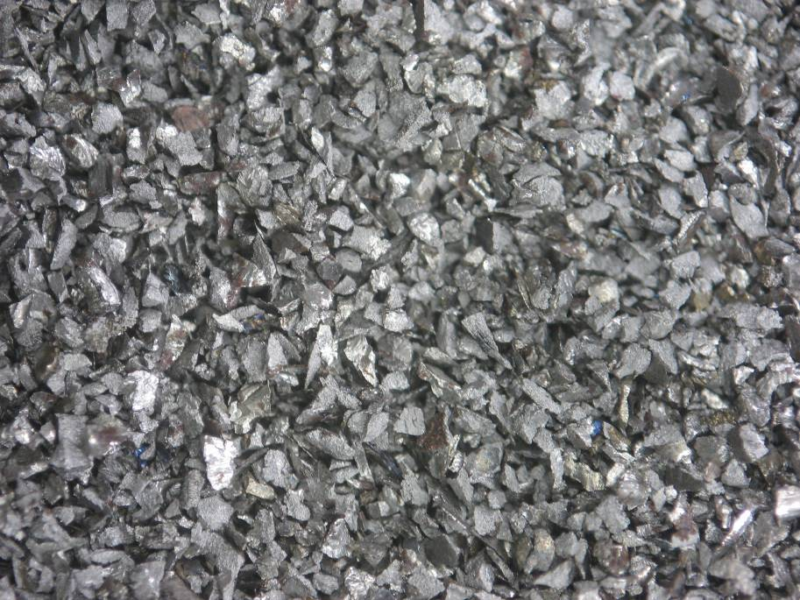
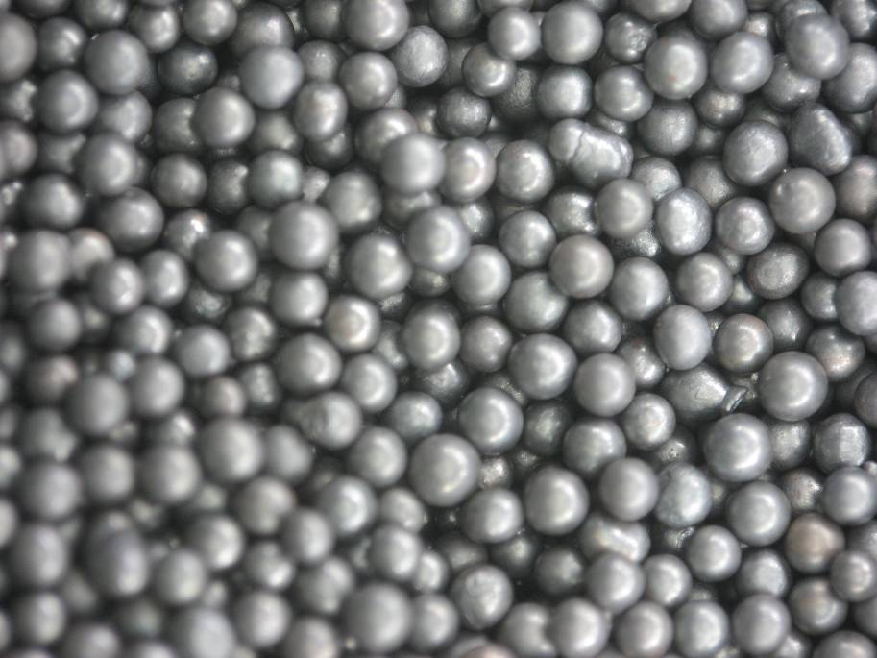
Paperless QA
  All materials have some kind of profile on the surface
  Large surface profiles are created during blasting
  The profiles created by grit, shot, garnet, copper slag will look and feel different even if the profile height is the same
Grit Shot
Grit
Shot

Slide 16
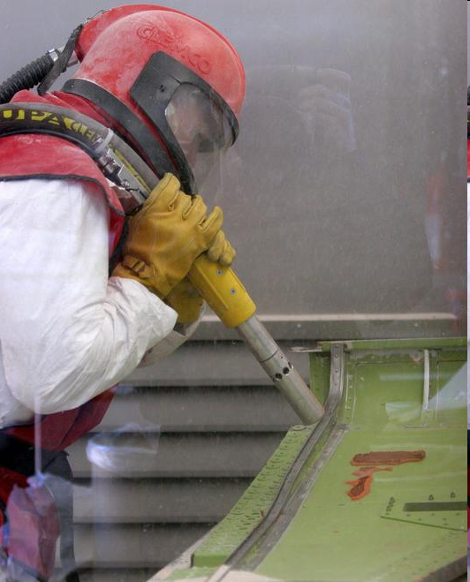
Paperless QA
What is a blast profile?
  The roughened surface that results from abrasive blast or power-tool cleaning on bare metal
  For steel surfaces: A measurement of the peak-to-valley height of this roughness
  Often expressed as an average
  Typically ranges from 25 to 125 microns
  Profile depth can be varied in two ways
    Blast media
    Blast pressure

Slide 17
Paperless QA
Why create a blast profile?
Promotes Adhesion
  Provides a “key” for the coating to cling to
  Too little profile – The coating will have poor adhesion and will fail prematurely
  Too much profile – More coating needed to fully cover the high peaks
  – Increased time to blast
  – Increased cost
  – Poor cure
  – Thinning of substrate
Removes some contamination
Notes:
17
Surface preparation is the key to good anticorrosion coating performance. A paint will only stick to a surface if it is clean. One benefit of blast cleaning is that it leaves a profile which also enhances adhesion.
Elcometer is concerned with the assessment or measurement of profile and cleanliness and these are separate processes.

Slide 18
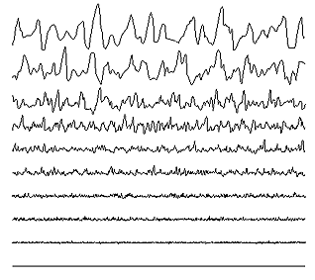
Paperless QA
Increasing peak to valley profile
Notes:
18
Surface preparation is the key to good anticorrosion coating performance. A paint will only stick to a surface if it is clean. One benefit of blast cleaning is that it leaves a profile which also enhances adhesion.
Elcometer is concerned with the assessment or measurement of profile and cleanliness and these are separate processes.

Slide 19
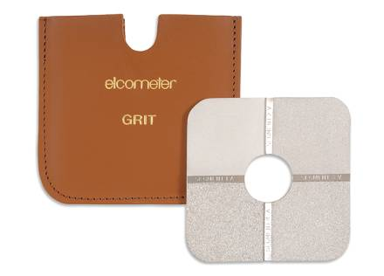
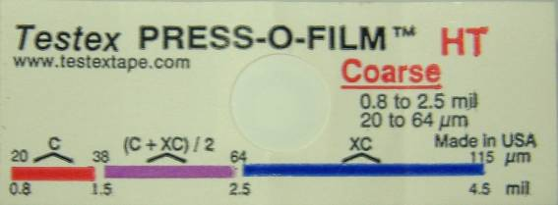
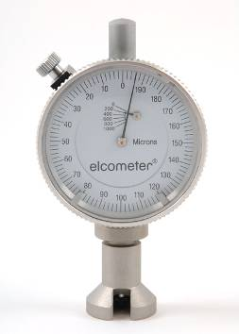
Paperless QA
How can it be measured?
  Comparators
    Quick way to characterise surface profile
    Potentially inaccurate, subjective
  Replica Tape
    Widely used established method
    Different grades required for different profiles
    Time consuming
  Surface profile gauges (Needle gauges)
    Fast, accurate method
    Generates paper, results normally recorded manually

Slide 20
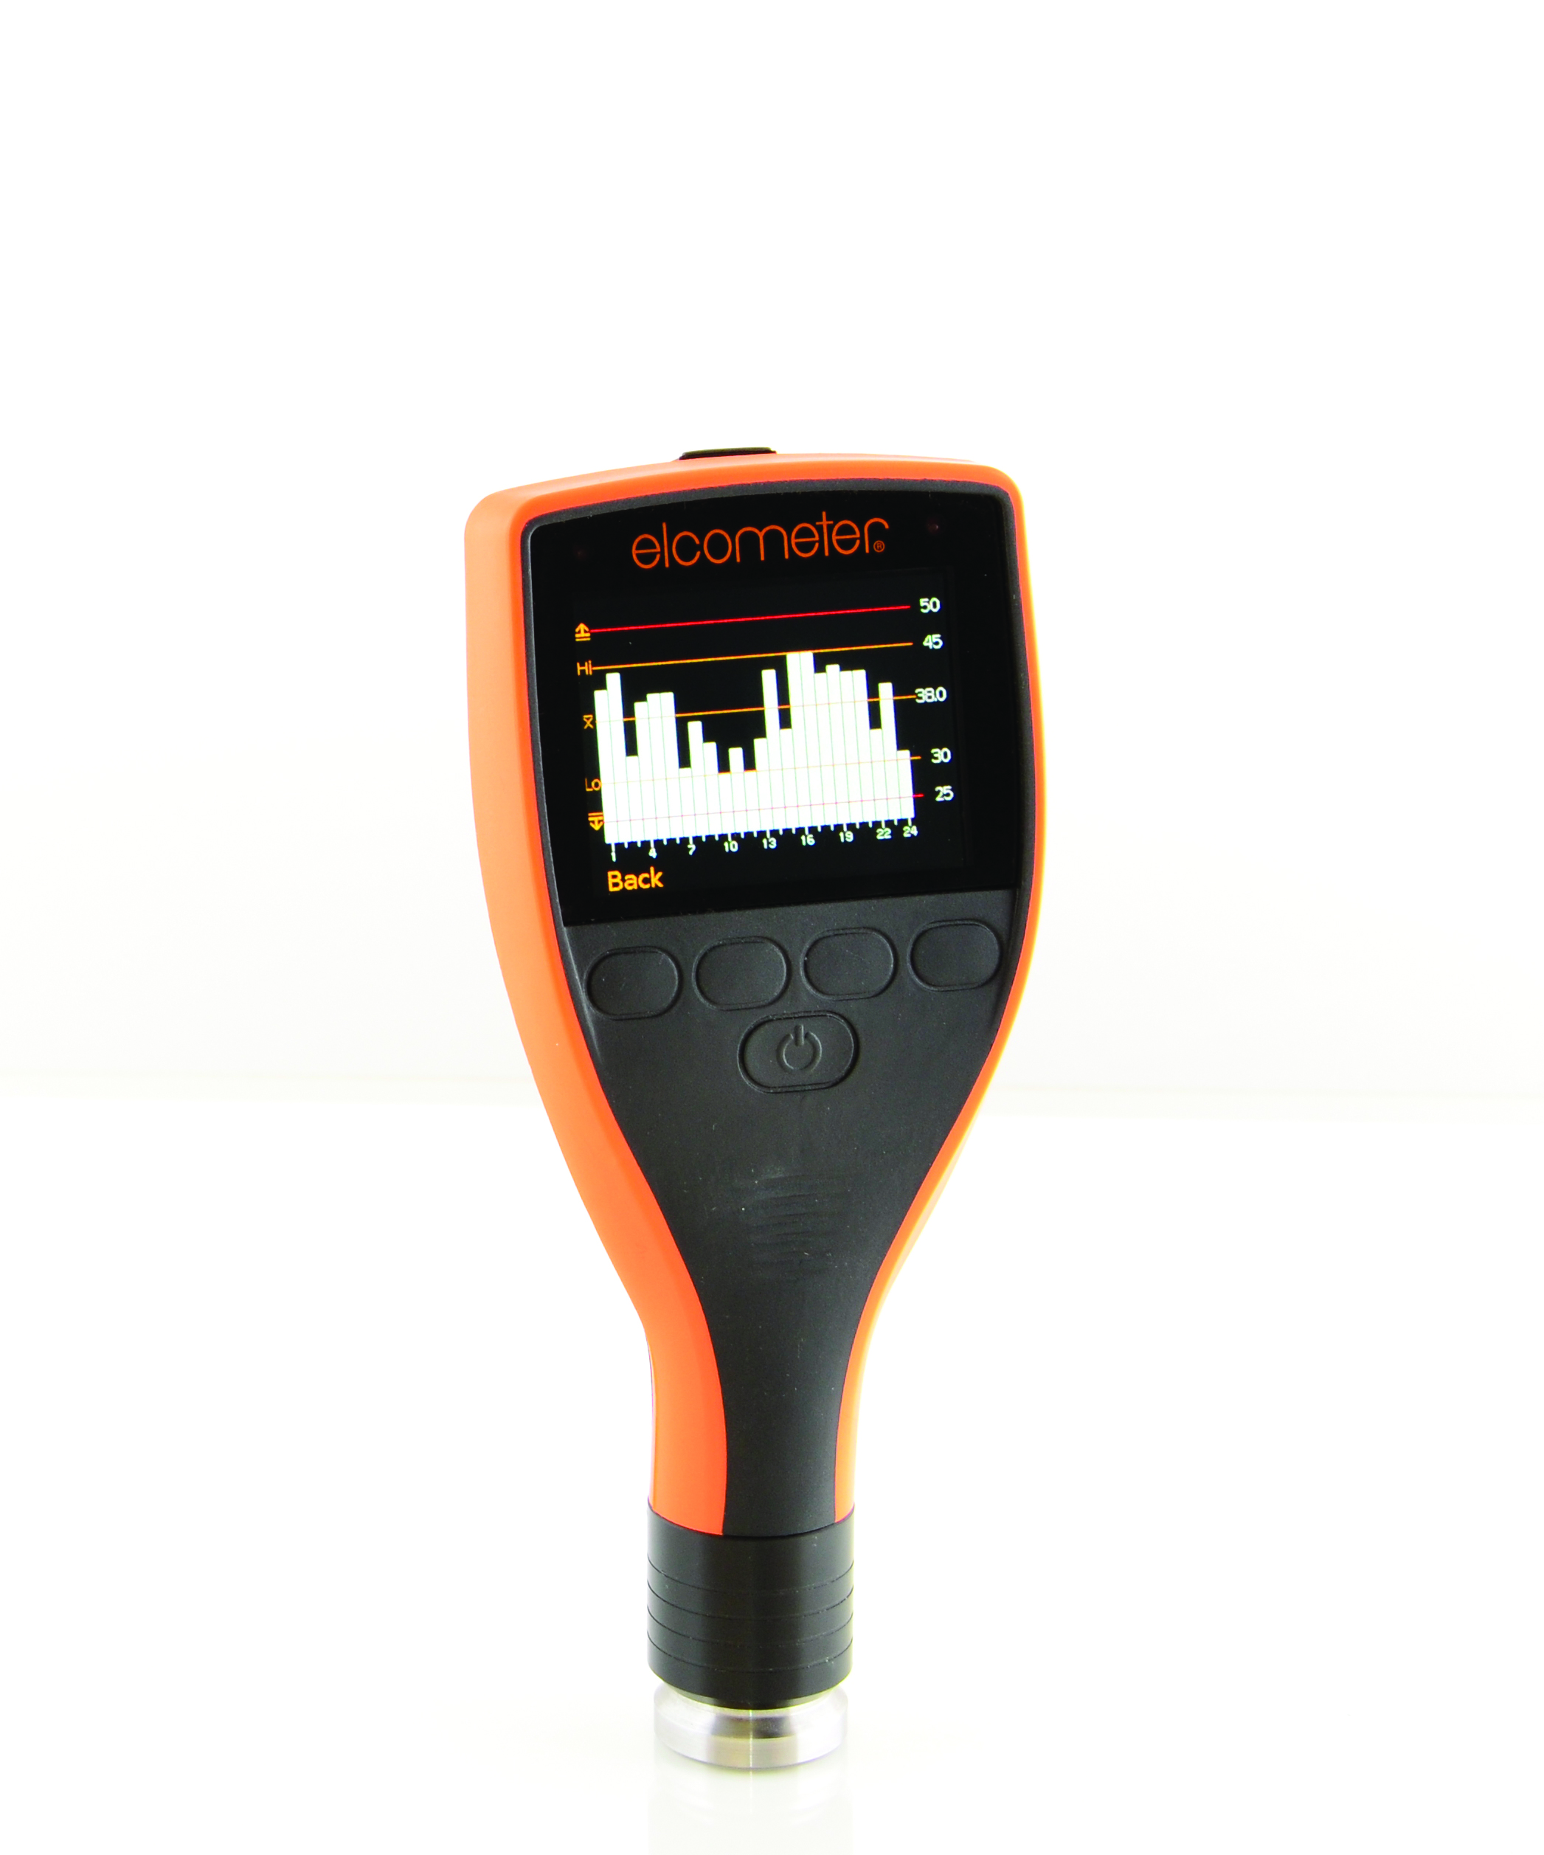
Paperless QA
Elcometer 224
  Digital surface profile gauge
  Available as standard and top models
  Standard and top models both come with statistics
  Top model stores data
  Compatible with Elcomaster 2.0
Notes:
20
This image shows the effect of the different cutter angles on the same thickness of coating.

Slide 21
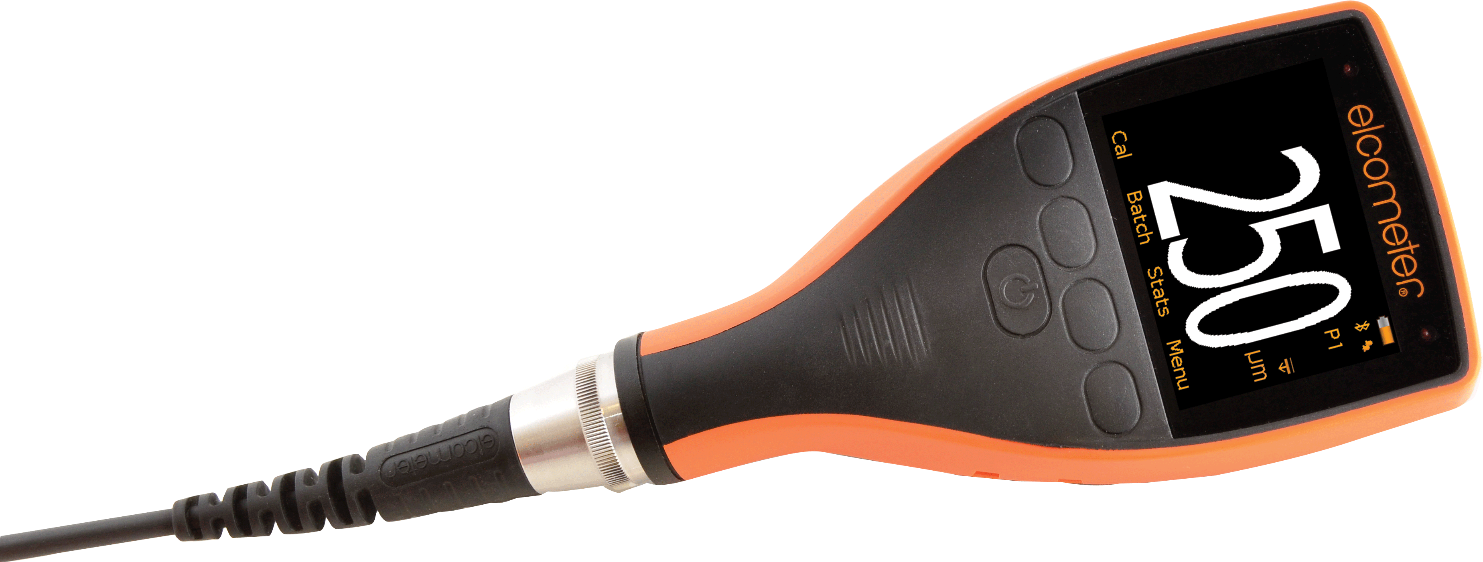
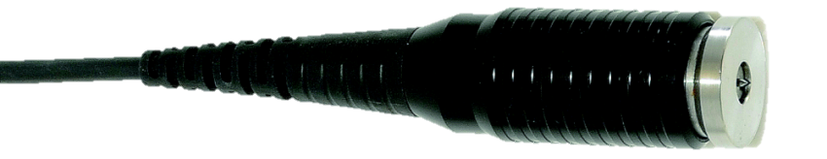
Paperless QA
Tungsten carbide user replaceable probe tips, suitable for up to
20,000 readings
Scratch and solvent
resistant screen
Large easy to read
colour display
Auto rotating display with tap awake feature
Dust and water resistant
rugged design to IP64
Separate probes available with standard or armoured, reinforced heavy duty cables
Large buttons with
positive feedback
Fast reading rate of more than
60 readings per minute
Compatible with ElcoMaster™ for Android™
Stores up to 150,000 readings in alpha numerical batches
Integral and separate gauges to measure surface profiles up to 500µm (20mils)
USB and Bluetooth® data output to ElcoMaster™ 2.0 software

Slide 22
Paperless QA
Advantages of Digital Profile Measurement
Accuracy
  Digital display
Speed
  Up to 60 readings per minute
  No calculation of averages necessary
Convenience
  Data can be stored in gauge and/or imported to Elcomaster 2.0 – Paperless QA

Slide 23
Counted Average Mode
Paperless QA
The “Counted Average” feature on the new Elcometer 224 is a useful technique for assessing an area of profile.
To establish the average surface profile, between 5 and 10 readings should be
taken within a 150 x 150mm (6 x 6”) area.
The average of these individual spot measurements provides the user with the peak-to-valley height over the measurement area.
The Counted Average records the average of the spot readings into the memory

Slide 24
Paperless QA
Demo: Opening a counted average batch

Slide 25
Paperless QA
Measurement Method
  Zero the instrument on toughened glass slide
  Open a new counted average batch in the 224
  Take an average of ‘x’ gauge readings as agreed or stated in the standard to produce a ‘measurement’.
  Readings or average of readings may be saved for download to Elcomaster 2.0
Notes:
25

Slide 26
Paperless QA
Surface profile test standards
ASTM D4417 Method B
Provides a description of the techniques for measuring the profile of abrasive blast cleaned surfaces using a digital surface profile gauge. Suggests a mean value is taken as is average of 10 readings at each location. Then the mean for all surface locations is reported.

Slide 27
Paperless QA
Surface profile test standards
ASTM D4417 Method B
Provides a description of the techniques for measuring the profile of abrasive blast cleaned surfaces using a digital surface profile gauge. Suggests one measurement is average of 10 readings
International Maritime Organization (IMO) Performance Standard for Protective Coatings (PSPC)
The measured profile should be between 30 and 75 microns

Slide 28
Paperless QA
Surface profile test standards
ASTM D4417 Method B
Provides a description of the techniques for measuring the profile of abrasive blast cleaned surfaces using a digital surface profile gauge. Suggests one measurement is average of 10 readings
International Maritime Organization (IMO) Performance Standard for Protective Coatings (PSPC)
The measured profile should be between 30 and 75 microns
US Navy NAVSEA Standard Item (NSI) 009-32
For the first 100 m², one profile reading shall be taken for every 20 m²
For each additional area of 50 m² or less, one profile reading shall be taken
For critically coated areas, profile readings shall be a minimum of 50 microns
For non critical areas the minimum is 25 microns

Slide 29
Paperless QA
Example – Calculating the number of measurements
  Consider a 100m² area
  A mean value needs to be taken every 20m²
  _
  One mean profile value = 10 gauge measurements
  Total is 5 x 10 = 50 measurements

Slide 30
Paperless QA
Example – Calculating the number of measurements
  Now expand this to 200m²
  For each additional area of less than 50m² one profile mean value shall be taken
  Already have 5 mean values for the first 100m²
  Additional 2 mean values (1 per 50m²) required for a total of 7 mean values
  10 gauge measurements per reading
  70 Readings in total

Slide 31
Paperless QA
Workshop 1: Taking Surface Profile Measurements & Mean Values

Slide 32

Paperless QA
and the Elcometer 224

Slide 33

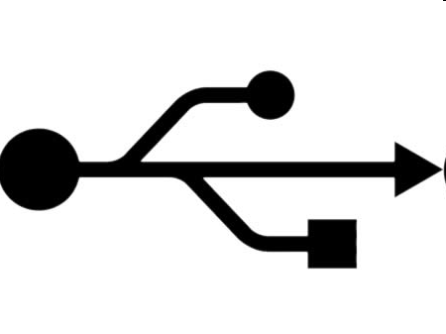
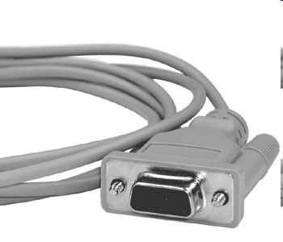
Paperless QA
Connecting Gauges
  Elcometer gauges may be connected in 3 ways
USB
RS232

Slide 34
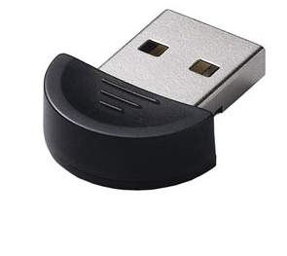
Paperless QA
Creating a Bluetooth connection
  All 224 top gauges come with Bluetooth built in
  Your PC requires Bluetooth as well in order to connect to the gauge
  Should your computer not have bluetooth, a USB bluetooth dongle may be used
A typical bluetooth USB adapter

Slide 35
Paperless QA
Creating a Bluetooth connection
  Gauges must be “added” to the software before data can be downloaded
  Elcomaster will remember the gauge for quick downloads in future
  The “Download” screen is displayed by default
  All previously added gauges are displayed here

Slide 36
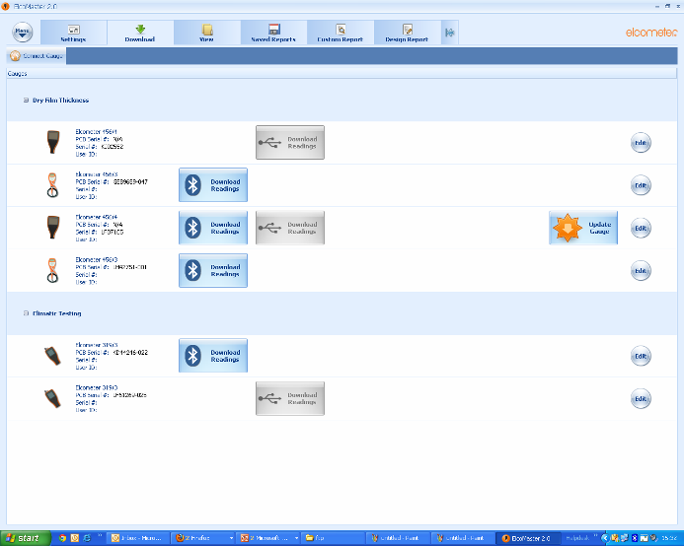
Paperless QA
The connect gauge button opens the wizard to add a gauge

Slide 37


Paperless QA
Creating a Bluetooth connection
  Click “connect gauge”
  Follow the wizard through, selecting the appropriate options for the Elcometer 224
  After Elcomaster 2.0 finds your gauge, add the correct one by checking the serial number in the bluetooth menu …. menu > Bluetooth
  Key in the Bluetooth PIN found on the same screen
  The gauge is now saved and data may be downloaded with

Slide 38
Paperless QA
Data Storage
Organising your data is simple
Elcomaster 2.0 makes it easy to effectively file your information away for later review
Elcomaster 2.0
Database
PROJECTS
Top level folder for
large of data
Folders
Divide up related
collections of data
Batches

Slide 39
Paperless QA
Simple Reporting in Elcomaster 2.0
  Elcomaster 2.0 already contains a very simple report template function
  If a client doesn’t have Elcomaster 2.0 then it can be used to send a simple summary of the data by email
  Select a batch in the “View” screen and select “PDF” from the bar across the top
  The key parts are “batch summary” and “batch readings” but other features can be added too
  Your company logo can be added to this in settings/report
Notes:
39

Slide 40
Paperless QA
Downloading Data and Simple Reporting Walkthrough
Viewing Batches
Creating a simple pdf report
Exporting data to excel
Adding a company logo to the simple report

Slide 41
Paperless QA
Benefits of Paperless QA
Surface Profile

Slide 42
Paperless QA
The number of readings that have to be collected builds up
quickly on large structures
  A large ship has a surface area to be coated of 58,000m²
  First take readings for the first 100m², 1 per 20m² = 5 mean values
  The next 57,900m² are divided up into 50m² sections with one mean value in each
  1158 readings plus the original 5 is 1163 readings
  Ten measurements per mean value = 11,630 measurements in total
  A vast amount of data is created
  Time taken would stretch into days of work for an inspector over the course of the job

Slide 43
Paperless QA
How Elcomaster 2.0 can help
  Organise the data using batches
  Save time transcribing readings onto paper
  Store the readings in an organised way for easy review later
  Store data safely and securely using cloud technology
  Create customised, professional reports in seconds using Elcomaster 2.0

Slide 44
Paperless QA
Summary
  The Elcometer 224 is designed to measure profiles created by abrasive blast cleaning
  Creating a suitable surface profile is key to coating adhesion and longevity
  The Elcometer 224 is used by taking several readings in an area to get a spot measurement
  Standards can be used to help determine how many readings to take and optimum blast profile

Slide 45
Paperless QA
What have we learned so far?
  A broad understanding of Profile and Roughness Measurement techniques
  How to use the Elcometer 224 Profile Gauge
  How to create and store a counted average profile batch to speed up data collection when working to a standard
  How to connect the Elcometer 224 gauge to Elcomaster 2.0
  How to create a simple inspection report
  This is the basis of PQA

Slide 46
Paperless QA
Salt Contamination Testing
Using the Elcometer 130

Slide 47
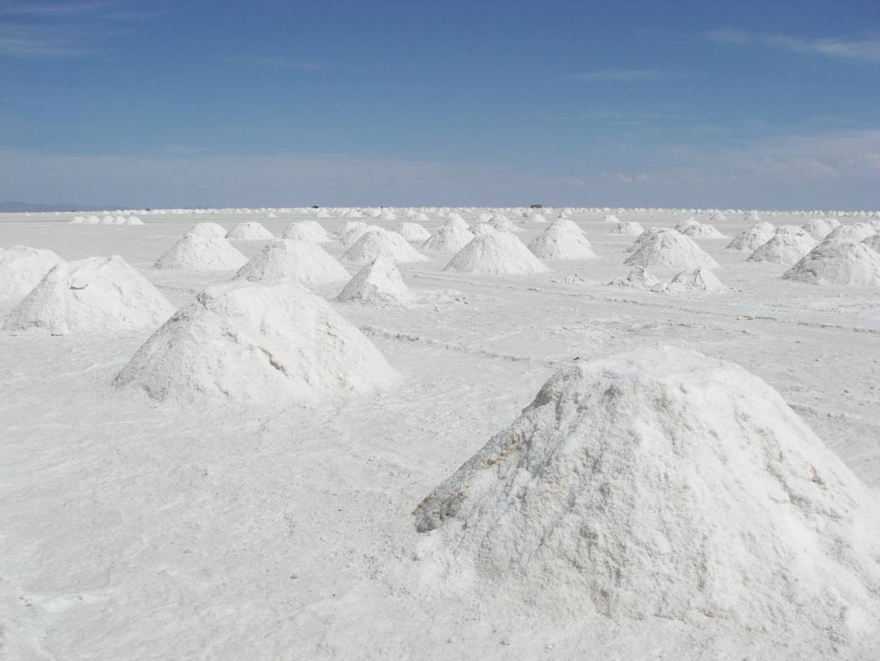
Measuring Salt Contamination
Chloride Salts are not uniformly spread across a surface
Salt ‘Mountains’ form by ionic bonding
Salt ‘Deserts’ form as a result of the ‘mountains’
Measuring Chloride Salts is a complex science and requires a deeper understanding of the real conditions
Measurement techniques work more reliably when testing larger areas
Multiple Tests are therefore required
.

Slide 48
Paperless QA
Presence of soluble salts on a surface causes corrosion to greatly accelerate and reduces the serviceable lifespans of protective coatings
Soluble salts that contaminate a surface are typically invisible, therefore some method of testing must be performed to determine if such contamination exists
The salts stimulate corrosion by drawing moisture through the coating

Slide 49
Paperless QA
Moisture, when combined with chlorides, actually often forms a mild hydrochloric acid. This causes corrosion, undercutting of the coating and, finally, a coating failure
The U.S. Navy has adopted an acceptable level of <3 micrograms/cm2 for hulls below the water line, and many coating manufacturers are rewriting surface preparation specifications that require soluble salts be tested for and limited to certain levels.

Slide 50
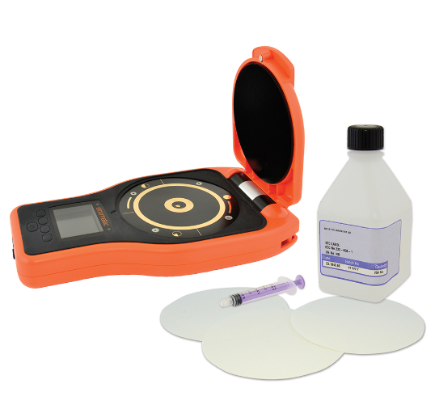
Paperless QA
The Elcometer 130 is designed to detect the level of soluble salts on a surface

Slide 51
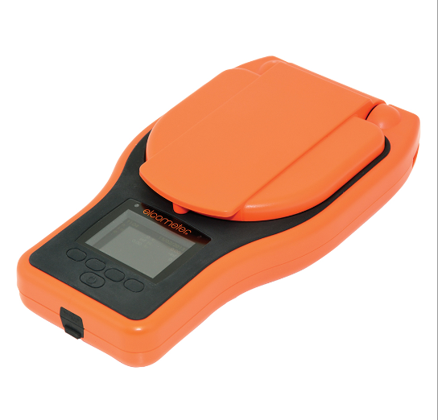
Paperless QA
Specially cleansed filter papers are dosed
with pure water
Filter paper placed on surface for 2 minutes
Removed and placed into Elcometer 130 for
analysis
Filter papers can be halved or quartered
and dosed accordingly
Automatic paper size detection

Slide 52
Paperless QA
USB and Bluetooth output to Elcomaster
Batch memories on top model
Upto 150,000 readings in 2,500 batches
Results measured in µg/cm2
Additional units in top model
  ppm
  µS/cm
  mS/cm
  % Salinity
  mg/m²
Bluetooth on top model only

Slide 53
Paperless QA
Elcometer 130 Walkthrough

Slide 54
Paperless QA
What have we learned so far?
  A broad understanding of Salt Contamination Measurement techniques
  How to use the Elcometer 130 SCM
  How to create and store a batch to speed up data collection
  How to download Salt Contamination data into Elcomaster 2.0
  How to create a simple inspection report

Slide 55
Paperless QA
Climatic Testing
Using the Elcometer 319

Slide 56
Paperless QA
Module Objectives
  Define ambient conditions
  Define the ambient condition coating requirements of related industry standards
  Measure the ambient conditions using a digital dewpoint meter

Slide 57
Paperless QA
Ambient Conditions
  The climatic conditions at a given place and time
    Air temperature
    Relative humidity
    Dew point temperature
    Wind velocity
  Conditions must be monitored on the job site

Slide 58
Paperless QA
What effect do the climatic conditions have?

Slide 59


Paperless QA
Relative Humidity
  A ratio of the amount of moisture in the air at a given temperature to the maximum amount of water that the air at that temperature can hold expressed as a percentage
  At 100% RH water cannot evaporate - the air is full of water
  Direct effects
RH too low
RH too high

Slide 60
Paperless QA
Temperature readings Ta and Ts
  Ta – Air temperature
  Ts – Surface temperature
  Most coatings will have a range of temperatures over which they may be applied. Generally it must be at least 12°C to paint
  Direct effects
Ts or Ta too high
Ts or Ta too low

Slide 61
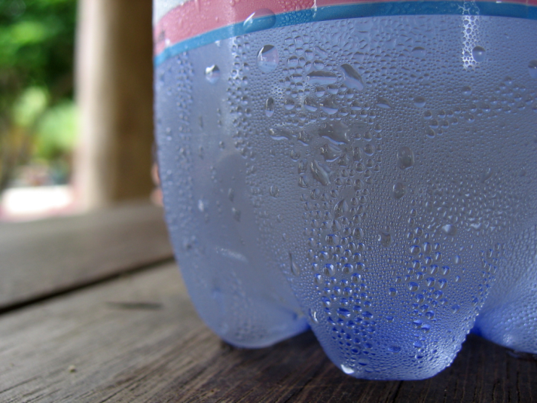
Paperless QA
Dew Point Temperature
  Indirect effect on coating performance
  The temperature at which the moisture in the air condenses as water
    Steam on a cold glass window
    or moisture on the outside of a cold drink
  When air is cooled, the amount of water it can hold decreases
Dew on a cold bottle
Notes:
What happens if the air is at 100%RH and then it cools?

Slide 62
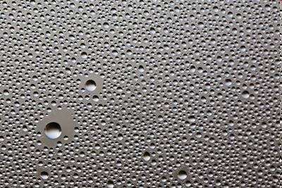
Paperless QA
Dew Point Temperature
  Dew is of concern to coating contractors and paint inspectors
  Presence of water on a surface detrimental effect on coating performance
    Prevents good adhesion
    Poor surface finish (blistering etc)
    Premature substrate corrosion
  Invisible “micro beads” of dew may be there if steel surface close to dewpoint

Slide 63
Paperless QA
Dew Point Temperature
  There may be localised dew formation
  Dew may be formed in shaded areas as they are cooler
  Measurements should be taken in several locations to ensure surface is clear of micro beads prior to coating

Slide 64
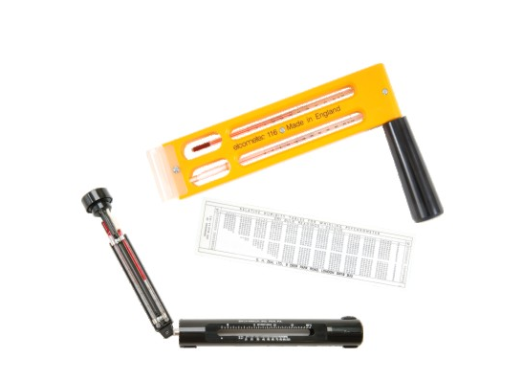
Paperless QA
Delta T (ΔT)
  Difference between surface and dewpoint temperature
  Must be greater than 3°C to paint
Other measurements
  Dry bulb temperature and wet bulb
  temperature
  Measurements taken by the whirling
  hygrometer; used to calculate humidity and
  dewpoint
Notes:
Kept these in because of the San Francisco Bridge application

Slide 65
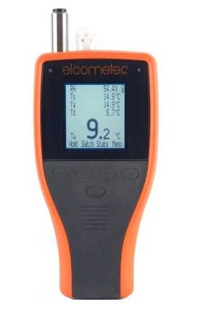
Paperless QA
Elcometer 319 Dewmeter
  Measures
    Surface temperature
    Relative humidity
    Air temperature
  Calculates
    Dew point temperature
    Delta T
    Wet Bulb Temperature
Notes:
65
This image shows the effect of the different cutter angles on the same thickness of coating.

Slide 66
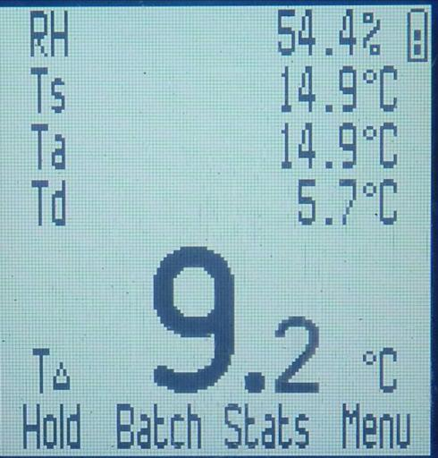
Paperless QA
Elcometer 319 Dewmeter
  Displays 5 different parameters
  Sensors integrated into a tough drop and water resistant enclosure
  Special components allow functionality up to 80C
  Top gauge features large memory for paperless QA inspections

Slide 67
Paperless QA
Operating the gauge
  Controlled using 4 “softkeys”
  Function changes depending on gauge screen
  Word or symbol above each key indicates function at that time
Notes:
67

Slide 68
Paperless QA
Operating the gauge
  The hold key freezes whatever is on the display
  In batch mode, a save option is also provided
Notes:
68

Slide 69
Paperless QA
Batching
  Two types of data logging
    Manual logging batch: The gauge will save a reading when the hold and save function is used. A batch must be open for the data to be saved
    Interval logging batch: The gauge saves readings at programmed time intervals
Notes:
69

Slide 70
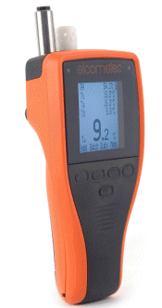
Walkthrough:
Using the Elcometer 319
Operation
Measurement
Statistics
Batching
Limits
Manual and Interval Logging

Slide 71
Paperless QA
Workshop 2:
Manual and Interval Logging
Live Readings
Combined Batches
Combined Reports

Slide 72
Paperless QA
Summary
  To avoid premature coating degradation, coatings should only be applied under optimum climatic conditions. Typical conditions
    Relative humidity under 85%
    Surface temperature above 12°C
    The surface temperature is at least 3 °C above the dewpoint
  The Elcometer 319 can be used to measure and record all climatic conditions simultaneously
  The interval logging function on the gauge may be used to reduce the workload on inspectors and save time

Slide 73
Paperless QA
What have we learned so far?
  An understanding of Climatic Condition Measurement techniques
  How to use the Elcometer 319 Dewmeter
  How to create and store a batch in the gauge to speed up data collection
  how to create an inspection report with combined attributes
  How to create a more detailed inspection report

Slide 74
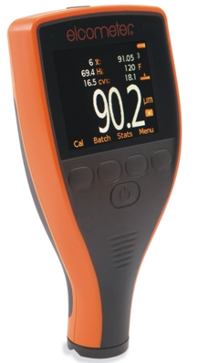
Paperless QA
Measuring with a DFT Gauge
The Elcometer 456

Slide 75
Paperless QA
Module Objectives 1
  What is Dry Film Thickness
  Substrates & coatings
  Instrument types – E,B,S,T
  Smooth and Rough Surface Gauge Calibration Techniques
  80/20 and IMO 90/10 rules

Slide 76
Paperless QA
Module Objectives 2
  Elcometer 456 Batch Types
  Elcometer 456 Probes and Scales
  Elcometer 456 Scan Probes

Slide 77
Paperless QA
Definition – Dry Film Thickness
The thickness of a dry paint layer on top of a substrate
Often expressed in microns but for thicker coatings millimetres is sometimes used

Slide 78
Paperless QA
What is Calibration
Calibration is an adjustment made to a gauge by the user before measurement
Calibration should be carried out:
  At the start of each shift
  When the base material type changes
  When the nominal coating thickness changes
  When the shape of the base material changes
Correct calibration ensures best accuracy and instrument performance
Wherever possible calibrate on an uncoated sample of the same material
Notes:
78
The Elcometer 456 is the most popular of the Elcometer coating thickness gauges.
It is available as Basic, Standard or Top software options with either integral or separate probes and F, N or dual FNF operation.
This is the Elcometer philosophy of Customer choice in operation.

Slide 79
Paperless QA
What is Calibration
A calibration certificate for the gauge or probe cannot be provided by the manufacturer
  A test certificate is available
If the manufacturer calibrates and the first thing the user does is recalibrate it to their job the manufacturer calibration is lost
Notes:
79
The Elcometer 456 is the most popular of the Elcometer coating thickness gauges.
It is available as Basic, Standard or Top software options with either integral or separate probes and F, N or dual FNF operation.
This is the Elcometer philosophy of Customer choice in operation.

Slide 80
Paperless QA
What is Calibration
Instead we provide a calibration certificate for the tools the user uses for calibration
Calibration Shims
A certificate for the shims is traceable to international standards
Notes:
80
The Elcometer 456 is the most popular of the Elcometer coating thickness gauges.
It is available as Basic, Standard or Top software options with either integral or separate probes and F, N or dual FNF operation.
This is the Elcometer philosophy of Customer choice in operation.

Slide 81
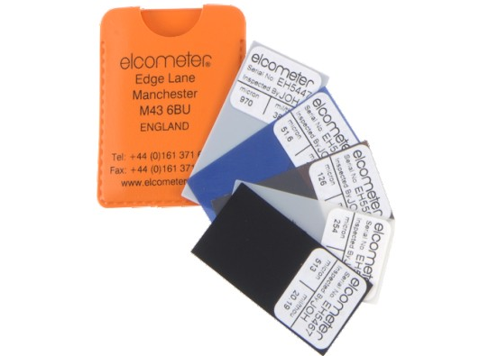
Paperless QA
Calibration Shims
  Shims (or foils) are provided with every gauge
  Shims are accurately measured standards, certificates are available
  Shims allow a gauge’s accuracy to be verified
  Shims allow a gauge to be adjusted to be best suited to the current job
Notes:
81
The Elcometer 456 is the most popular of the Elcometer coating thickness gauges.
It is available as Basic, Standard or Top software options with either integral or separate probes and F, N or dual FNF operation.
This is the Elcometer philosophy of Customer choice in operation.

Slide 82
Paperless QA
Accuracy Verification
  Gauges and their probes should regularly have their accuracy verified
  Use a smooth “zero plate”
  Calibrate between a range
  Test the gauge on some shims in between
  If outside of accuracy statement recalibrate
Notes:
82
The Elcometer 456 is the most popular of the Elcometer coating thickness gauges.
It is available as Basic, Standard or Top software options with either integral or separate probes and F, N or dual FNF operation.
This is the Elcometer philosophy of Customer choice in operation.

Slide 83
Paperless QA
Accuracy Verification
  Record data on:
    Serial number
    Reference standard used (foil and zero plate serial number)
    Foil Thicknesses
    Calibration method
  The stated thickness of the standard and the measured value should be recorded. Check tolerances
Notes:
83
The Elcometer 456 is the most popular of the Elcometer coating thickness gauges.
It is available as Basic, Standard or Top software options with either integral or separate probes and F, N or dual FNF operation.
This is the Elcometer philosophy of Customer choice in operation.

Slide 84
Paperless QA
Calibration Methods
  Smooth surfaces
  Blasted surfaces – Rough and 2-point calibration
  Smooth Surface with Base Metal
  Reading compensation (SSPC method)
Notes:
84
The Elcometer 456 is the most popular of the Elcometer coating thickness gauges.
It is available as Basic, Standard or Top software options with either integral or separate probes and F, N or dual FNF operation.
This is the Elcometer philosophy of Customer choice in operation.

Slide 85
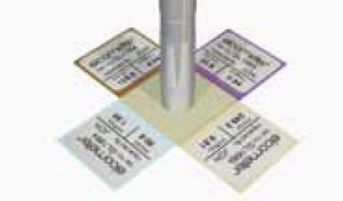
Paperless QA
Calibration – Smooth Surfaces
  Carry out on an unblasted smooth surface
  Requires one calibration foil and a zero reference
  Choose a foil or combination of foils that is slightly greater than the expected coating thickness
Stacked Foils
Notes:
85
The Elcometer 456 is the most popular of the Elcometer coating thickness gauges.
It is available as Basic, Standard or Top software options with either integral or separate probes and F, N or dual FNF operation.
This is the Elcometer philosophy of Customer choice in operation.

Slide 86
Paperless QA
Smooth Surface Calibration Demo
Notes:
86
The Elcometer 456 is the most popular of the Elcometer coating thickness gauges.
It is available as Basic, Standard or Top software options with either integral or separate probes and F, N or dual FNF operation.
This is the Elcometer philosophy of Customer choice in operation.

Slide 87
Paperless QA
So we have some shims to calibrate with, but they’re not the same material as the paint.
How can this work?
Notes:
87
The Elcometer 456 is the most popular of the Elcometer coating thickness gauges.
It is available as Basic, Standard or Top software options with either integral or separate probes and F, N or dual FNF operation.
This is the Elcometer philosophy of Customer choice in operation.

Slide 88
Paperless QA
Calibration – Why you can measure almost any coating on steel
Probe
Probe
Air Gap
Non-magnetic coating
Magnetic Substrate
Substrate
Notes:
88
The Elcometer 456 is the most popular of the Elcometer coating thickness gauges.
It is available as Basic, Standard or Top software options with either integral or separate probes and F, N or dual FNF operation.
This is the Elcometer philosophy of Customer choice in operation.

Slide 89
Paperless QA
Ferrous Calibration – Why you can measure almost any coating on steel
The gauge measures from the probe tip to the substrate
Except for a few rare cases what is in between makes no difference
Probe
Probe
Air Gap
Non-magnetic coating
Magnetic Substrate
Magnetic Substrate
Notes:
89
The Elcometer 456 is the most popular of the Elcometer coating thickness gauges.
It is available as Basic, Standard or Top software options with either integral or separate probes and F, N or dual FNF operation.
This is the Elcometer philosophy of Customer choice in operation.

Slide 90
Paperless QA
Non-Ferrous Calibration – Why you can measure almost any coating on other metals
Non Ferrous gauges are similar
The coating must be an electrical insulator
Probe
Probe
Air Gap
Non-conductive coating
Metal Substrate
Metal Substrate
Notes:
90
The Elcometer 456 is the most popular of the Elcometer coating thickness gauges.
It is available as Basic, Standard or Top software options with either integral or separate probes and F, N or dual FNF operation.
This is the Elcometer philosophy of Customer choice in operation.

Slide 91
Paperless QA
Calibration – Rough Surfaces
  Most protective coatings are applied to abrasively blasted surfaces
  DFT specification should be coverage from the peaks of the profile to ensure all steel is effectively covered
  Thickness measured will be the minimum – ensures proper coverage
Notes:
91
The Elcometer 456 is the most popular of the Elcometer coating thickness gauges.
It is available as Basic, Standard or Top software options with either integral or separate probes and F, N or dual FNF operation.
This is the Elcometer philosophy of Customer choice in operation.

Slide 92
Paperless QA
Calibration on Rough Surfaces - The Problem
  Where do we take the zero
  Using a smooth calibration the zero could be anywhere, depends where the probe lands
Location of zero
Notes:
92
The Elcometer 456 is the most popular of the Elcometer coating thickness gauges.
It is available as Basic, Standard or Top software options with either integral or separate probes and F, N or dual FNF operation.
This is the Elcometer philosophy of Customer choice in operation.

Slide 93
Paperless QA
Calibration on Rough Surfaces - The Problem
  Where do we take the zero
  Using a smooth calibration the zero could be anywhere, depends where the probe lands
Location of zero
Notes:
93
The Elcometer 456 is the most popular of the Elcometer coating thickness gauges.
It is available as Basic, Standard or Top software options with either integral or separate probes and F, N or dual FNF operation.
This is the Elcometer philosophy of Customer choice in operation.

Slide 94
Paperless QA
Calibration on Rough Surfaces - Solution #1
  If we use two calibration foils instead of a zero, the problem of moving zero is eliminated
  The thin calibration foil bridges the profile
  A second, thick calibration foil is also used
  The gauge is accurate between these two values
Calibration foil
Location of zero
Notes:
94
The Elcometer 456 is the most popular of the Elcometer coating thickness gauges.
It is available as Basic, Standard or Top software options with either integral or separate probes and F, N or dual FNF operation.
This is the Elcometer philosophy of Customer choice in operation.

Slide 95
Paperless QA
2-Point (Rough) Calibration Demo
Notes:
95

Slide 96
Paperless QA
Calibration on rough surfaces
Solution #2
  The ISO 19840 standard specifies a method to compensate for the effect of blast profile on the reading
  The Base metal reading (BMR) method
  The profile is categorised as fine, medium or coarse according to ISO 8503 and then a figure is subtracted from the gauge reading

Slide 97
Paperless QA
Measuring paint on blasted surfaces
ISO 8503 Profile Grade | Correction Value (µm) | Correction Value (mil)
Fine | 10 | 0.4
Medium | 25 | 1.0
Coarse | 40 | 1.6
  The SSPC-PA 2 Standard provides approximate BMR values that can be used when access to the blast-cleaned surface is not possible.

Slide 98
Paperless QA
Calibration on blasted surfaces 2
  Select zero offset cal method and set offset to required value
  Calibrate on a flat steel plate (unblasted)
  Measure as normal, create counted average batches with appropriate number of readings based on the standard

Slide 99
Paperless QA
Batching on the 456 Demo
Creating Batches
Naming Batches
Counted Average and Fixed Batches
Auto Repeat and Scan Batches
Notes:
99
The Elcometer 456 is the most popular of the Elcometer coating thickness gauges.
It is available as Basic, Standard or Top software options with either integral or separate probes and F, N or dual FNF operation.
This is the Elcometer philosophy of Customer choice in operation.

Slide 100
Paperless QA
80/20 Rule
Values above NDFT
NDFT
Values 80+% of NDFT
Values below 80% of NDFT
Instant Fail
Increasing thickness

Slide 101
Paperless QA
Above upper limit set by coating manufacturer
80/20 Rule
Values above NDFT
NDFT
Values 80+% of NDFT
Values below 80% of NDFT
Instant Fail
Increasing thickness

Slide 102
Paperless QA
IMO PSPC Regulations
  Stipulate an NDFT or Nominal Dry film Thickness
  NDFT for ballast tank coating is 320 microns
  Use a 90/10 rule to determine pass or fail criteria
  Measurement frequency and procedure determined by ISO 19840

Slide 103
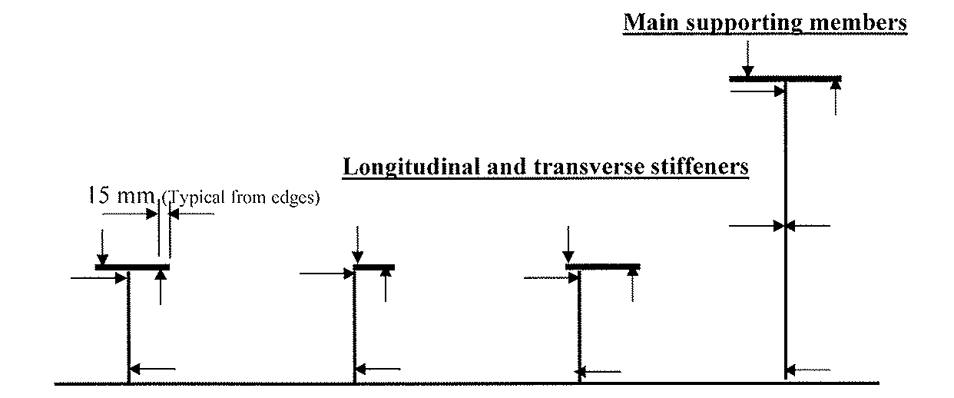
Paperless QA
IMO PSPC Regulations
  IMO PSPC provides guidance on where to measure on steel supporting members in ballast tanks
  Example

Slide 104
Paperless QA
Above upper limit set by coating manufacturer
90/10 Rule
Values above NDFT
NDFT
Values 90+% of NDFT
Values below 90% of NDFT
Instant Fail
Increasing thickness

Slide 105
Paperless QA
  Using the features of the Elcometer 456 DFT gauge to work to the standards

Slide 106
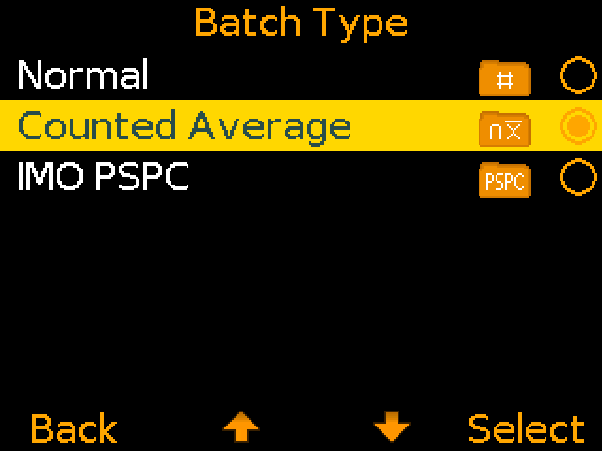
Paperless QA
Counted averages
  Counted average batches can be used to aggregate your spot readings into average measurement
  Set number of readings to become a measurement
  Gauge saves and notifies average when spot measurement complete
  Useful for working with ISO 19840

Slide 107
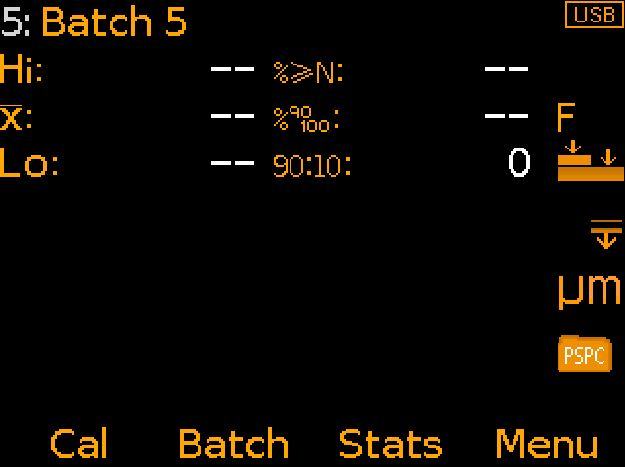
Paperless QA
IMO PSPC Batches
  Set the NDFT to the desired thickness
  IMO PSPC dynamic statistics displayed on screen
  Immediate indication of pass/fail on IMO PSPC regulations

Slide 108
Paperless QA
  Workshop 6: 456 Extension exercise
  Limits, counted average and fixed batch

Slide 109
Paperless QA
What have we learned?
  Correct dry film thickness measurement is essential to coating performance
  Gauge accuracy can be verified using calibration foils
  Standards are available as a guide to the measurement process
  Correct gauge and software set up can save time and money

Slide 110
Coating Inspection
Data Management and Reporting

Slide 111
Coating Inspection – Trends
The need for coating inspection is driven by Project Specifications
  These specifications determine
    The type coating to be applied
    The film thickness to be achieved
    The National/International Standard to use to determine the coating thickness

Slide 112
Coating Inspection – Trends
Coating thickness has always been seen as critical in Corrosion prevention
However we see other factors are increasingly being recognised as critical to the successful application of a coating and the prevention of corrosion

Slide 113
Coating Inspection – Trends
Project specifications are requiring inspection at all key stages of the application process
    Surface Profile
    Surface Cleanliness
    Climatic Conditions
    Dry Film Thickness
    Adhesion

Slide 114
Coating Inspection – Trends
The coatings market is demanding:
  Increased inspection through the whole application process
  Proof that inspections were completed

Slide 115
Coating Inspection – Trends
Proof of inspection requires Reports
Reports require data
    Simple visual assessments
    Multiple Readings/Measurements
    Statistics
    Analysis

Slide 116
Coating Inspection – Trends
The volume of data/measurement is increasing
Trend is for electronic data capture over manual/hand written/paper based inspection

Slide 117
Coating Inspection - Trends
Equipment to record data must be
    Rugged
    Accurate/Reliable
    Calibrated/Certified
    Batch Memory/Time & Date Stamped
    Traceability/Serial Number

Slide 118
Coating Inspection – Elcometer Solution
Elcometer have developed a range of gauges in response to these market demands

Slide 119
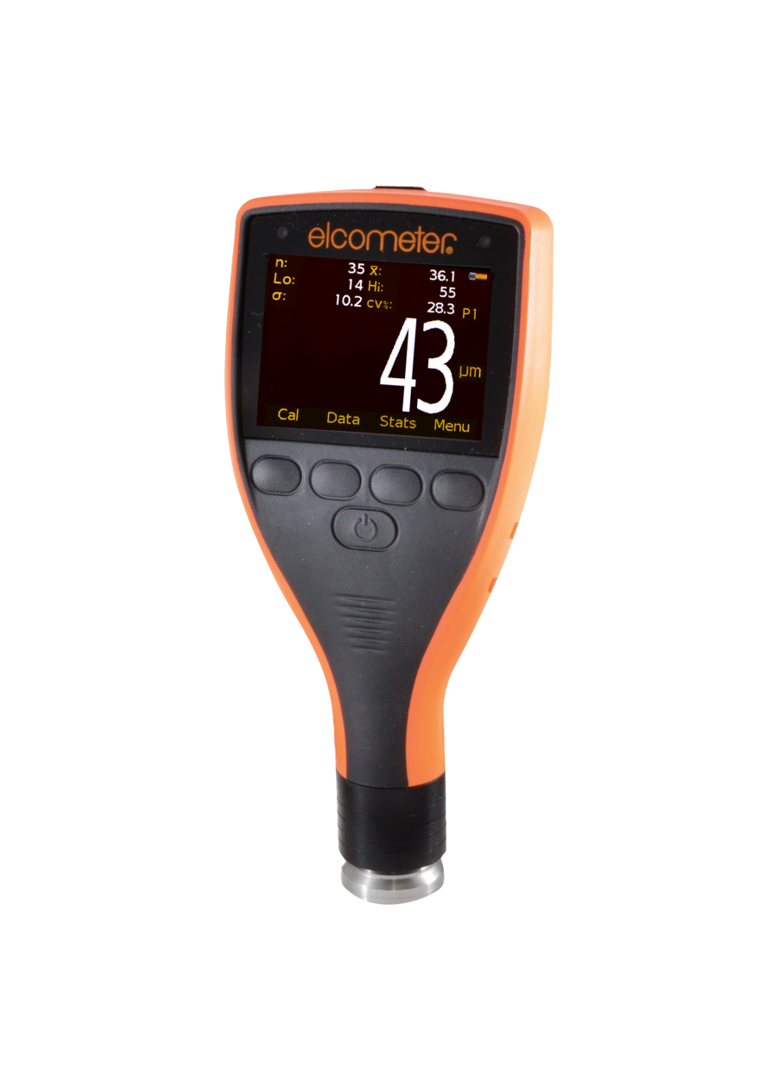
Data Collection – Elcometer Solution
Surface Profile
    Elcometer 224 Surface Profile Gauge
      150,000 readings / 2,500 batches
      50+ readings/minute
      Rated to IP64
      Bluetooth® connectivity
      USB connectivity
      Compatible with ElcoMaster™

Slide 120
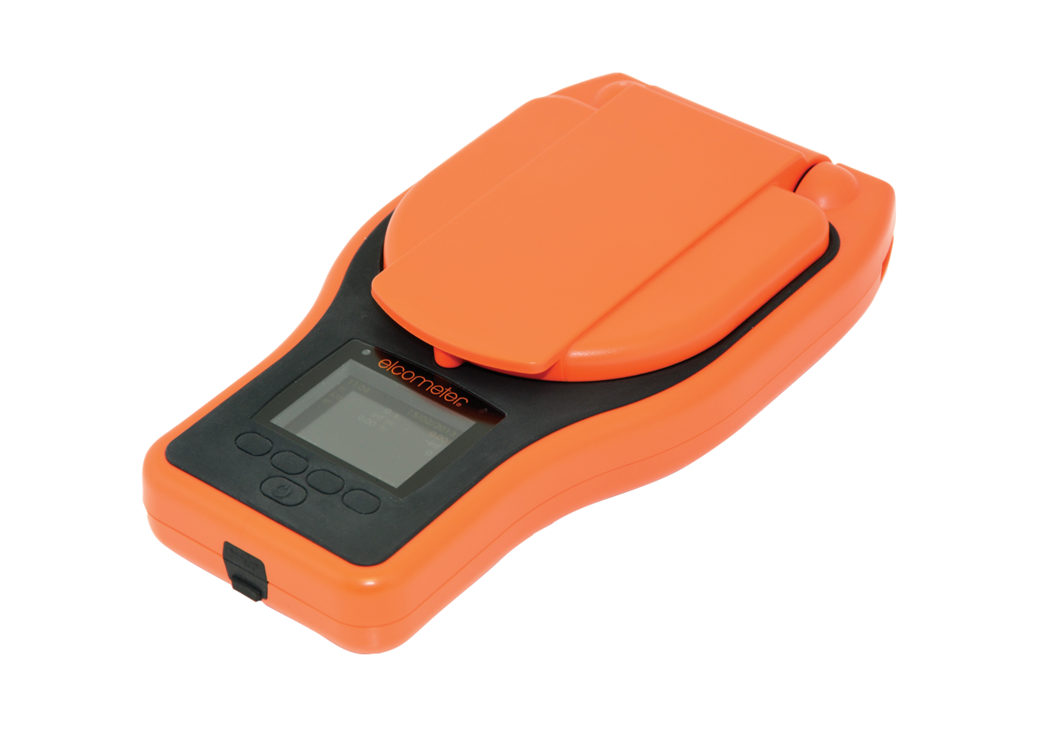
Data Collection– Elcometer Solution
Surface Cleanliness
    Elcometer 130 Salt Contamination Meter
      150,000 readings / 2,500 batches
      Measuring range up to 50μg/cm
      Rated to IP64
      Bluetooth® connectivity
      USB connectivity
      Compatible with ElcoMaster™

Slide 121
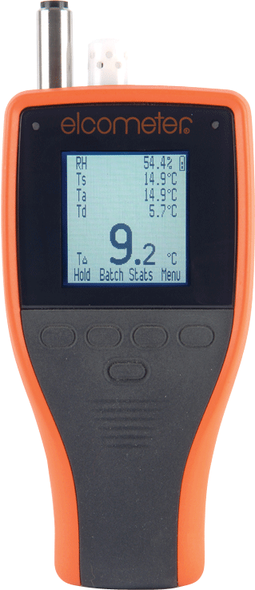
Data Collection– Elcometer Solution
Climatic Conditions
    Elcometer 319 Dewpoint Meter
      25,000 readings / 999 batches
      Measuring RH%, Ta,Ts, Td and TΔ
      Rated to IP66
      Bluetooth® connectivity
      USB connectivity
      Compatible with ElcoMaster™

Slide 122
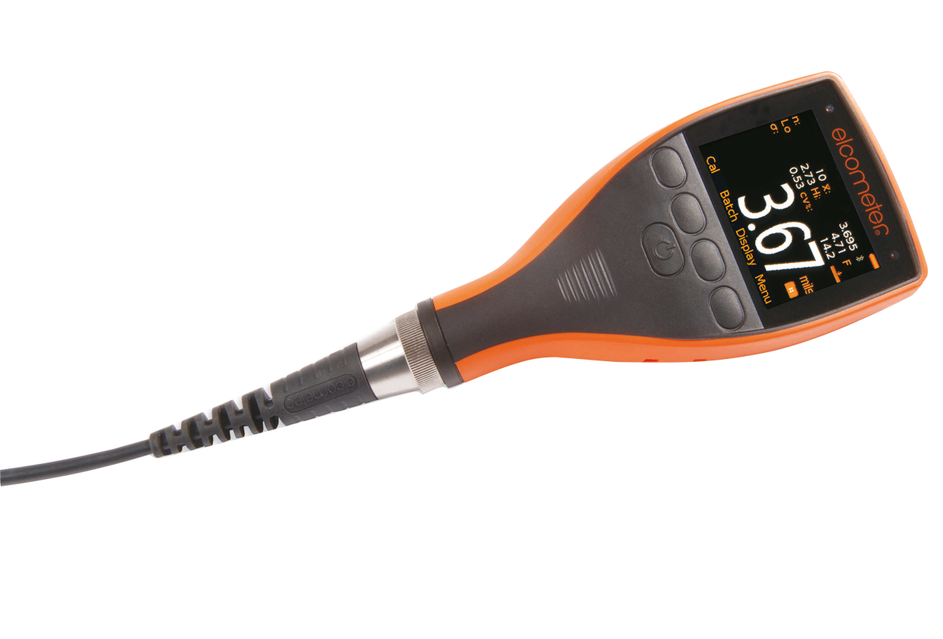
Data Collection– Elcometer Solution
Dry Film Thickness
    Elcometer 456 Dry Film Thickness Gauge
      150,000 readings / 2,500 batches
      70+ readings/minute
      Rated to IP64
      Bluetooth® connectivity
      USB connectivity
      Compatible with ElcoMaster™

Slide 123
Data Management – Elcometer Solution
  To organise the volumes of data collected during inspections Elcometer have developed:
  ElcoMaster™ 2.0 Software – PC and Laptop
  ElcoMaster™ Mobile Software - tablet/mobile phone
  Provides one standard platform for all Elcometer gauges
  USB/Bluetooth®/Cloud/email/Live data

Slide 124
Data Management – ElcoMaster™ 2.0
Developing ElcoMaster™ Software
  Elcometer looked at other software products in the market
  We based the visual appearance and data structure on email applications
  We designed a ‘one click’ intuitive menu based on Satellite Navigation products

Slide 125
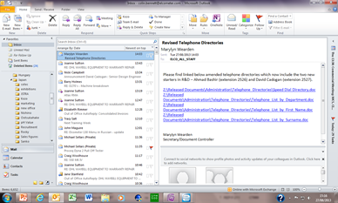
Data Management – ElcoMaster™ 2.0
Visual appearance and data storage based on email applications

Slide 126
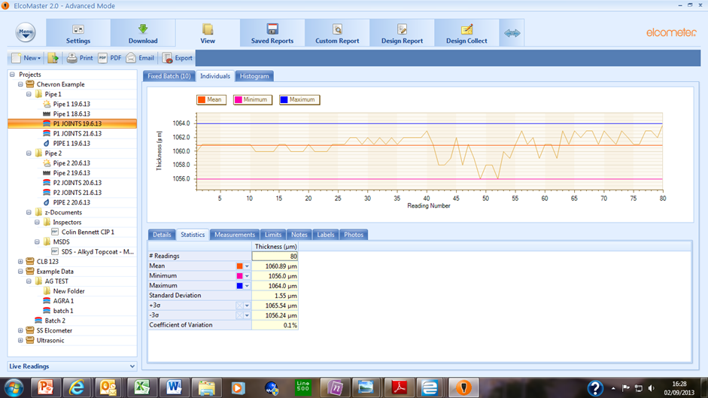
Data Management – ElcoMaster™ 2.0
Data is organised in to Projects/Folders/Batches – all details of the batch can be seen
1
3
2
4

Slide 127

Data Management – ElcoMaster™ 2.0
The intuitive menu design based on Satellite Navigation products
  Wherever possible all ‘actions’ within ElcoMaster™ are ‘one click’ operations
  Wizards guide the user through key operations

Slide 128
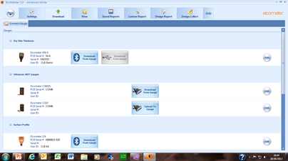
Data Management – ElcoMaster™ 2.0
Downloading data via Bluetooth® or USB is a ‘one click’ operation
1
2

Slide 129
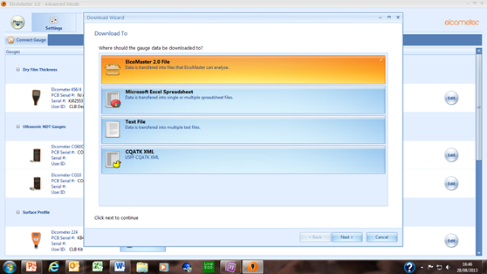
Data Management – ElcoMaster™ 2.0
Wizard guides user to store data in required location:
1
2

Slide 130
Data Management – ElcoMaster™ 2.0
ElcoMaster™ Software Summary
    Key features include:
    PC, Tablet and Mobile phone software options
    USB/Bluetooth®/Cloud/email/Live data connectivity
    Three operating modes: Microsoft Excel/Standard/Advanced
    One platform – connects all Elcometer (memory) gauges
    Easy download of data
    Instant archiving of data
    Data organised into Projects/Folders
    Standardised reporting templates – limited customisation possible
    Labels – Customised Project & Batch labels can be added
    Photographs can be added to batches (unlimited)
    Design reporting templates – full customisation possible
    PDF based software – PDF exported and any PDF can be imported

Slide 131
Data Management – ElcoMaster™ 2.0
We will now look at some of the features of
ElcoMaster™ 2.0

Slide 132
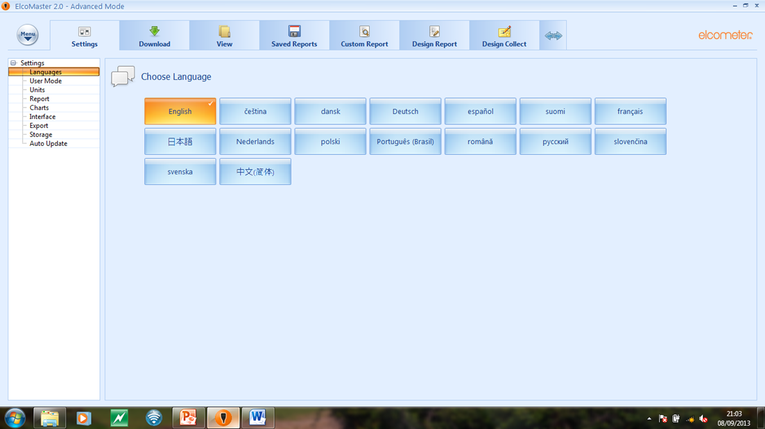
Data Management – ElcoMaster™ 2.0
ElcoMaster™ – Settings: Language
1

Slide 133
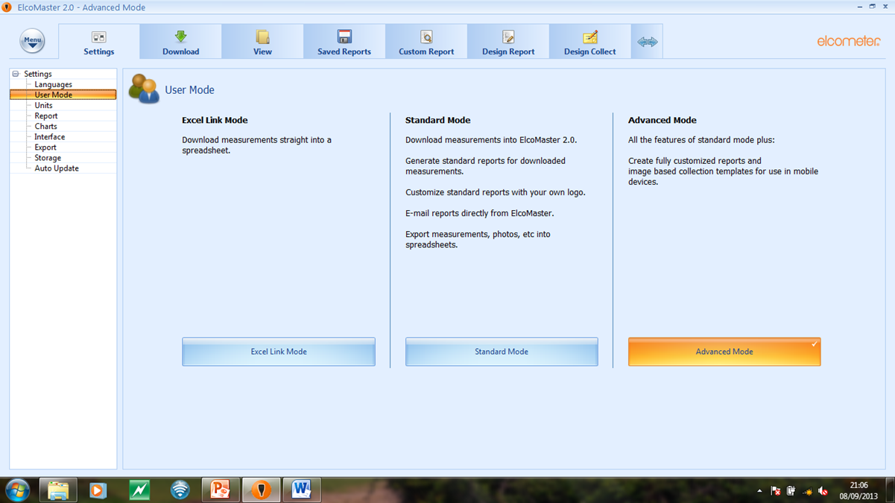
Data Management – ElcoMaster™ 2.0
ElcoMaster™ – Settings: Mode

Slide 134
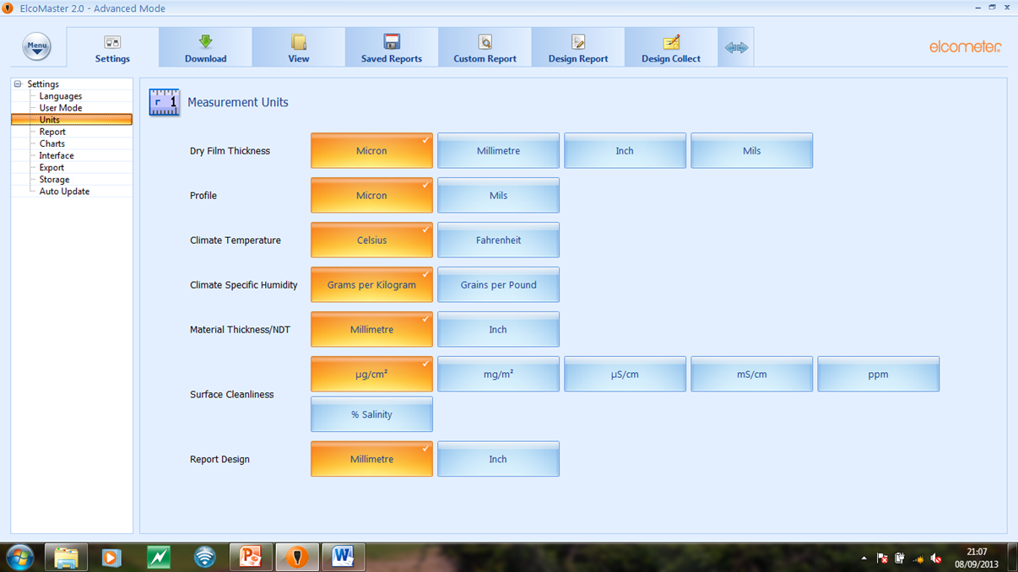
Data Management – ElcoMaster™ 2.0
ElcoMaster™ – Settings: Units

Slide 135
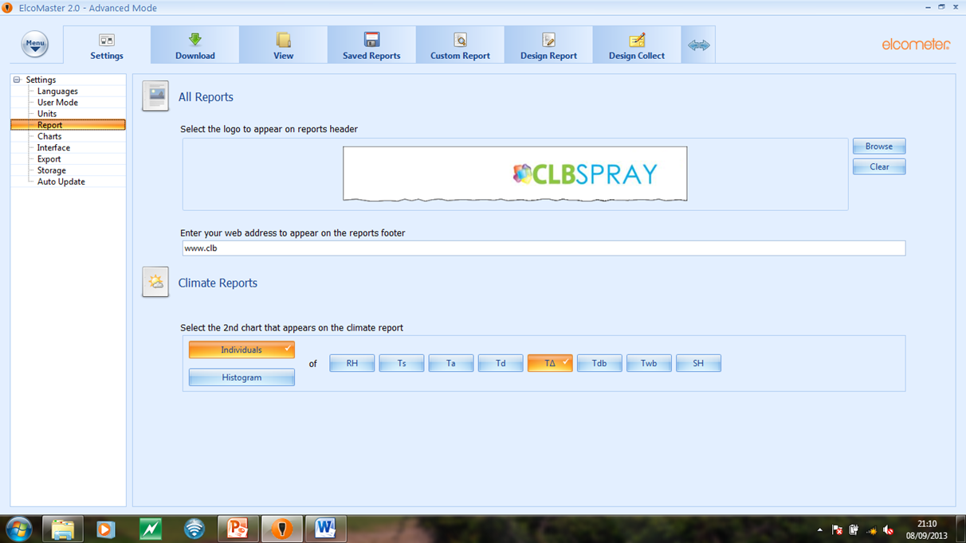
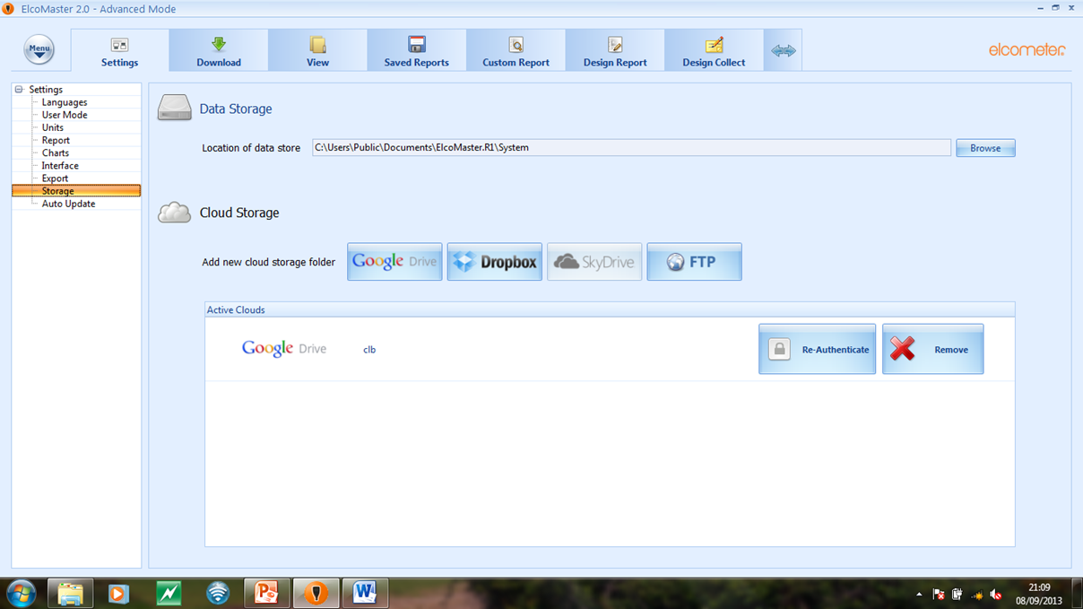
Data Management – ElcoMaster™ 2.0
ElcoMaster™ – Settings: Report
1
2

Slide 136
Data Management – ElcoMaster™ 2.0
ElcoMaster™ – Settings: Storage
1
2

Slide 137
Connecting Gauges
“Pairing”

Slide 138
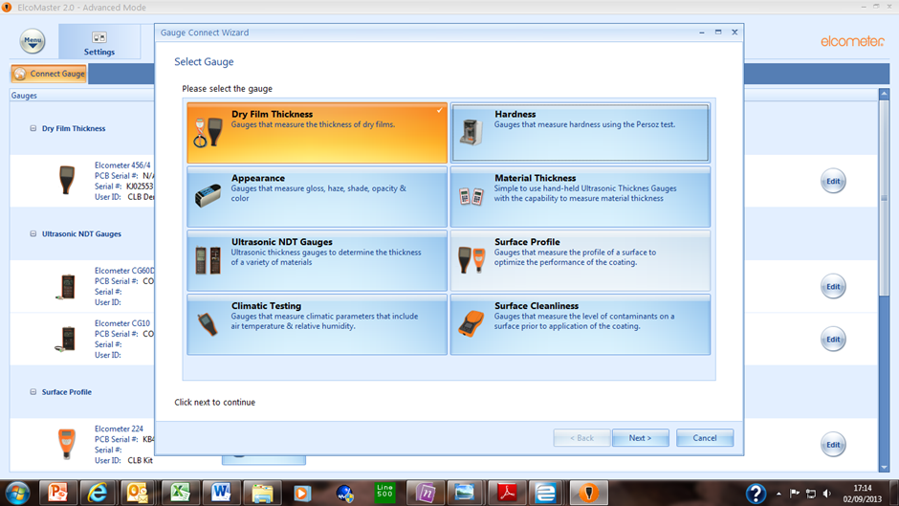
Data Management – ElcoMaster™ 2.0
Connecting/Pairing Gauges – Connect Gauge Wizard
1
2

Slide 139
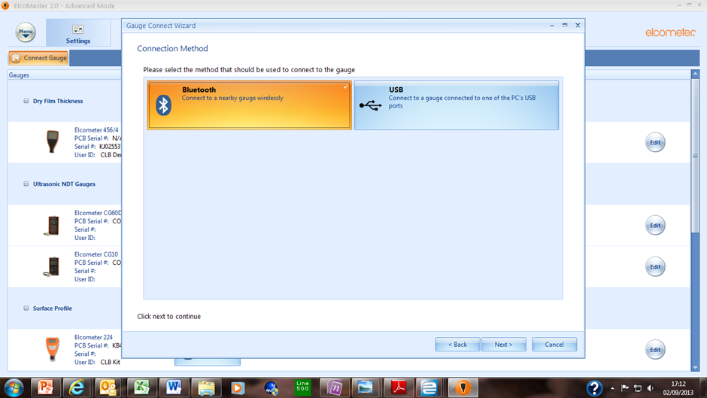
Data Management – ElcoMaster™ 2.0
Connecting/Pairing Gauges – Select connection
1

Slide 140
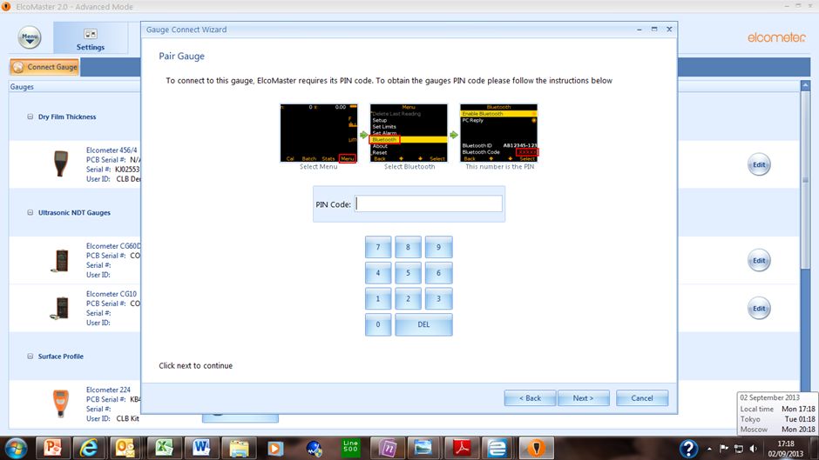
Data Management – ElcoMaster™ 2.0
Connecting/Pairing Gauges – Enter Bluetooth® code
1
2

Slide 141
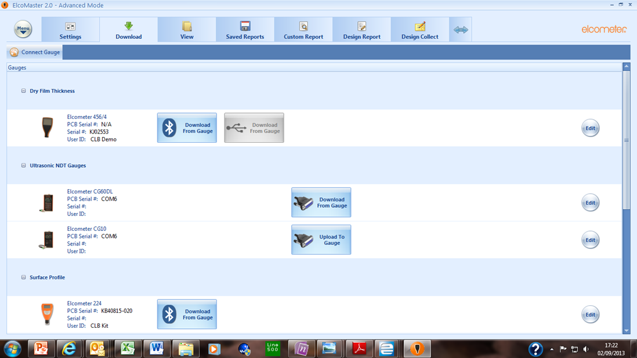
Data Management – ElcoMaster™ 2.0
Connecting/Pairing Gauges – Gauge paired

Slide 142
Download Data
From Gauges

Slide 143
Data Management – ElcoMaster™ 2.0
Download data - select gauge/download method
1
2

Slide 144

Data Management – ElcoMaster™ 2.0
Select download destination – ElcoMaster™ 2.0 File

Slide 145
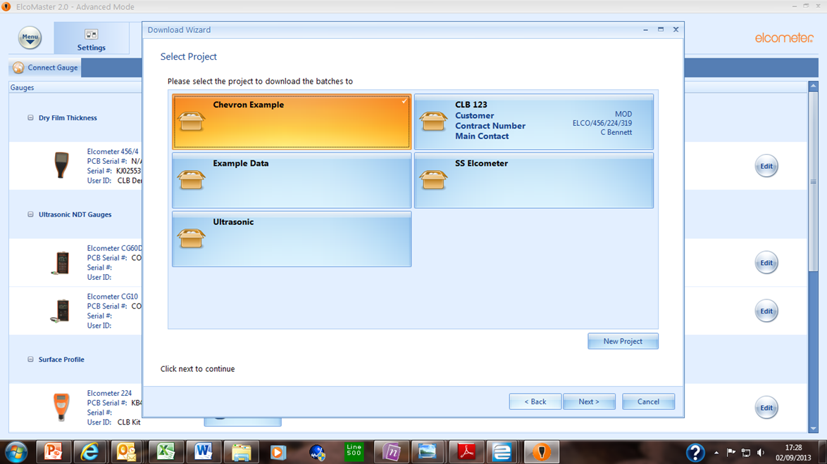
Data Management – ElcoMaster™ 2.0
From Project list – select existing project or ‘new’
1
2

Slide 146


Data Management – ElcoMaster™ 2.0
Download complete – Finish to see data
1
2

Slide 147

Data Management – ElcoMaster™ 2.0
Instant visibility of Batch Data details

Slide 148
Organising Data
Into Projects

Slide 149
Data Management – ElcoMaster™ 2.0
All batch data files can be organised into
  Projects
  Folders

Slide 150
Data Management – ElcoMaster™ 2.0
So what is a “Project”?
  A major construction:
    Ship
    Pipeline
  A key account/customer:
    Acme Windows
  A production line in the factory:
    Line 1 - panels
    Line 2 - boxes

Slide 151

Data Management – ElcoMaster™ 2.0
Example construction project
HMS Elcometer
  Project data organised into :
  Location Folders
    Zones
  Document Folders
    Imported PDF files

Slide 152

Data Management – ElcoMaster™ 2.0
Example key account project
Acme Windows
  Batch data organised into :
  Year Folders
    Product Folders
      Contract Folders

Slide 153

Data Management – ElcoMaster™ 2.0
Example production line project
Production Line 1
  Batch data organised into:
  Product Folders
    Year Folders
      Month Folders

Slide 154
Download Elcometer 456 Batch: BT 1 28.8.13
to a project

Slide 155
Data Management – ElcoMaster™ 2.0
Use download wizard
Select Project
  HMS Elcometer
Select Location
  Ballast Tank 1

Slide 156

Data Management – ElcoMaster™ 2.0
  - HMS Elcometer/Ballast Tank 1/Batch BT 1 28.8.13

Slide 157
Data Management – ElcoMaster™ 2.0
Other information can be added to Projects
  Labels – Project & Batch
  Photographs
  PDF documents

Slide 158
Adding
Project & Batch
Labels

Slide 159

Data Management – ElcoMaster™ 2.0
Select a Project – Label input screen visible
  All labels are defined by the user
  3 Project labels can be added – universal to project reports
  5 Batch labels can be added – specific to batch reports

Slide 160

Data Management – ElcoMaster™ 2.0
Input Project/Batch Labels
  All labels are defined by the user
  3 Project labels can be added – universal to project report
  5 Batch labels can be added – specific to batch report

Slide 161
Data Management – ElcoMaster™ 2.0
Input Project/Batch Labels
  These labels will be printed on all Project and Batch reports

Slide 162
Adding
Batch Photographs

Slide 163

Data Management – ElcoMaster™ 2.0
Adding Batch photographs
4
1
2
3

Slide 164

Data Management – ElcoMaster™ 2.0
Adding Batch photographs – unlimited number

Slide 165
Adding
PDF Documents

Slide 166
Data Management – ElcoMaster™ 2.0
ElcoMaster™ exports all Project and Batch Reports as PDF files
ElcoMaster™ will also import PDF files
  Product Datasheets
  Word documents
  CAD drawings
  Hand written forms

Slide 167

Data Management – ElcoMaster™ 2.0
Adding PDF Documents – Select Project/Folder
1
2
3

Slide 168

Data Management – ElcoMaster™ 2.0
Unlimited number of documents can be added

Slide 169
Creating Reports

Slide 170
Data Management – ElcoMaster™ 2.0
All reports are generated as PDF Files
A variety of reports can be produced from a simple one page summary of one Batch to a full multi-page Project report

Slide 171

Data Management – ElcoMaster™ 2.0
Producing Batch reports – ‘Summary’ sheet
2
3
1

Slide 172

Data Management – ElcoMaster™ 2.0
Producing Batch reports – ‘Summary’ PDF

Slide 173

Data Management – ElcoMaster™ 2.0
1
2
Batch Report – Summary Page
3

Slide 174
Adding Notes
To Batch Reports

Slide 175

Data Management – ElcoMaster™ 2.0
Select Batch – Notes
1
2
3

Slide 176

Data Management – ElcoMaster™ 2.0
Producing Batch reports – Additional pages
2
1
3

Slide 177

Data Management – ElcoMaster™ 2.0
Batch Summary page, Batch Photo, Batch readings

Slide 178

Data Management – ElcoMaster™ 2.0
Batch Summary Page

Slide 179

Data Management – ElcoMaster™ 2.0
Batch Photographs

Slide 180

Data Management – ElcoMaster™ 2.0
Batch Readings

Slide 181
Project Reports

Slide 182

Data Management – ElcoMaster™ 2.0
Folder reports – all batches included
1
2

Slide 183

Data Management – ElcoMaster™ 2.0
Project reports – all folders/batches included
2

Slide 184
Emailing Reports

Slide 185

Data Management – ElcoMaster™ 2.0
Producing Reports – via email
1
2
3

Slide 186

Data Management – ElcoMaster™ 2.0
Producing Reports – via email
1
2
3

Slide 187
Live Data Input
Collect Batches
(Image)

Slide 188
Data Management – ElcoMaster™ 2.0
“Collect” reports use photos/images with the measurement points highlighted on the image to tell the user where to take measurements
Requires live data input using USB or Bluetooth®

Slide 189
Design
Collect Batches

Slide 190


Data Management – ElcoMaster™ 2.0
Design Collect – Select ‘New’ opens design wizard
1
2
3

Slide 191

Data Management – ElcoMaster™ 2.0
Design Collect – Select Report Type

Slide 192

Data Management – ElcoMaster™ 2.0
Design Collect – Select Report Image from file
1
2
3

Slide 193

Data Management – ElcoMaster™ 2.0
Design Collect – Select the number of readings
1

Slide 194

Data Management – ElcoMaster™ 2.0
Design Collect – Locate the points on the image
1
2

Slide 195

Data Management – ElcoMaster™ 2.0
Design Collect – Save the Collect Report

Slide 196
Use
Collect Batches
(Image)

Slide 197

Data Management – ElcoMaster™ 2.0
View: Project/Folder – Open new ‘Turkcoat 2013’

Slide 198

Data Management – ElcoMaster™ 2.0
Collect/Live Data – Connect gauge
1
2

Slide 199

Data Management – ElcoMaster™ 2.0
Collect/Live Data – Select gauge
2
1

Slide 200

Data Management – ElcoMaster™ 2.0
Collect/Live Data – Turkcoat 2013 ready
2
1

Slide 201

Data Management – ElcoMaster™ 2.0
Collect/Live Data– Readings displayed at location
1
2

Slide 202

Data Management – ElcoMaster™ 2.0
Collect/Live Data – 3 units measured
1
2

Slide 203
Creating
Collect Batch
Reports

Slide 204

Data Management – ElcoMaster™ 2.0
Select PDF – Select ‘Collections’

Slide 205

Data Management – ElcoMaster™ 2.0
Turkcoat 2013 Batch Report – P1 of 5
1

Slide 206

Data Management – ElcoMaster™ 2.0
Turkcoat 2013 Batch Report – P2 of 5
1

Slide 207

Data Management – ElcoMaster™ 2.0
Turkcoat 2013 Batch Report – P3 to 5
1

Slide 208
ElcoMaster™ Mobile App

Slide 209




Data Management – ElcoMaster™ App
ElcoMaster™ 2.0 links with ElcoMaster™ Mobile App
  Android platform
    Laptop
    Tablet
    Mobile phone
    Bluetooth®
    Cloud

Slide 210

Data Management – ElcoMaster™ 2.0
Mobile App

Slide 211

Data Management – ElcoMaster™ 2.0
Mobile App

Slide 212

Data Management – ElcoMaster™ 2.0
Mobile App
  Connect Gauge
    Select Device Menu

Slide 213

Data Management – ElcoMaster™ 2.0
Mobile App
  Connect Gauge

Slide 214

Data Management – ElcoMaster™ 2.0
Mobile App
  Connect Gauge

Slide 215
Data Management – ElcoMaster™ 2.0
Mobile App
  New Batch
    Select Device Menu

Slide 216

Data Management – ElcoMaster™ 2.0
Mobile App
  New Batch
1
2

Slide 217
Data Management – ElcoMaster™ 2.0
Mobile App
  New Batch
    Added to list

Slide 218
Data Management – ElcoMaster™ 2.0
Mobile App
  Review Batch

Slide 219

Data Management – ElcoMaster™ 2.0
Mobile App
  Review Batch
    Header
1
2
3
4

Slide 220

Data Management – ElcoMaster™ 2.0
Mobile App
  Review Batch
    Readings
1
2
3

Slide 221

Data Management – ElcoMaster™ 2.0
Mobile App
  Review Batch
    Graph
    Chart
1
2
3

Slide 222

Data Management – ElcoMaster™ 2.0
Mobile App
  Review Batch
    Add Photo(s)
1
2
3

Slide 223
Data Management – ElcoMaster™ 2.0
Mobile App
  email
1

Slide 224

Data Management – ElcoMaster™ 2.0
Mobile App
  email
    Long press batch
1
2

Slide 225

Data Management – ElcoMaster™ 2.0
Mobile App
  email
1

Slide 226

Data Management – ElcoMaster™ 2.0
Mobile App
  email
4
1
2
3

Slide 227

Data Management – ElcoMaster™ 2.0
Receiving Reports via email from mobile device

Slide 228
Data Management – ElcoMaster™ 2.0
Receiving Reports – via email from mobile device
Double click

Slide 229
Data Management – ElcoMaster™ 2.0
Receiving Reports – via email from mobile device
Double click
Automatically opens ElcoMaster™ 2.0 to allow data input into Project Folder

Slide 230

Data Management – ElcoMaster™ 2.0
Mobile App
  GPS Location
1

Slide 231

Data Management – ElcoMaster™ 2.0
Mobile App
  GPS Location
1
2

Slide 232

Data Management – ElcoMaster™ 2.0
Mobile App
  GPS Location
    Long Press
1

Slide 233

Data Management – ElcoMaster™ 2.0
Mobile App
  GPS Location
1

Slide 234

Data Management – ElcoMaster™ 2.0
Mobile App
  GPS Location
    Google Maps
    Display reading
1

Slide 235

Data Management – ElcoMaster™ 2.0
Mobile App
  GPS Location
    Long press
1
2

Slide 236

Data Management – ElcoMaster™ 2.0
Mobile App
  GPS Location
    Google Map
    All readings

Slide 237

Data Management – ElcoMaster™ 2.0
Mobile App
  Collect Batch
    Display readings on image
1

Slide 238

Data Management – ElcoMaster™ 2.0
Mobile App
  Collect Batch
    Display readings on image
1
2

Slide 239

Data Management – ElcoMaster™ 2.0
Mobile App
  Collect Batch
    Display readings on image
    Image focus on next reading
1
2

Slide 240
Data Management – ElcoMaster™ 2.0
ElcoMaster™ 2.0
  Free download www.elcometer.com
  Free CD with all Elcometer Gauges
ElcoMaster™ Mobile
  Free at Google Play Store

Slide 241
Thank You

Slide 242
Paperless QA
Elcomaster 2.0 Appendix

Slide 243
Paperless QA
CHARTS
  Elcomaster 2.0 can create line graphs or histograms of your data
  Useful for analysing trends in data
  Limits and statistical data can be added to the graph in the view section

Slide 244

Paperless QA
Individuals Chart

Slide 245

Paperless QA
Histogram with normal distribution curve

Slide 246

Paperless QA
LABELS
  Include optional data on the data in your project
  Project labels apply to all batches
  Batch labels are options for each batch in the project
  Accessed and edited from the view screen

Slide 247
Paperless QA
What can labels be used for
  Marking out different structures in a project
  Marking out different inspectors within a project
  Different physical locations
  Labels can be added to report templates later

Slide 248

Paperless QA
Setting labels up
  Select a project from the view screen
  Add a project label with the green button
  Add a batch label below

Slide 249
Paperless QA
Batch Labels
  When batches are added to a project, Elcomaster 2.0 will prompt for which label to apply
  Set the label options in the project
  Labels may be picked from a drop down list or manually typed in

Slide 250
Paperless QA
BATCH PHOTOS
  Applying images to your batch allows quick identification of the gauge job in hand.
  Images can be attached to any simple report that you create

Slide 251
Paperless QA
Labels and Photos Demonstration

Slide 252


Paperless QA

Slide 253
Paperless QA
What’s an Android
  Android is a common mobile phone operating system or OS
  Android allows you to run “Apps” or applications just like programs on a desktop PC
  Elcometer produce an Elcomaster App with many of the analysis features found on the desktop Elcomaster

Slide 254

Paperless QA
Features
  Bluetooth connection to gauges
  Graphing, statistics
  Can use your device’s camera to attach a photo to a batch
  GPS location tagging
  Email batches from anywhere
  Integrate with the cloud and send your data to Elcomaster PCs or other Elcomaster mobile devices

Slide 255

ElcoMaster 2.0
Cloud Computing

Slide 256

ElcoMaster 2.0
Cloud Computing
Scenario
Inspection is taking place
Here
Here
& Here
How is the data stored and collected?
Manual methods are the only way

Slide 257

ElcoMaster 2.0
Cloud Computing
Imagine
Inspections are
being carried out at
all these locations
And you are inspecting
here
and your PC is here

Slide 258

ElcoMaster 2.0
Cloud Computing
Imagine
Components
Manufactured
Here
Here
& Here
are Assembled here

Slide 259

ElcoMaster 2.0
Cloud Computing
Problem
  For progress reports between sites, individual reports had to be created and then emailed manually
  Sharing data between interested parties can be a time consuming process
  Transferring data between computers can be difficult enough

Slide 260


ElcoMaster 2.0
Cloud Computing
Solution
ElcoMaster 2.0
Cloud Computing
ElcoMaster 2.0 and ElcoMaster for Android allows you to automatically:
  Synchronise data across multiple users and computers
  Share gauge information immediately anywhere in the world
  Link Elcomaster 2.0 and Elcomaster for Android so you need never visit the computer data is being sent to

Slide 261
ElcoMaster 2.0
Cloud Computing
What is
Cloud Computing ?
Cloud Computing is
database storage on the web

Slide 262





ElcoMaster 2.0
Cloud Computing
Is it Independent?
  ElcoMaster 2.0 supports several cloud service providers
  Elcometer do not have access to your data
  Data is held on the provider’s servers, protected by your own login credentials

Slide 263














ElcoMaster 2.0
Cloud Computing
How does it work?
3G
3G

Slide 264
ElcoMaster 2.0
Cloud Computing
How does it work?
Limited Users
3G
3G
Administrator

Slide 265
ElcoMaster 2.0
Cloud Computing
Demonstration
Limited Users
3G
3G
Administrator

Slide 266
ElcoMaster 2.0
Cloud Computing
Demonstration?

Slide 267
Paperless QA
Creating Paperless QA reports with Elcomaster 2.0

Slide 268

Paperless QA
Report Design
  Elcomaster 2.0 report designer is a major update from Elcomaster 1
  Accessed using “Design Report”

Slide 269
Paperless QA
Report Design
  Elcomaster 2.0 report designer is a major update from Elcomaster 1
  Available templates listed under “Design report”

Slide 270
Paperless QA
New Design
  Opens the new design wizard
  Any settings here may be changed later
  Choose the number and type of batches to go on the sheet
  Elcomaster 2.0 will handle any combination of material thickness, profile, climate and DFT batches in a single report

Slide 271

Paperless QA
Report Items – Drag and Drop
  Elcomaster uses a “drag and drop” interface to build reports
  Boxes are positioned on the report template where you want data to appear
  Any data or gauge information can be placed on the report with the appropriate box
  Other boxes may be used to include additional user generated information

Slide 272
Paperless QA
The four data box types
  Standard report items
    Manual entry, appears on every report
  Batch items
    Any information that can be downloaded from the gauge
  Manual entry items
    Areas that may be edited for each separate report
  Calculation report items
    Performs simple calculations on any other box item

Slide 273


Paperless QA
Notes:
From the basic elements you can create complex reports like this
Calculations are the % above the NDFT or % below the NDFT

Slide 274
Paperless QA
Formatting Simple Boxes
  Boxes are formatted and adjusted by double clicking
  The report item property editor is displayed
  Examples

Slide 275

Paperless QA
Formatting Boxes – Text Entry

Slide 276

Paperless QA
Formatting Boxes – Text Entry 2

Slide 277

Paperless QA
Formatting Boxes – Batch Readings

Slide 278

Paperless QA
Formatting Boxes – Batch Readings 2

Slide 279

Paperless QA
Calculation Boxes
Use different calc boxes for each operation – Can be chained together

Slide 280
Paperless QA
Workshop 7: Recreating the simple report
Notes:
280

Slide 281
Paperless QA
Backgrounds
  Your report may be created from scratch on blank pages
  Alternatively a pdf or jpeg image file background may be used
  Example SSPC QCS 2-07
    Available as free download from the Elcometer database

Slide 282
Paperless QA
Notes:
From the basic elements you can create complex reports like this
Calculations are the % above the NDFT or % below the NDFT
282

Slide 283


Slide 284
Paperless QA
Practice – Creating a report by filling in a pdf document
  You will be provided with a pdf document of a report and some instructions on how to fill it in
  Use Elcomaster 2.0 to fill in at least one section of the report.
  Drag and drop a batch into the report to populate the boxes
  What happens if the batch is too big for the number of boxes created?

